Slide 1
Finance's Role in Driving Company Success
Aligning the department with the #1 Brand Goal
October 17, 2025
Grand Westside Hotel

Slide 2

Setting the Stage – Company Direction

Slide 3
“WHO ARE WE”
We are a trading and servicing company for home appliances.

Slide 4
TOP MANAGEMENT’S 2026 GOAL
Become the number 1 brand choice of our customers.

Slide 5
“WE”
Achieving this requires cross-functional alignment, financial discipline, and operational excellence

Slide 6
“FOR US”
As a support group, our role is to ensure stability, control, and informed decision-making.

Slide 7
Our Department
🧾 Billing
💰 Collect
💳 Credit
🏦 Treasury
👤 Payroll
🚢
Importation
📒
General
Accounting
📄
Service
Accounting

Slide 8
Record, manage, and control financial activities that support the company’s value chain — like the oil in an engine: not always visible, but essential.
OUR CORE ROLE

Slide 9
2025 Performance Highlights
Objective | Target | Actual | Status | Notes
Past Due Accounts Receivable | < 10% | 13% | ⚠ Above Target | Indicates slower sell-out despite sell-in.
Imported Goods Delivery Rate | > 95% | 98% | ✔ Exceeds Target | Strong performance in timely delivery
Operating Expense Variance | < 5% Unfavorable | < .97 % Unfavorable | ✔ Within Target | Monitoring ongoing to maintain control
Financial Statement Submission | 100% on time | 100% | ✔ On Time | Consistent performance on compliance

Slide 10
Achievements based on previous plans
Performance Area | 2024 Result | 2025 Result | Target | Status
Sales Order to Sales Invoice Conversion | 85% - 89% | 89% - 92% | > 95%
Supplier Payment Timing | Paid 5 days in advance | Paid 3 days in advance
Unsettled Deductions on Past Due | 15% of total past due | 13% of total past due
Service Job Billing Evaluation | 30% monthly evaluated | 100% monthly evaluated
Payroll Payslip Automation | Manual | Automated
Inventory Assessment | Manual | Automated Nationwide
Tax Compliance Monitoring | Basic Tracking | Full Compliance
Near Target
Match Credit Term
Improved Efficiency
< 10%
Exceeded Target
100%
Goal Achieved
Automated
Goal Achieved
Automated
Goal Achieved
Full Compliance
On Track

Slide 11
Key Challenges, Operational Impact & Strategic Relevance
No formal CAPEX determination process in place.
Objective
Operational Impact
Strategic Impact Alignment to #1 Brand Goal
Priority ( 1-10)
Single-broker reliance causing slow container dispatch and added shipment charge.
Delays shipments, increases cost,
disrupts inventory management
Reduces product availability and customer
satisfaction, harming brand image
10
Cash management lacks structured forecasting and allocation strategy.
Limits fund optimization, reduces liquidity and financial planning.
Restricts ability to invest in growth and marketing initiatives.
9
Accounts receivable includes non-cash items, causing cash flow forecasting inaccuracies
Distorts true cash position, complicates collection strategies.
Weakens working capital management and operational agility
8
Lack of financial ratio reporting limits proactive decision-making.
Reduces ability to identify risks early and adjust controls timely.
Increase vulnerability to unexpected financial problems.
7
Risks uninformed spending, jeopardizes cash flow.
May limit funds available for strategic investments.
6
Delays in last pay processing ( exceeding 30 days).
Lower employee satisfaction, causes internal process bottleneck.
Could affect internal morale and service quality
6
Supplier billing submission delays slow expense recognition and reporting.
Accounts receivable includes non-cash items, causing cash flow forecasting inaccuracies
May hinder timely financial decisions affecting operations.
6
Payroll timekeeping errors (20% affected) increase validation workload.
Increases administrative burden and inefficiency.
Lower operational efficiency, but minimal direct customer impact.
5

Slide 12
Proposed Next Steps - SMART Goals (Prioritized)
Goal Area | Strategic Statement
Importation | By Q2 2026,Importation Team will streamline importation logistics through regular broker performance assessments and the selection of qualified alternatives, targeting a 50% reduction in container dispatch delays to strengthen supply chain reliability and cost-efficiency.
AR ; Financial Reporting ; CAPEX & SUPPLIER BILLING | Q3 2026 - Enhance financial management by improving liquidity, visibility, and process efficiency through the following initiatives: Implement monthly cash forecasting and fund allocation for better liquidity planning. Refine AR classification to support clearer and more effective collection strategies. Introduce key financial ratio reporting to promote data driven decision-making. Establish a CAPEX process to ensure settlements are completed within 30 days. Enforce supplier billing deadlines to achieve 90% on time compliance.
Payroll & Employee Payments | By Q1 2026, the Payroll section, in collaboration with HR, will reduce timekeeping errors by 50% through joint initiatives to enhance data accuracy and process efficiency, thereby reducing workload and improving overall operational performance. The section will streamline the last pay settlement process to ensure completion within 30 days through better coordination with concerned departments, supporting timely processing and improved employee satisfaction.

Slide 13
Addressing these will strengten our internal support, helping frotline teams deliver excellent customer experience and reinforce our brand leadership goal.
CLOSING AND DISCUSSION
Let’s collaborate on excuting these SMART goals and build a more agile transparent, and customer-focused finance function.
Our highest priorities are improving importation logistics, cash management, and accounts receivable clarity, which directly influence customer satisfaction, financial stability, and operational efficiency.

Slide 14
Our highest priorities are improving importation logistics, cash management, and accounts receivable clarity, which directly influence customer satisfaction, financial stability, and operational efficiency.
Addressing these will strengten our internal support, helping frontline teams deliver excellent customer experience and reinforce our brand leadership goal.
Let’s collaborate on excuting these SMART goals and build a more agile transparent, and customer-focused finance function.
CLOSING
AND DISCUSSION

Slide 15
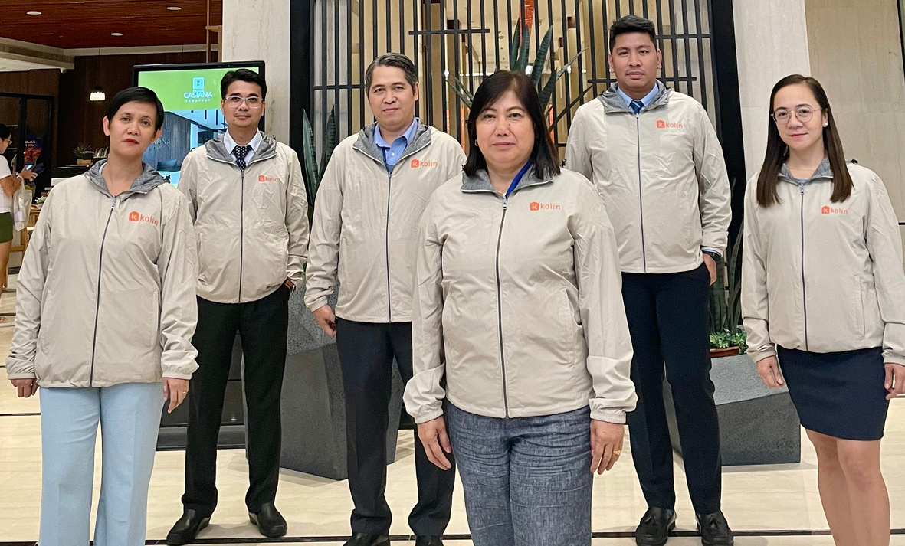
THANK YOU
FOR YOUR ATTENTION
We appreciate the opportunity to serve you and assist you in achieving your set goals and objectives.

