Slide 1
Control system Oasis
Nov.2012
Notes:
1

Slide 2

Contents
1. DC inverter technology introduction
2. Refrigerant flow control
3. Function control

Slide 3
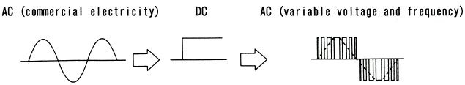
1. DC inverter technology
1. DC inverter electric control principle
An inverter simply converts Direct Current (DC) to Alternating Current (AC). In air-conditioning systems, inverters are largely referred to as devices which convert commercial AC electricity to AC with adjustable frequency and voltage. Converter which convert AC to DC form part of such devices. The rotational speed of compressor can be adjusted freely by inverter.
Commercial AC Electricity
Stabilized DC Voltage
Adjustable frequency
Adjustable voltage
COMP.
AC DC
CONVERSION
DC AC
CONVERSION
CONVERTER
INVERTER
Generally Called Inverter

Slide 4
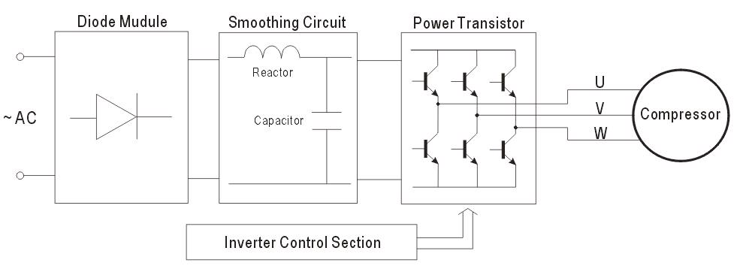
1. DC inverter technology
1. DC inverter electric control principle
Name | Function
Diode Module | Rectifies AC and converts it to DC
Smoothing Circuit Capacitor | Makes DC smoother by charging and discharging
Reactor | Decreases ripples
Power Transistor | Makes AC of approximate sine waves by dividing DC
Control Section | Emits signals to switch on the power transistor when operation and frequency setting commands are received.

Slide 5
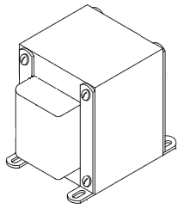
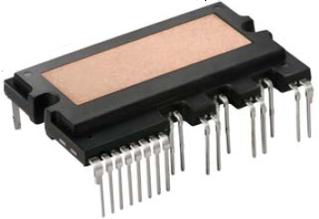
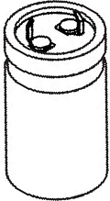
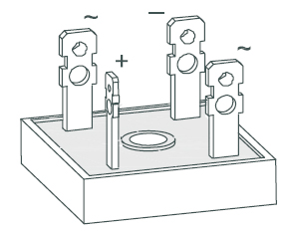
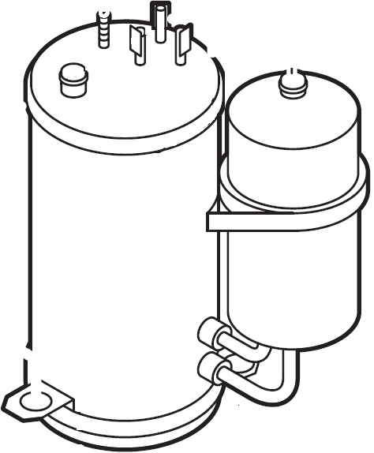
1. DC inverter technology
1. DC inverter electric control principle
Reactor
IPM
Electrical Supply
(AC 208-230V)
Inverter Compressor
Capacitors
Rectifier

Slide 6
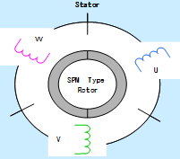
1. DC inverter technology
2. Control system chart
Indoor Control PCB
Power
Temperature check
Communication with outdoor Unit
Control of indoor fan
Control of buzzer
Fresh air motor
Water pump
CCM(display error code)
Alarm
Main Control PCB
* Current check * Control of outdoor fan * Four-way valve * Electrical heater * Power for IPM switch power * Power for control PCB * EMC filter* Temperature check * Refrigerant pressure check * Control of cooling or heating mode *
Communication
Rectifying Bridge
IPM
Control of compressor
Switch power
Compressor driving
Display PCB
Infrared receiver
Information display
Electrolytic Capacitor
PFC Board
220-230V, 1Ph
50Hz
220-230V (1Ph), 50Hz

Slide 7
1. DC inverter technology
2. Control system chart
230V (1Ph) 50Hz
230V (1Ph) 50Hz
230V (1Ph) 50Hz
380V (DC)
Power Terminal of Outdoor Unit
Power Filter
Module
Rectifier, PFC, Filter Capacitor
IPM Reverses into AC
3 Phase AC (0 ~200V)
230V (1 Phase)
50Hz
Power of Outdoor Control PCB
230V (1Ph) 50Hz
6 PWM Driving signals
Power Terminal of Indoor Unit
IPM Module

Slide 8
1. DC inverter technology
3. Inverter VS Fixed speed
Comparison | Inverter | Fixed Speed
1. Energy saving | Capacity output adjustable，Saving 30% energy. | On/off control，waste energy
2. Time to reach set temp | Cooling and heating rapidly，decrease starting time 1/3 | Time is longer
3. Comfortable | Temperature tolerance around 1℃ ，comfortable | Temperature tolerance around 3~4℃
4. Starting current | 1.5 times of Rating current | 5~6 times of rating current
5. Temp Operating range | -15℃~50℃ | -7℃~43℃
6. Maintenance | Complicated | Simply
7. cost | high | low

Slide 9
2. Refrigerant flow control
Stage of refrigeration cycle at cooling mode
1. Compress process (compressor)
Before entering the compressor, the temperature of refrigerant is low (10~18℃) and pressure is low (7~10bar). After the gas is compressed, the temperature is high (70~90℃) and the pressure is high (25~30bar).
2. Condensate process (Condenser)
After discharged from the compressor, through the four-way valve (only for heat pump type), the refrigerant flows into the condenser and is changed from gas state to gas-liquid state step by step, then to liquid state. At the outlet of the condenser, the temperature of liquid refrigerant is a little higher (about 5℃) than the ambient temperature and the pressure is high, almost the same as the pressure of compressor outlet.
3. Throttle process (Capillary or electronic expansion valve)
The refrigerant flows from the condenser outlet to the one-way valve (only for heat pump type), then is throttled through the capillary. At the outlet of the capillary, the refrigerant is changed gas-liquid state and starts evaporating. The temperature is about 5~10℃ and the pressure is 7.5~10.5bar.You can feel cold when touching the capillary.

Slide 10
2. Refrigerant flow control
Stage of refrigeration cycle at cooling mode
4. Evaporate process (Evaporator)
After entering the evaporator, the gas-liquid refrigerant is evaporated to gas state and absorbs the heat from the surrounding air at the same time. In this process, the temperature and pressure almost hold the line. At the outlet of the evaporator, the pressure is 7.5~10bar. The outlet temp is about 8~15 ℃.
5. Overheat process
From the outlet of the evaporator, the gas refrigerant flows through the connection pipe, the low pressure valve, the four-way valve (only for heat pump type), the accumulator, then return to the compressor. In this process, the pressure almost hold the line and the temperature becomes a little higher because the connection pipe releases some heat and sucks from the refrigerant. At the position of the low pressure valve, the temperature is 10~18℃ and the pressure is 7 ~10bar.

Slide 11
3. Function control
1.Code Definition
1. T1 Room Temperature
2. T2 Temperature of middle part of evaporator
3. T2B Temperature of outlet of evaporator 4. Ts Setting Temperature
5. T3 Temperature of outlet of condenser
6. T4 Ambient temperature
7. T5 or TP Compressor discharge temperature
8. TH Heat sink temperature

Slide 12
3. Function control
2.Temperature Operation Range
Mode | Indoor temperature | Outdoor temperature
Cooling | ≥17℃ | 0℃～50℃ -15℃～50℃(With Low ambient kit)
Dehumidify | >10℃ | 0℃～50℃

Slide 13
3. Function control
3. Main Protection
1. Three Minutes Delay at restart for compressor
1 minute delay for the 1st time start-up and 3 minutes delay for others.
2. Temperature protection of compressor top
The unit will stop working when the compressor top temp. protector cut off, and will restart after the compressor top temp. protector restart.
3. Temperature protection of compressor discharge
When the compressor discharge temp. is getting higher, the running frequency will be limited as below rules:
If Compressor discharge temp. T5>115℃ for 5s, compressor stops.
If 108<T5<115℃, decrease the frequency to the lower level every 3 minutes.
If 90<T5<105℃, keep running at the current frequency.
If T5<90℃, no limit for frequency.

Slide 14
3. Function control
3. Main Protection
4. Fan Speed has been out of control
When indoor fan speed keeps too low (300RPM) for certain time, the unit will stop and the LED will display the failure
5. Inverter module Protection
The Inverter module has a protection function about current, voltage and temperature. If these protections happen, the corresponding code will display on indoor unit and the unit will stop working.
6. Indoor fan delayed open function
When the unit starts up, the louver will be active immediately and the indoor fan will open 10s later.
If the unit runs in heating mode, the indoor fan will be also controlled by anti-cold wind function.

Slide 15
3. Function control
3. Main Protection
7. Compressor preheating functions
Preheating permitting condition:
Outdoor newly power one and T4 ＜3℃ or if T4＜3℃ and compressor has stopped for over 3 hours, the compressor heating cable will work.
Preheating mode:
A weak current flow through the coil of compressor from the wiring terminal of the compressor, then the compressor is heated without operation.
Preheating release condition:
If T4＞5℃ or the compressor starts running, the preheating function will stop.
8. Zero crossing detection error protection
If AC detects time interval is not correct for continuous 240s, the unit will stop and the LED will display the failure. The correct zero crossing signal time interval should be between 6-13ms.

Slide 16
3. Function control
3. Main Protection
9. Condenser temperature protection
If 55℃<T3<60℃, the compressor frequency will decrease to the lower level until to F1 and then runs at F1.
If T3<54℃, the compressor will keep running at the current frequency.
If T3<52℃, the compressor will not limit the frequency and resume to the former frequency.
If T3>60℃ for 5 seconds, the compressor will stop until T3<52℃.
10. Evaporator temperature protection
If T2<0℃, the compressor will stop and restart when T2>=5℃.
If 0℃≦T2<4℃, the compressor frequency will be limited and decreased to the lower level
If 4℃≤T2≤7℃, the compressor will keep the current frequency.
If T2>7℃, the compressor frequency will not be limited.

Slide 17
3. Function control
3. Main Protection
11. Current Protection
Protection active: If total current >I_Max,，the compressor and outdoor fan will stop. Indoor fan keep running.
Protection resume: if total current<I-Max last 30s.
Before the over current error, there is frequency limitation to control the current.
12. IGBT heat sink temperature protection
Protection active: If TH>60 ℃ and T4>46 ℃, reduce the frequency to the lowest.
Protection resume: if TH<55 ℃ , or T4<44 ℃.

Slide 18
3. Function control
4. Operation Modes and Functions of cooling only
1. Fan mode
(1) Outdoor fan and compressor stop.
(2) Temperature setting function is disabled, and no setting temperature is displayed.
(3) Indoor fan can be set to high/med/low/auto.
(4) The louver operates same as in cooling mode.
(5) Auto fan:

Slide 19
3. Function control
4. Operation Modes and Functions of cooling only
2. Cooling mode
2. 1 Compressor running rules
The maximum operation frequency of compressor after starting submits to following rule.
If users switch on AC by remote controller, the compressor will run at the Fmax frequency for 7 minutes according to the outdoor ambient temp. During the 7 minutes, the frequency limitation is active. 7 minutes later, the compressor running frequency will be controlled by the T1-Ts, refer to next page.

Slide 20
3. Function control
4. Operation Modes and Functions of cooling only
2. Cooling mode
2. 1 Compressor running rules
While the zones of A,B,C... are corresponding to different compressor running frequency.
Note:
When T1-Ts keeps in the same temp. zone for 3 minutes, the compressor will run as the below rules:
A~E: Increase the frequency to the higher level until to Fmax.
F: Keep the current frequency.
G: Decrease the frequency to the lower level until to F1.
H: Run at F1 for 1h then stop compressor 0r if T1-Ts<-2℃, the compressor will stop

Slide 21
3. Function control
4. Operation Modes and Functions of cooling only
2. Cooling mode
2. 1 Compressor running rules
Meanwhile, the compressor running frequency is limited by the current.
Off: Compressor stops.
Decrease: Decrease the running frequency to the lower level.
Hold: Keep the current frequency.
Resume: No limitation for frequency.
Note:
When AC is in “hold” zone for 3 minutes, the compressor frequency will rise to the higher level.(frequency will increase twice at most

Slide 22
3. Function control
4. Operation Modes and Functions of cooling only
2. Cooling mode
2. 2 Outdoor fan running rules

Slide 23
3. Function control
4. Operation Modes and Functions of cooling only
2. Cooling mode
2. 3 Indoor fan running rules
In cooling mode, indoor fan runs all the time and the speed can be selected as high, medium, low and auto.
Auto fan in cooling mode acts as follow:

Slide 24
3. Function control
4. Operation Modes and Functions of cooling only
3. Auto mode
This mode can be chosen with remote controller and the setting temperature can be changed between 17~30℃.
In auto mode, the machine will choose cooling or fan-only mode according to T1-Ts.
T1-Ts | Running mode
＞1℃ | Cooling
T1-Ts≤1℃ | Fan-only
Under auto mode, indoor fan will run at auto fan of the relevant mode.
The louver operates same as in relevant mode.

Slide 25
3. Function control
4. Operation Modes and Functions of cooling only
4. Drying mode
Indoor fan speed is fixed at breeze and can’t be changed. The louver angle is the same as in cooling mode.
Compressor running rules

Slide 26
3. Function control
4. Operation Modes and Functions of cooling only
4. Drying mode
Low indoor room temperature protection
In drying mode, if room temperature is lower than 10℃, the compressor will stop and not resume until room temperature exceeds 12℃.
Evaporator anti-freezing protection, condenser high temperature protection and outdoor unit frequency limit are active and the same as that in cooling mode.
The outdoor fan operates the same as in cooling mode.

Slide 27
3. Function control
4. Operation Modes and Functions of cooling only
5. Forced operation function
Forced operation function
When the machine is off, pressing the touch button will carry the machine to forced auto mode. If pressing the button once again within 5 seconds, the machine will turn into forced cooling mode.
In forced auto, forced cooling or any other operation mode, pressing touch button will turn off the machine.
In forced operation mode, all general protections and remote control are valid.

Slide 28
3. Function control
4. Operation Modes and Functions of cooling only
5. Forced operation function
Operation rules:
Forced cooling mode:
The compressor runs at F2 frequency and indoor fan runs as breeze. After running for 30 minutes. the machine will turn to auto mode as 24℃ setting temperature.
Forced auto mode:
The action of forced auto mode is the same as normal auto mode with 24℃ setting temperature.

Slide 29
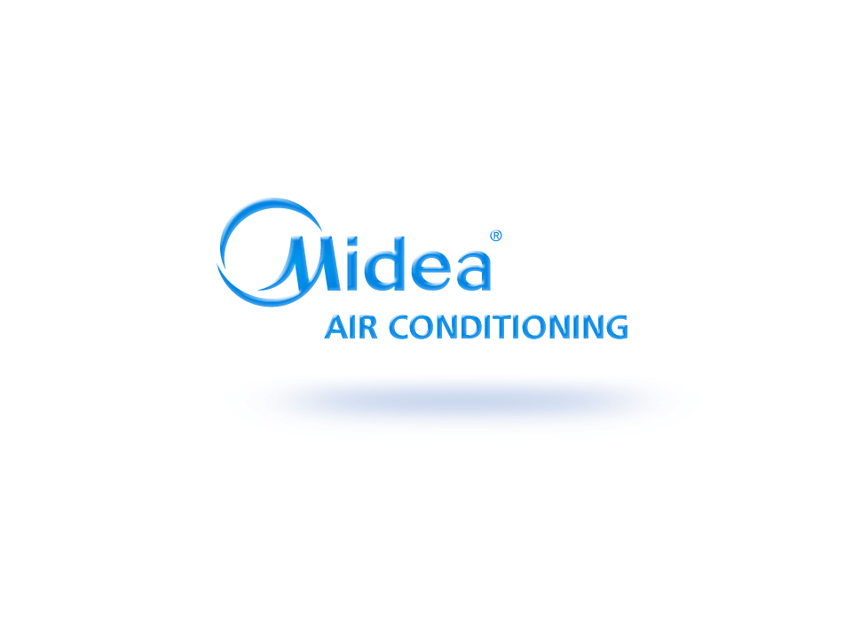
Notes:
29

