Slide 1
Control system LCAC
Nov.2012
Notes:
1

Slide 2

Contents
1. DC inverter technology introduction
2. Refrigerant flow control
3. Function control

Slide 3
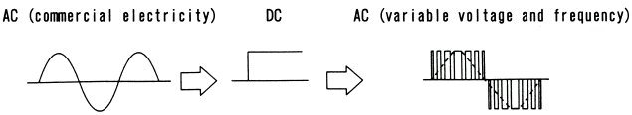
1. DC inverter technology
1. DC inverter electric control principle
An inverter simply converts Direct Current (DC) to Alternating Current (AC). In air-conditioning systems, inverters are largely referred to as devices which convert commercial AC electricity to AC with adjustable frequency and voltage. Converter which convert AC to DC form part of such devices. The rotational speed of compressor can be adjusted freely by inverter.
Commercial AC Electricity
Stabilized DC Voltage
Adjustable frequency
Adjustable voltage
COMP.
AC DC
CONVERSION
DC AC
CONVERSION
CONVERTER
INVERTER
Generally Called Inverter

Slide 4
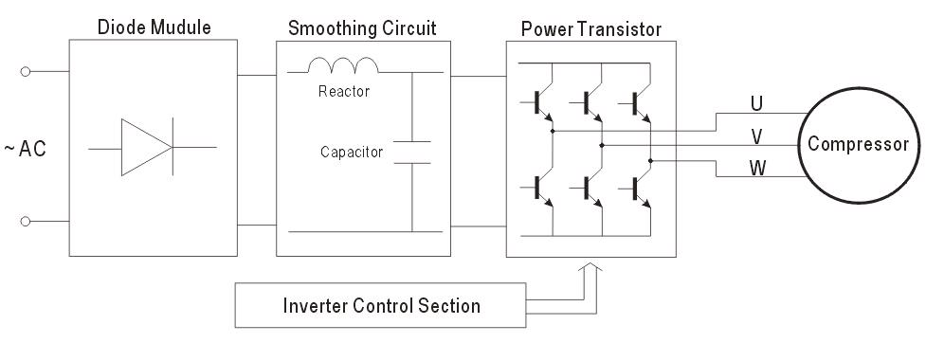
1. DC inverter technology
1. DC inverter electric control principle
Name | Function
Diode Module | Rectifies AC and converts it to DC
Smoothing Circuit Capacitor | Makes DC smoother by charging and discharging
Reactor | Decreases ripples
Power Transistor | Makes AC of approximate sine waves by dividing DC
Control Section | Emits signals to switch on the power transistor when operation and frequency setting commands are received.

Slide 5
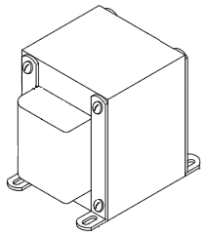
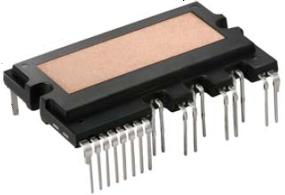
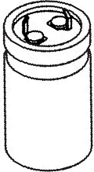
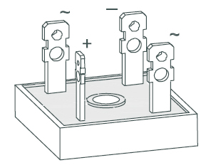
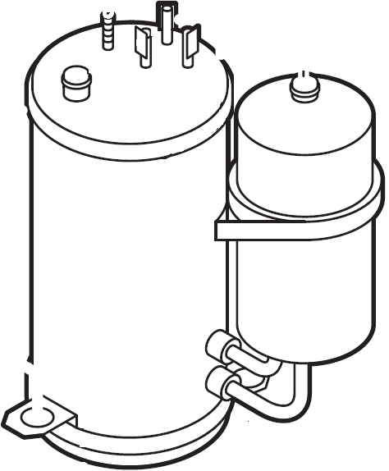
1. DC inverter technology
1. DC inverter electric control principle
Reactor
IPM
Electrical Supply
(AC 208-230V)
Inverter Compressor
Capacitors
Rectifier

Slide 6
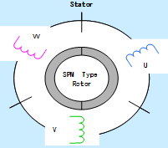
1. DC inverter technology
2. Control system chart
Indoor Control PCB
Power
Temperature check
Communication with outdoor Unit
Control of indoor fan
Control of buzzer
Fresh air motor
Water pump
CCM(display error code)
Alarm
Main Control PCB
* Current check * Control of outdoor fan * Four-way valve * Electrical heater * Power for IPM switch power * Power for control PCB * EMC filter* Temperature check * Refrigerant pressure check * Control of cooling or heating mode *
Communication
Rectifying Bridge
IPM
Control of compressor
Switch power
Compressor driving
Display PCB
Infrared receiver
Information display
Electrolytic Capacitor
PFC Board
220-240V, 1Ph
60Hz
220-240V (1Ph), 60Hz

Slide 7
1. DC inverter technology
2. Control system chart
230V (1Ph) 60Hz
230V (1Ph) 60Hz
230V (1Ph) 60Hz
380V (DC)
Power Terminal of Outdoor Unit
Power Filter
Module
Rectifier, PFC, Filter Capacitor
IPM Reverses into AC
3 Phase AC (0 ~200V)
230V (1 Phase)
60Hz
Power of Outdoor Control PCB
230V (1Ph) 60Hz
6 PWM Driving signals
Power Terminal of Indoor Unit
IPM Module

Slide 8
1. DC inverter technology
3. Inverter VS Fixed speed
Comparison | Inverter | Fixed Speed
1. Energy saving | Capacity output adjustable，Saving 30% energy. | On/off control，waste energy
2. Time to reach set temp | Cooling and heating rapidly，decrease starting time 1/3 | Time is longer
3. Comfortable | Temperature tolerance around 1℃ ，comfortable | Temperature tolerance around 3~4℃
4. Starting current | 1.5 times of Rating current | 5~6 times of rating current
5. Temp Operating range | -15℃~50℃ | -7℃~43℃
6. Maintenance | Complicated | Simply
7. cost | high | low

Slide 9
2. Refrigerant flow control
Stage of refrigeration cycle at cooling mode
1. Compress process (compressor)
Before entering the compressor, the temperature of refrigerant is low (10~18℃) and pressure is low (7~10bar). After the gas is compressed, the temperature is high (70~90℃) and the pressure is high (25~30bar).
2. Condensate process (Condenser)
After discharged from the compressor, through the four-way valve (only for heat pump type), the refrigerant flows into the condenser and is changed from gas state to gas-liquid state step by step, then to liquid state. At the outlet of the condenser, the temperature of liquid refrigerant is a little higher (about 5℃) than the ambient temperature and the pressure is high, almost the same as the pressure of compressor outlet.
3. Throttle process (Capillary or electronic expansion valve)
The refrigerant flows from the condenser outlet to the one-way valve (only for heat pump type), then is throttled through the capillary. At the outlet of the capillary, the refrigerant is changed gas-liquid state and starts evaporating. The temperature is about 5~10℃ and the pressure is 7.5~10.5bar.You can feel cold when touching the capillary.

Slide 10
2. Refrigerant flow control
Stage of refrigeration cycle at cooling mode
4. Evaporate process (Evaporator)
After entering the evaporator, the gas-liquid refrigerant is evaporated to gas state and absorbs the heat from the surrounding air at the same time. In this process, the temperature and pressure almost hold the line. At the outlet of the evaporator, the pressure is 7.5~10bar. The outlet temp is about 8~15 ℃.
5. Overheat process
From the outlet of the evaporator, the gas refrigerant flows through the connection pipe, the low pressure valve, the four-way valve (only for heat pump type), the accumulator, then return to the compressor. In this process, the pressure almost hold the line and the temperature becomes a little higher because the connection pipe releases some heat and sucks from the refrigerant. At the position of the low pressure valve, the temperature is 10~18℃ and the pressure is 7 ~10bar.

Slide 11
3. Function control
1.Code Definition
1. T1 Room Temperature
2. T2 Temperature of middle part of evaporator
3. T2B Temperature of outlet of evaporator
4. Ts Setting Temperature
5. T3 Temperature of outlet of condenser
6. T4 Ambient temperature
7. T5 or TP Compressor discharge temperature
8. TH Heat sink temperature

Slide 12
3. Function control
2.Temperature Operation Range
Mode | Indoor temperature | Outdoor temperature
Cooling | ≥17℃ | 0℃～50℃ -15℃～50℃(With Low ambient kit)
Dehumidify | >17℃ | 0℃～50℃

Slide 13
3. Function control
3. Main Protection
1. Three Minutes Delay at restart for compressor
1 minute delay for the 1st time start-up and 3 minutes delay for others.
2. Temperature protection of compressor top
The unit will stop working when the compressor top temp. protector cut off, and will restart after the compressor top temp. protector restart.
3. Temperature protection of compressor discharge
When the compressor discharge temp. is getting higher, the running frequency will be limited as below rules:
If Compressor discharge temp. T5>115℃ for 5s, compressor stops.
If 108<T5<115℃, decrease the frequency to the lower level every 3 minutes.
If 90<T5<105℃, keep running at the current frequency.
If T5<90℃, no limit for frequency.

Slide 14
3. Function control
3. Main Protection
4. Fan Speed has been out of control
When indoor fan speed keeps too low (300RPM) for certain time, the unit will stop and the LED will display the failure
5. Inverter module Protection
The Inverter module has a protection function about current, voltage and temperature. If these protections happen, the corresponding code will display on indoor unit and the unit will stop working.
6. Indoor fan delayed open function
When the unit starts up, the louver will be active immediately and the indoor fan will open 10s later.
If the unit runs in heating mode, the indoor fan will be also controlled by anti-cold wind function.

Slide 15
3. Function control
3. Main Protection
7. Compressor preheating functions
Preheating permitting condition:
Outdoor newly power one and T4 ＜3℃ or if T4＜3℃ and compressor has stopped for over 3 hours, the compressor heating cable will work.
Preheating mode:
A weak current flow through the coil of compressor from the wiring terminal of the compressor, then the compressor is heated without operation.
Preheating release condition:
If T4＞5℃ or the compressor starts running, the preheating function will stop.
8. Zero crossing detection error protection
If AC detects time interval is not correct for continuous 240s, the unit will stop and the LED will display the failure. The correct zero crossing signal time interval should be between 6-13ms.

Slide 16
3. Function control
3. Main Protection
9. Low temperature protection in cooling mode
Protection active: T2<2℃ last 3 minutes, the compressor and outdoor fan will stop. Indoor fan keep running.
Protection resume: T2>7℃, the compressor and outdoor fan will restart.
10. T3 High temperature protection in cooling mode
Protection active: T3>65℃ last 3 second， the compressor will stop but the outdoor fan and indoor fan keep running.
Protection resume: T3<52℃, the compressor will restart.

Slide 17
3. Function control
3. Main Protection
11. High pressure protection
Protection active: Hp>44Bar, the compressor and outdoor fan will stop. Indoor fan keep running.
Protection resume: Hp<32Bar, the compressor and outdoor fan will restart
12. Low pressure protection
Protection active: Lp<1.4Bar, the compressor and outdoor fan will stop. Indoor fan keep running.
Protection resume: Lp>3Bar, the compressor and outdoor fan will restart
If -8℃≤T4≤0℃，it will not inspect the low pressure within 5min counted from compressor start.
If T4≤-8℃，not inspect low pressure.
Defrosting and 8min after the defrosting mode ended, it will not inspect the low pressure protection..

Slide 18
3. Function control
3. Main Protection
13. Current Protection
Protection active: If total current >I_Max,，the compressor and outdoor fan will stop. Indoor fan keep running.
Protection resume: if total current<I_Max last 30s.
Before the over current error, there is frequency limitation to control the current.
14. IGBT heat sink temperature protection
Protection active: If TH>60 ℃ and T4>46 ℃, reduce the frequency to the lowest.
Protection resume: if TH<55 ℃ , or T4<44 ℃.
15. PFC protection
Protection active: Low level occurs on the pin, the protection is active. Compressor stop first and PFC cut off 5s later. After 3 minute restart the compressor

Slide 19
3. Function control
4. Operation Modes and Functions of cooling only
1. Fan mode
(1) Outdoor fan and compressor stop.
(2) Temperature setting function is disabled, and no setting temperature is displayed.
(3) Indoor fan can be set to high/med/low/auto.
(4) The louver operates same as in cooling mode.
(5) Auto fan:
℃
T1 – 24
5
high
4
medium
3
2
low

Slide 20
3. Function control
4. Operation Modes and Functions of cooling only
2. Cooling mode
2.1 Compressor running rules
According the capacity requirement to adjust the compressor frequency
Capacity request means how many capacity the indoor side need to cool or heat the room.
When the unit starts, the main program chip will scan indoor capacity request every 2 minutes and controls the compressor to run at a certain frequency so that controls the cooling output based on the capacity request.
The capacity request value is calculated in accordance with setting temperature (Ts), room temperature (T1), outlet temperature of evaporator (T2B, cooling mode) and ambient temperature (T4).

Slide 21
3. Function control
4. Operation Modes and Functions of cooling only
2. Cooling mode
2.1 Compressor running rules ---Capacity Request Calculation
T1-Ts
Capacity area | a | b | c | d
Norm value (N) | 3 | 3 | 2 | 0
a
b
c
d
4
2
0
3
1
-1
Formula：capacity request=N×HP
24K: HP=2.5;
30K: HP=3.2；
36K: HP=4.0；
48K: HP=5.0;
60K: HP=6.0
E.g . 60K unit， T1=28， Ts=24, temp is dropping; so N=3, then CR=6*3=18
CR: Capacity request

Slide 22
3. Function control
4. Operation Modes and Functions of cooling only
2. Cooling mode
2.1 Compressor running rules---Capacity Request Correction
Correction by T4
Correction by T2B
26℃
100%
17℃
+2
25℃
14℃
16℃
80%
+1
13℃
18℃
6℃
+0
40%
17℃
5℃
4℃
-1
3℃
E.g . If T4=25 and raising, T2B=15 and dropping; CR=18*0.8+1=14.4+1=15.4, take 16.
Note: The final result is integer.
Capacity request value and frequency list
Frequency(Hz) | 0 | 32 | 38 | 38 | 44 | 48 | 48 | 52 | 52 | 56 | 56 | 62 | 62 | 66 | 66 | 70 | 70
CR | 0 | 1 | 2 | 3 | 4 | 5 | 6 | 7 | 8 | 9 | 10 | 11 | 12 | 13 | 14 | 15 | ≥16
60K
So the compressor will work at 70Hz

Slide 23
3. Function control
4. Operation Modes and Functions of cooling only
2. Cooling mode
2.2. Outdoor fan running rules
outdoor temperature
℃
outdoor fan speed
27
high
25
low

Slide 24
3. Function control
4. Operation Modes and Functions of cooling only
2. Cooling mode
2.3. Indoor fan running rules
Indoor fan runs all the time and the speed can be selected as high, medium, low and auto.
Auto fan in cooling mode acts as follow:
℃
T1 – Ts
5
high
4
medium
3
2
low

Slide 25
3. Function control
4. Operation Modes and Functions of cooling only
3. Auto-mode
This mode can be chosen with remote controller and the setting temperature can be changed between 17~30℃.
In auto mode, the machine will choose cooling or fan-only mode according to T1-Ts.
T1-Ts | Running mode
＞2℃ | Cooling
T1-Ts≤2℃ | Fan-only
Under auto mode, indoor fan will run at auto fan of the relevant mode.
The louver operates same as in relevant mode.

Slide 26
3. Function control
4. Operation Modes and Functions of cooling only
4. Drying mode
Indoor fan speed is fixed at breeze and can’t be changed. The louver angle is the same as in cooling mode.
Compressor running rules is the same as cooling mode.
If room temperature is lower than 10℃, compressor will stop and not resume until room temperature climbs up to 12℃.
The protection is the same as cooling mode.
The outdoor fan operates the same as in cooling mode.

Slide 27
3. Function control
4. Operation Modes and Functions of cooling only
5. Forced operation function
The forced cooling mode is controlled by holding check button on the outdoor PCB for at least 10s
Hold check button for 10s
Forced cooling mode
Quit
Hold check button for 10s
Under this mode, no remote control signal will be received.
Indoor fan is set to be high.
Under this mode, the corresponding protections are effective.
Operation and timer lamp flash at 1hz and display “FC”

Slide 28
3. Function control
4. Operation Modes and Functions of cooling only
6. Other functions
6.1. Oil return control function
If the frequency continuously less than 35Hz last 90min, the system will start oil return control, the compressor is working at 57Hz with 100s.
Oil return function will stop when meet defrosting, frequency limitation.
6.2. Sleep mode
Running time in sleep mode is 7 hours. After 7 hours the machine quits this mode and turns off.
In cooling mode, the setting temperature rises 1℃(no more than 30℃) every one hour, 2 hour later the rising stops and indoor fan is fixed as low speed.
  In heating mode, the setting temperature descends 1℃(no less than 17℃) every one hour, 2 hour later the descending stops and indoor fan is fixed as low speed, and anti-cold-wind is available.

Slide 29

3. Function control
4. Operation Modes and Functions of cooling only
6. Other functions
6.3. Check button
Check button is a multi-function button on the outdoor main PCB.
Funcion1: Operating parameters inquire.
Check many parameters of the control system by pressing it in different ways with the display of “88” digital LED. No. means the times that the button is pressed.
No. | Contents | Digital LED Display Remark
00 | Normal | Display running frequency, mode or error code.
01 | Capacity request of indoor unit | Basic capacity request *10. If it is higher than 99, the point will be on. (For example, 5.0 means 150. Then the capacity request is 15. If 60 displayed, means the capacity request is 6.)
02 | Corrected capacity request | Corrected by T4 and T2B (or T2).
03 | Target running frequency. | In accordance with the capacity request.
04 | Target frequency when frequency limits occurs
05 | Target frequency to IR341
06 | T2 (true) | When lower than 0℃, it is displayed as 0. When higher than 70 ℃, it is displayed as 70. (When the capacity request is 0, it is 0.)
07 | T3 (true) | When lower than -9℃, it is displayed as -9. When higher than 70 ℃, it is displayed as 70.
08 | T4 (true)
09 | TP (true) | Display range is 30~120℃. If it is higher than 99, the point will be on. (For example, 0.5 means 105℃. If 1.6 displayed, means 116℃.)

Slide 30
3. Function control
4. Operation Modes and Functions of cooling only
6. Other functions
6.3. Check button
No. | Contents | Digital LED Display Remark
10 | Current AD | Hex display. B6 means algorism 182.
11 | Voltage AD | Hex display. CD means algorism 205.
12 | Indoor mode | (0—Standby; 1-Fan only; 2—Cooling; 3—Heating; 4—Forced cooling)
13 | Outdoor mode | (0—Standby; 1-Fan only; 2—Cooling; 3—Heating; 4—Forced cooling)
14 | EXV Steps (true) | ¼ of current EXV steps. If it is higher than 99, the point will be on. (For example, 2.0 means 120, then EXV steps = 120*4 = 480P. If 80 displayed, means EXV steps is 320P.)
15 | Signs of frequency limit. | Bit7 | Limit caused by high temp. of IGBT radiator. | Hex display. If it displays 2A, it can be transformed to binary 101010, which means Bit5, Bit3, Bit1 are 1. Then there are frequency limits caused by high ambient temp., condenser temp. and current.
 |  | Bit6 | PFC
 |  | Bit5 | High ambient temp.
 |  | Bit4 | Evaporator temp.
 |  | Bit3 | Condenser temp.
 |  | Bit2 | Discharge temp.
 |  | Bit1 | Current
 |  | Bit0 | Voltage
16 | DC motor speed | Speed of compressor
17 | IGBT Radiator Temperature (live) | Display range is 30~120℃. If lower than 30℃, it display 30. If it is higher than 99, the point will be on. (For example, 0.5 means 105℃. If 1.6 displayed, means 116℃.) This is not available in 24-36K models.

Slide 31
3. Function control
4. Operation Modes and Functions of cooling only
6. Other functions
6.3. Check button
Funcion2:
Forced cooling mode entrance
Pressing it with 10s, it will enter the forced cooling mode.
Funcion3:
Capacity test mode entrance
Pressing it with 2s, it will enter the capacity test after set the indoor operating mode. Cooling with setting 17 ℃ and high speed. Heating with setting 30 ℃ and high speed.

Slide 32
3. Function control
4. Operation Modes and Functions of cooling only
6. Other functions
6.4. Auto restart
Remember the On-off, operating mode, fan speed, Temperature, lock mode.
Not record the economic and timer function.
6.5. Fresh air function
Fresh air fan motor starts/stop when indoor fan motor starts/stop except forced cooling and energy test mode.
6.6. Remote on-off
Display “CP”， or operation and time lamp flash at 1Hz alternatively.
Controller function will be not acted, but record the order signal.
Press it to open the air-con, it will start according to the memory.
6.7. Lock function of remoter controller or CCM

Slide 33
3. Function control
4. Operation Modes and Functions of cooling only
6. Other functions
6.8. Follow me function
Controlled by T2 and sensor on remoter controller, shield the T1 sensor temperature collection.
If operation mode changed, follow me need to be reset.
If not receive the signal continuously 7min from remote controller, change to T1 sensor control.
6.9. Capacity address
ENC1 | 0 | 1 | 2 | 3 | 4 | 5 | 6
Capacity(KW) | Reserve | Reserve | Reserve | Reserve | 5.3 | 7.1 | Reserve
ENC1 | 7 | 8 | 9 | A、B、C、D、E、F
Capacity(KW) | 9 | 10.5 | 14 | 16

Slide 34

Notes:
34

