Slide 1
Installation introduction
Nov.2012
Notes:
1

Slide 2
Contents
1. Installation procedure
2. Location selection
3. Indoor unit installation
4. Outdoor Unit Installation
5. Connection pipe installation
6. Drainage pipe installation
7. Insulation work
8. Vacuum drying and leakage checking
9. Wiring
10. Test running
11.Failure Cases for Installation

Slide 3
1. Installation procedure
Indoor unit installation location selection
Outdoor unit installation location selection
Indoor unit installation
Outdoor unit installation
Additional refrigerant charge
Refrigerant pipe installation and insulation
Refrigerant pipe installation and insulation
Insulation the joint part of refrigerant pipe
Wiring connection and electric safety checking
Drainage pipe installation and insulation
Drainage pipe installation and insulation
Test operation
Vacuum drying and leakage checking

Slide 4
2. Location selection
1. Indoor unit location selection
Easily support the indoor unit’s weight.
Ensure the indoor unit installation and inspection.
Ensure the indoor unit horizontally installed.
Easy water drainage.
Easily connect with the outdoor unit.
Good air circulation in the room.
No heat source or steam near the unit.
No oil gas near the unit
No corrosive gas near the unit
No salty air near the unit
No strong electromagnetic wave near the unit
No inflammable materials or gas near the unit
No strong voltage vibration.

Slide 5
2.Location selection
2. Outdoor unit location selection
Easily support the outdoor unit’s weight.
As close to indoor unit as possible
The piping length and height drop can not exceed the allowable value.
The noise, vibration and outlet air do not disturb the neighbors.
Enough room for installation and maintenance.
The air outlet and the air inlet are not impeded, and not face the strong wind.
Easy to install the connecting pipes and cables.
No danger of fire due to leakage of inflammable gas.
Dry and well ventilation place
The support should be flat and horizontal
Not a dirty or severely polluted place to avoid blockage of the condenser.
If is built over the unit to prevent direct sunlight, rain exposure, direct strong wend, snow and other scraps accumulation, make sure that heat radiation from the condenser is not restricted.

Slide 6
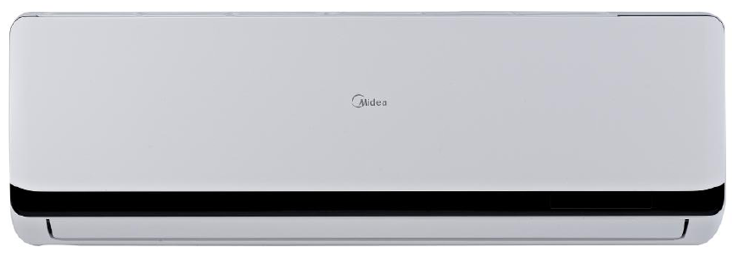
3. Indoor unit installation
1. Installation of Oasis
1.1 Indoor unit service space
More than 15cm
More than 12cm
More than 12cm
More than 2.0m

Slide 7
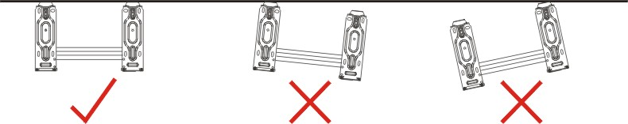
3. Indoor unit installation
1. Installation of Oasis
1.2 Fit the Installation Plate
Fit the installation plate horizontally on the wall with level gauge around the installation plate.
Correct orientation (should be lever to prevent water drop from indoor unit)
of Installation Plate

Slide 8
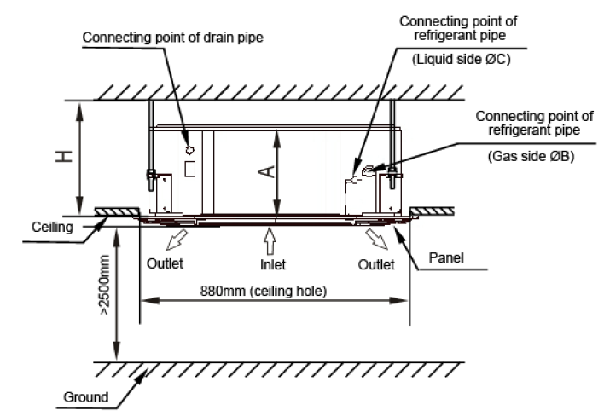
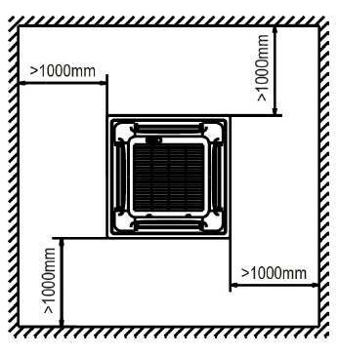
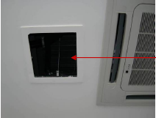
3. Indoor unit installation
2. Installation of Cassette
2.1 Indoor unit service space
Service hole should be more than 640*640 mm
H: 24K more than 260mm;
30K-60K more than 330mm

Slide 9
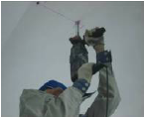
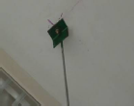
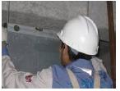
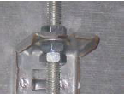
3. Indoor unit installation
2. Installation of Cassette
2.2 Body installation
Insert the expanding bolt into the hole and screw in the hanging pole.
Drill holes on the ceiling
Use nuts and washers on both sides of the hook to fix the body. There should be 2 nuts for lock the position under the hanging hook on the body.
Use a level gauge to check the body. The horizontal level must be within ±1
.

Slide 10
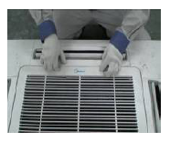
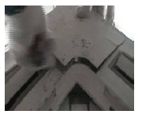
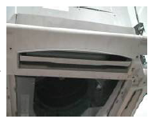
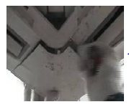
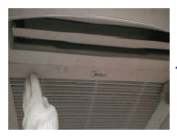
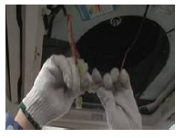
3. Indoor unit installation
2. Installation of Cassette
2.3 Panel Installation
Remove the grille.
Remove the 4 corner covers.
Install the panel.
Put the corner covers back.
Put the grille back.
Connect the swing motor and display panel.

Slide 11
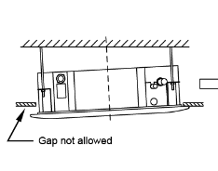
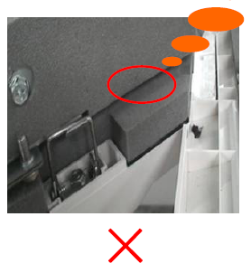
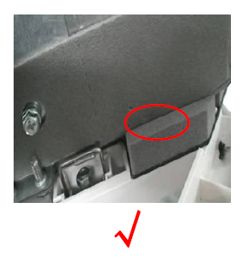
3. Indoor unit installation
2. Installation of Cassette
2.3 Panel Installation
The panel must be close to the bottom of the body, or there may be cool air out even condensate water leakage.

Slide 12
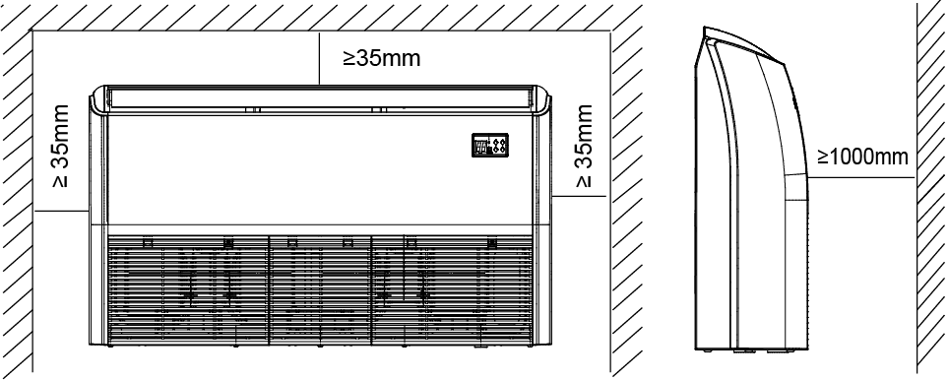
3. Indoor unit installation
3. Installation of Ceiling & floor
3.1 Indoor unit service space
Keep enough space for maintenance and ventilation.

Slide 13
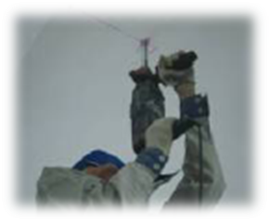
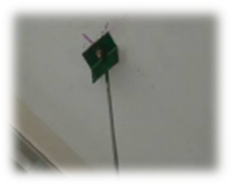
3. Indoor unit installation
3. Installation of Ceiling & floor
3.2 Body installation
① Ceiling installation
Select the position of installation hooks according to the hook holes positions showed in upper picture.
Drill four holes of Ø12mm, 45~50mm deep at the selected positions on the ceiling. Then embed the expansible hooks (fittings).

Slide 14
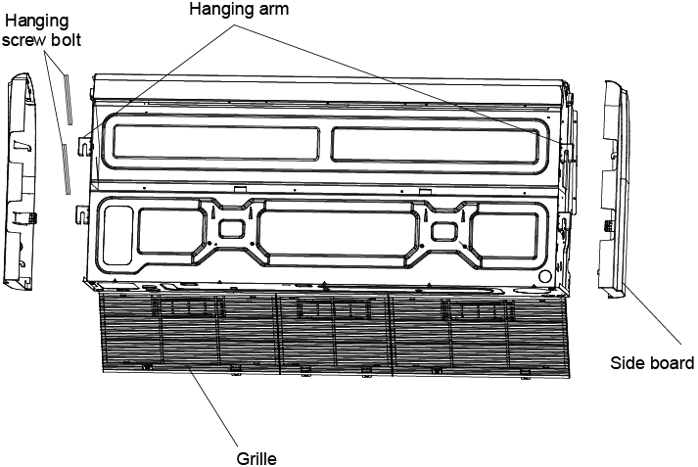
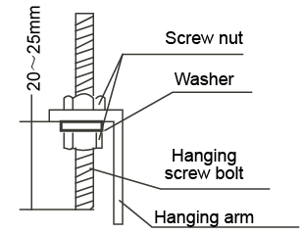
3. Indoor unit installation
3. Installation of Ceiling & floor
3.2 Body installation
① Ceiling installation
Locate the hanging arm on the hanging screw bolt. Prepare the mounting bolts on the unit.
Remove the side board and the grille.

Slide 15
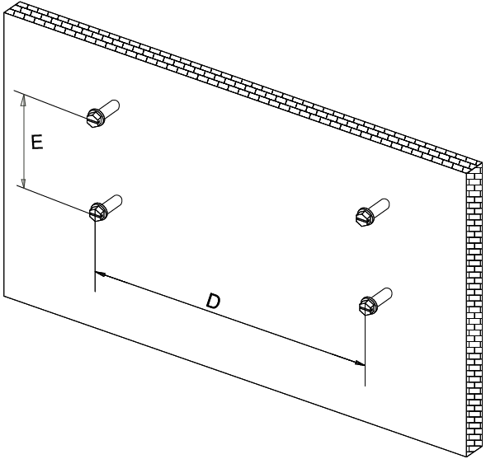
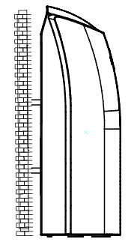
3. Indoor unit installation
3. Installation of Ceiling & floor
3.2 Body installation
② Wall-mounted installation
Hang the indoor unit by insert the tapping screws into the hanging arms on the main unit. (The bottom of body can touch with floor or suspended, but the body must install vertically.)
Install the tapping screws onto the wall.
Capacity (Btu/h) | D | E
36K | 1200 | 220
48K, 60K | 1565 | 220

Slide 16
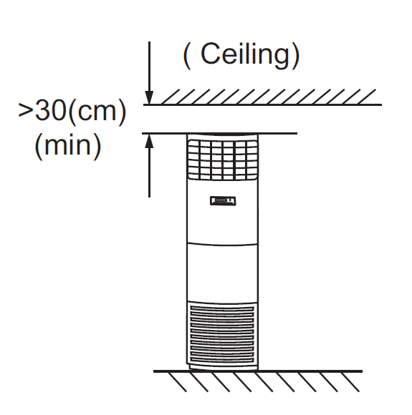
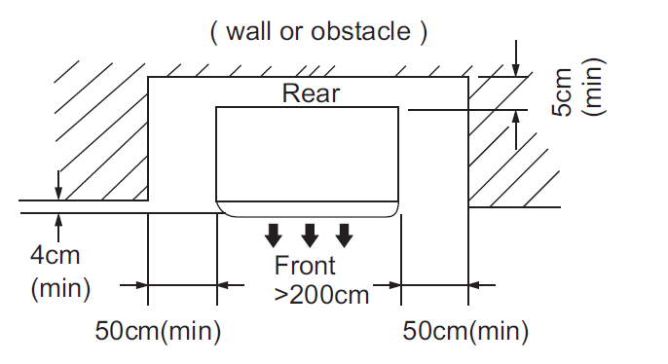
3. Indoor unit installation
4. Installation of GA
3.1 Indoor unit service space

Slide 17
4. Outdoor unit installation
1. Service space
Keep enough space for maintenance and air free to intake and output.

Slide 18
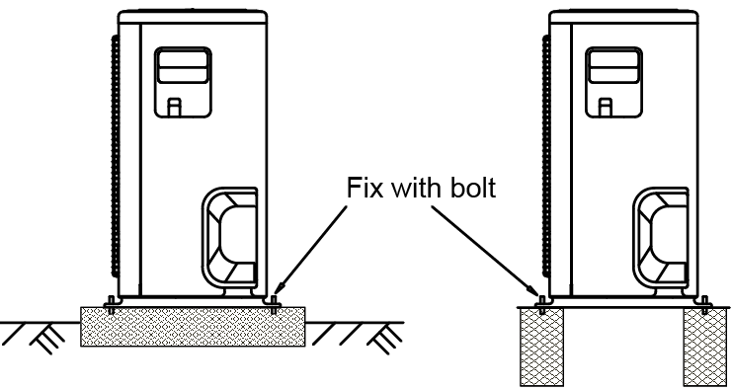
4. Outdoor unit installation
2. Install the body
Since the gravity center of the unit is not at its physical center, so please be careful when lifting it with a sling.
Never hold the inlet of the outdoor unit to prevent it from deforming.
Do not touch the fan with hands or other objects.
Do not lean it more than 45, and do not lay it sidelong.
Make concrete foundation according to the specifications of the outdoor units.
Fasten the feet of this unit with bolts firmly to prevent it from collapsing in case of earthquake or strong wind.

Slide 19
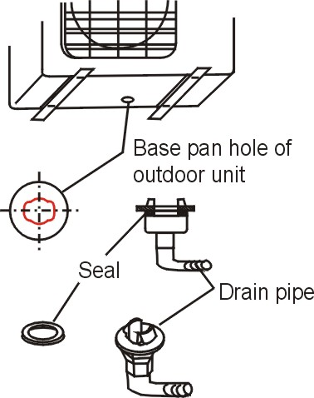
4. Outdoor unit installation
3. Service space
If a drain joint is used, the unit should be placed on a bracket which is taller than 3cm.
If the ambient temp is low than 0℃, we do not recommend to use the drain joint. Because if it not perfect installed, it may cause freeze and broken the fan. If must, ensure the drainage water flow is smooth.
Fit the seal into the drain hole, then insert the drain joint into the base pan hole of outdoor unit, rotate 90 degree to securely assemble them. Connecting the drain joint with an extension drain hose (Locally purchased), in case of the water draining off the outdoor unit during the heating mode.
Testing. Pour some water into the base pan to check if the water can be drained smoothly.

Slide 20
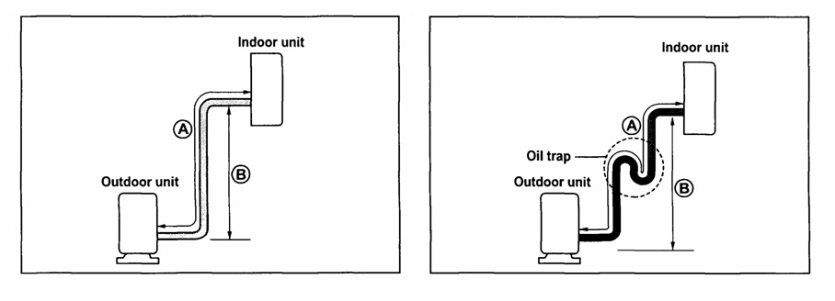
5. Connection pipe installation
1. Max refrigerant pipe length and drop
Capacity Btu/h | Max pipe length A (m) | Max. height difference B (m)
9K | 10 | 5
12K | 15 | 8
17K | 20 | 8
22K | 25 | 10
36K | 30 | 20
48K | 50 | 25
60K | 50 | 25

Slide 21
5. Connection pipe installation
1. Additional refrigerant charge
Capacity Btu/h | Pipe size |  | Standard Length (m) | Additional refrigerant (g/m) | Formula
 | Gas Side | Liquid Side
 |  |  |  | R410A
9K | Φ9.52 | Φ6.35 | 5 | 20 | V=(L-5)*20
12K | Φ12.7 | Φ6.35
17K | Φ12.7 | Φ6.35
22K | Φ16.0 | Φ9.52 |  | 30 | V=(L-5)*30
36K | Φ16.0 | Φ9.52
48K | Φ19.0 | Φ9.52
60K | Φ19.0 | Φ9.52
According to the liquid pipe size and pipe length to charge the additional refrigerant.
L means the liquid pipe length.

Slide 22
5. Connection pipe installation
2. Oil trap installation
Suggest every 5m(wall mounted), 8m(LCAC) in vertical pipe design an oil trap to ensure the oil return , gas pipe.

Slide 23
5. Connection pipe installation
3. Pipe installation procedure
Make the section flat and smooth
Choose the pipe size according to the specification table.
Confirm the cross way of the pipes.
Measure the necessary pipe length
Cut the selected pipe with pipe cutter
Insulate the copper pipe
Flare the pipe
Drill holes if the pipes need to pass the wall.
According to the field condition to bend the pipes so that it can pass the wall smoothly.
Set the wall conduit
Set the supporter for the pipe
Locate the pipe and fix it by supporter. Horizontal 1m, vertical 1.5m
Connect the pipe to indoor unit and outdoor unit by using two spanners.
Pipe diameter | Flare dimension A (mm)
 | Min | Max
1/4" (6.4) | 8.3 | 8.7
3/8" (9.52) | 12.0 | 12.4
1/2" (12.7) | 15.4 | 15.8
5/8" (16) | 18.6 | 19.1
3/4" (19) | 22.9 | 23.3

Slide 24
6.Drainage pipe installation
1. Installation principle
Ensure at least 1/100 slope of the drainage pipe
Adopt suitable pipe diameter
Adopt nearby condensate water discharge
Before installing condensate water pipeline, determine its route and elevation to avoid intersection with other pipelines and ensure slope is straight.
In general, the supporter gap of the drainage pipe horizontal pipe and vertical pipe is respectively 1m~1.5m and 1.5m~2.0m.

Slide 25
6.Drainage pipe installation
1. Installation principle
Drainage pipe selection
The drainage pipe diameter shall not small than the drain hose of indoor unit.
According to the water flowrate and drainage pipe slope to choose the suitable pipe, the water flowrate is decided by the capacity of indoor unit.
Capacity (x1000Btu) | Water flowrate (l/h)
12 | 2.4
18 | 4
24 | 6
30 | 7
36 | 8
42 | 10
48 | 12
60 | 14
According to the above table to calculate the total water flowrate for the confluence pipe selection.

Slide 26
6.Drainage pipe installation
1. Installation principle
Drainage pipe selection
For horizontal drainage pipe (The following table is for reference)
Attention: Adopt PVC40 or bigger pipe to be the main pipe.
PVC pipe | Reference value of inner diameter of pipe (mm) | Allowable maximum water flowrate (l/h) |  | Remark
 |  | Slope 1/50 | Slope 1/100
PVC25 | 20 | 39 | 27 | For branch pipe
PVC32 | 25 | 70 | 50
PVC40 | 31 | 125 | 88 | Could be used for confluence pipe
PVC50 | 40 | 247 | 175
PVC63 | 51 | 473 | 334
For Vertical drainage pipe (The following table is for reference)
Attention: Adopt PVC40 or bigger pipe to be the main pipe.
PVC pipe | Reference value of inner diameter of pipe (mm) | Allowable maximum water flowrate (l/h) | Remark
PVC25 | 20 | 220 | For branch pipe
PVC32 | 25 | 410
PVC40 | 31 | 730 | Could be used for confluence pipe
PVC50 | 40 | 1440
PVC63 | 51 | 2760

Slide 27
6.Drainage pipe installation
1. Installation principle
The horizontal pipe layout should avoid converse flow or bad flow

Slide 28
6.Drainage pipe installation
1. Installation principle
Water storage pipe setting
If the indoor unit has high extra static pressure and without water pump to elevate the condensate water, such as high extra static pressure duct unit , the water storage pipe should be set to avoid converse flow or blow water phenomena.

Slide 29
6.Drainage pipe installation
1. Installation principle
Lifting pipe setting of indoor unit with water pump
The length of lifting pipe should not exceed the pump head of indoor unit water pump.
Pump head of big four way cassette: 750mm
Pump head of compact four way cassette: 500mm
The drainage pipe should be set down inclined after the lifting pipe immediately to avoid wrong operation of water level switch.
Refer the following picture for installation reference.

Slide 30
6.Drainage pipe installation
1. Installation principle
Blowhole setting
For the concentrated drainage pipe system, there should design a blowhole at the highest point of main pipe to ensure the condensate water discharge smoothly.
The air outlet shall face down to prevent dirt entering pipe.
Each indoor system should be installed it.
The installation should be considering the convenience for future cleaning.

Slide 31
7. Insulation work
1. Insulation of refrigerant pipe
Purpose of refrigerant pipe insulation
1. Gas pipe temperature is very low during cooling. If insulation is not enough, it shall form dew and cause leakage.
2.Temperature of gas pipe is very high (generally 50-100℃) during heating. Insulation work must be carried out to prevent hurt by carelessness touching.
Operational procedure of refrigerant pipe insulation
Cut the suitable pipe → insulation (except joint section) → flare the pipe → piping layout and connection→ vacuum drying → insulate the joint parts
Insulation material selection for refrigerant pipe
1. The burning performance should over 120℃
2. According to the local law to choose insulation materials
3. The thickness of insulation layer shall be above 10mm.If in hot or wet environment place, the layer of insulation should be thicker accordingly.

Slide 32
7. Insulation work
1. Insulation of refrigerant pipe
Installation highlights of insulation construction
1. Gas pipe and liquid pipe shall be insulated separately, if the gas pipe and liquid pipe were insulated together; it will decrease the performance of air conditioner.
2. The insulation material at the joint part shall be 5~10cm longer than the gap between the two side insulation material.
3. The insulation material shall be inserted into the gap.
4. The insulation material at the joint part shall be banded to the gas pipe and liquid pipe tightly.
5. The linking part should be use glue to paste together
6. Be sure not bind the insulation material over-tight, it may extrude out the air in the material to cause bad insulation and cause easy aging of the material.

Slide 33
7. Insulation work
2. Insulation of drainage pipe
Purpose of drainage pipe insulation
The temperature of condensate drainage water is very low. If insulation is not enough, it shall form dew and cause leakage to damage the house decoration.
Operational procedure of refrigerant pipe insulation
Select the suitable pipe → insulation (except joint section) → piping layout and connection→ drainage test→ insulate the joint parts
Insulation material selection for drainage pipe
The insulation material should be nonflammable material, the flame retardant of the material should be selected according to the local law.
Thickness of insulation layer is usually above 10mm.
Use specific glue to paste the seam of insulation material, and then bind with adhesive tape. The width of tape shall not be less than 5cm. Make sure it is firm and avoid dew.
Installation and highlights of insulation construction
The single pipe should be insulated before connecting to another pipe, the joint part should be insulated after the drainage test.
There should be no insulation gap between the insulation material.

Slide 34
8. Vacuum drying and
leakage checking
1. Vacuum drying purpose
Air inside will cause,
Bad performance, low efficiency, high power input, high pressure
Water inside will cause,
Ice block happens in the capillary or at the filter.
Oil is turned bad.
Casting parts will be rusted.
Particle inside will cause,
The compressor will be broken or blocked
Metal particle will cause the insulation bad, maybe burn the terminals of compressor.
Filter or capillary may be blocked
Therefore, the indoor unit and tubing between the indoor and outdoor unit must be do leakage test and evacuated to remove any non-condensable air and moisture from the system.

Slide 35
8. Vacuum drying and
leakage checking
2. Vacuum drying target
2
Vacuum dry to 20pa
3.Vacuum drying method
Due to different construction environment, two kinds of vacuum drying ways could be chosen, namely ordinary vacuum drying and special vacuum drying.
Ordinary vacuum drying
When conduct first vacuum drying, connect pressure gauge to the infusing mouth of gas pipe and liquid pipe, and keep vacuum pump running for 30min of wall mounted (1hour of LCAC)
If the vacuum degree of vacuum pump could not reach 20Pa(compound meter indicates -0.1Mpa) after 30min (1 hour) of drying, it indicates that there is moisture or leakage in pipeline system and need to go on with drying for 20min (30min).
3 If the vacuum degree of vacuum pump still could not reach 20Pa after 50min (1.5 hours) of drying, check whether there is leakage source.
4 Pressure keep test: After the vacuum degree reaches 20Pa, stop vacuum drying and keep the pressure for 30min (1 hour). If the indicator of vacuum gauge does not go up, it is qualified. If going up, it indicates that there is moisture or leak source.

Slide 36
8. Vacuum drying and
leakage checking
3.Vacuum drying method
Special vacuum drying
The special vacuum drying method shall be adopted when:
1. Finding moisture during flushing refrigerant pipe.
2. Conducting construction on rainy day, because rain water might penetrated into pipeline.
3. Rain water might penetrate into pipeline during construction.
Procedures of special vacuum drying are as follows:
1. Vacuum drying for 30min (1 hour).
2. Vacuum damage, filling nitrogen to reach 0.05MPa
Because nitrogen is dry gas, vacuum damage could achieve the effect of vacuum drying, but this method could not achieve drying thoroughly when there is too much moisture. Therefore, special attention shall be drawn to prevent the entering of water and the formation of condensate water.
Vacuum drying again for 20min(30min)
If the pressure reached 20Pa, start to pressure leakage test. If it can not reached the value, repeat vacuum damage and vacuum drying again for 1 hour.
4 Leakage test: After the vacuum degree reaches -755mmHg, stop vacuum drying and keep the pressure for 30min (1 hour). If the indicator of vacuum gauge does not go up, it is qualified. If going up, it indicates that there is moisture or leak source.

Slide 37
8. Vacuum drying and
leakage checking
4. Leakage checking
1. Soap water method:
Apply a soap water or a liquid neutral detergent on the indoor unit connection ,outdoor unit connections and pipe joints by a soft brush to check for leakage of the connecting points of the piping. If bubbles come out, the pipes have leakage.
Charge nitrogen gas to more than15psi(0.103MPa).
2. Leak detector
Use the leak detector to check for leakage.
After performed the leakage test, insulate the pipe joints.

Slide 38
9. Wiring
1. Electric safety regulations for the initial Installation
All field wiring construction should be finished by qualified electrician.
If there is serious safety problem about the power supply, the technicians should refuse to install the air conditioner and explain to the client until the problem is solved.
Power voltage should be in the range of 90%~110% of rated voltage.
Air conditioning equipment should be grounded according to the local electrical regulations.
Do not connect the power wire to the terminal of signal wire.
Signal wire should be shield wiring.
Select different colors for different wire according to relevant regulations.
Do not use metal wire tube at the place with acid or alkali corrosion, adopt plastic wire tube to replace it.
There must be no wire connect joint in the wire tube If joint is a must, set a connection box at the place.
The wiring with different voltage should not be in one wire tube.
Ensure that the color of the wires of outdoor and the terminal No. are same as those of indoor unit respectively.
Secure the cable onto the control board with the cord clamp.

Slide 39
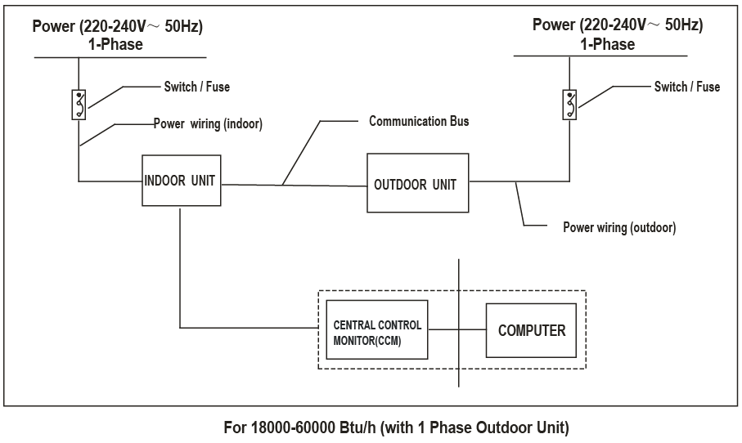
9. Wiring
2. Electric safety
Current leakage protection switch should be installed according to the power supply way.

Slide 40
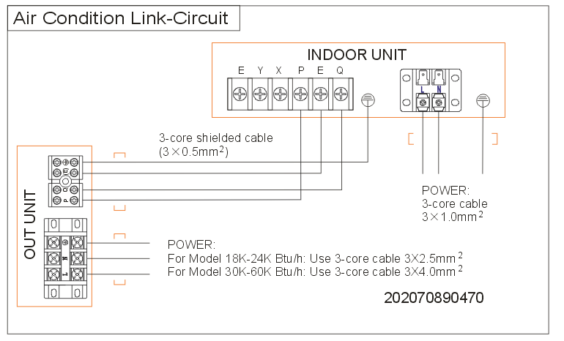
9. Wiring
2. Electric safety
Four light commercial , according to indoor and outdoor connection wiring label to choose the wiring.
For wall mounted according to the current to choose the wiring.
Rated current of appliance | Nominal cross-sectional area (mm²)
>3 and ≤6 | 0.75
>6 and ≤10 | 1
>10 and ≤16 | 1.5
>16 and ≤25 | 2.5

Slide 41
10. Test running
1. Previous checking
The test operation must be carried out after the entire installation has been completed. Double checking the following items:
The indoor unit and outdoor unit are installed properly.
Tubing and wiring are correctly completed.
The refrigerant pipe system is leakage-checked.
The drainage is unimpeded.
The ground wiring is connected correctly.
The length of the tubing and the added capacity of the refrigerant have been recorded.
The power voltage fits the rated voltage of the air conditioner.
There is no obstacle at the outlet and inlet of the outdoor and indoor units.
The gas-side and liquid-side stop values are both opened.
The air conditioner is pre-heated by turning on the power.

Slide 42
10. Test running
2. Test operation
Before switch on the unit, open the stop vale of outdoor and double checking the following items:
Set the air conditioner under the mode of "COOLING" by remote controller, and check the following points.
Indoor unit
Whether the buttons on the remote controller works well.
Whether the air flow louver moves normally.
Whether the room temperature is adjusted well.
Whether the indicator lights normally.
Whether the drainage is normal.
Whether there is vibration or abnormal noise during operation.
Outdoor unit
Whether there is vibration or abnormal noise during operation.
Whether the generated wind, noise, or condensed will influenced the neighborhood.
Whether the pressure of outdoor low pressure is normal
The test operation should last about 30 minutes.
If the temperature is too low to start cooling, press the check button 10s to switch to forced cooling mode.
After check the cooling mode , switch to heating mode to check the 4-way way.

Slide 43
10. Test running
3. Pressure and current checking
To judge whether the system is operating well, we normally test the low pressure of the system and the current of the compressor. When the following phenomena happen, we can fix the most possible reasons.
Phenomena |  | The most possible reason
Low pressure | Compressor current
Higher | Smaller | The gas in the compressor or 4-way valve is leaked from high pressure side to low pressure side.
Higher | Bigger | The refrigerant is over charge. The ambient temperature is too high.
Lower | Smaller | The refrigerant is not sufficient. The ambient temperature is too low.
Lower | Bigger | The refrigeration system is blocked.
Normal | Bigger | Low voltage
Low pressure 0.7~1.0Mpa

Slide 44
10. Test running
4. Pressure checking
According to the evaporator middle temperature(T2) to judge the low pressure correct or not.
No. | 1 | 2 | 3 | 4 | 5 | 6 | 7 | 8 | 9
Evaporator Temperature(℃) | -10 | -9 | -8 | -7 | -6 | -5 | -4 | -3 | -2
Low Pressure (Mpa) | 0.47 | 0.49 | 0.52 | 0.54 | 0.56 | 0.58 | 0.60 | 0.63 | 0.65
No. | 10 | 11 | 12 | 13 | 14 | 15 | 16 | 17 | 18
Evaporator Temperature(℃) | -1 | 0 | 1 | 2 | 3 | 4 | 5 | 6 | 7
Low Pressure (Mpa) | 0.68 | 0.70 | 0.73 | 0.75 | 0.78 | 0.81 | 0.84 | 0.87 | 0.90
No. | 19 | 20 | 21 | 22 | 23 | 24 | 25 | 26 | 27
Evaporator Temperature(℃) | 8 | 9 | 10 | 11 | 12 | 13 | 14 | 15 | 16
Low Pressure (Mpa) | 0.93 | 0.96 | 0.99 | 1.02 | 1.05 | 1.09 | 1.12 | 1.16 | 1.19
No. | 28 | 29 | 30 | 31 | 32 | 33 | 34 | 35 | 36
Evaporator Temperature(℃) | 17 | 18 | 19 | 20 | 21 | 22 | 23 | 24 | 25
Low Pressure (Mpa) | 1.23 | 1.27 | 1.31 | 1.35 | 1.39 | 1.43 | 1.47 | 1.51 | 1.56
No. | 37 | 38 | 39 | 40 | 41 | 42 | 43 | 44 | 45
Evaporator Temperature(℃) | 26 | 27 | 28 | 29 | 30 | 31 | 32 | 33 | 34
Low Pressure (Mpa) | 1.60 | 1.65 | 1.69 | 1.74 | 1.79 | 1.84 | 1.89 | 1.94 | 1.99

Slide 45
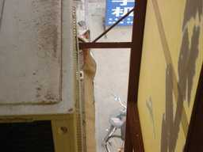
11. Failure cases for installation
Installation location:
Air outlet space not enough
It should be more than 2m.

Slide 46
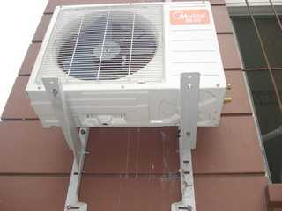
11. Failure cases for installation
Installation structure and safety
The mounted bolt is not fastened.
Installation Tips:
4 bolts (diameter bigger than Φ10mm) on the bottom bracket need to be well fastened.

Slide 47
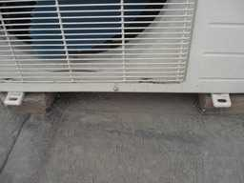
11. Failure cases for installation
Installation structure and safety
Outdoor unit is not horizontally placed, the unit is possibly to move and may have leakage.
Installation Tips:
When outdoor unit is installed on a platform, the drainage of outdoor unit have to be more care-taken, and the unit need to be fixed to avoid moving when units vibrate.

Slide 48
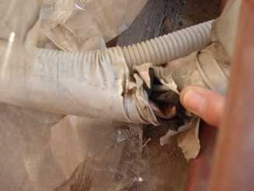
11. Failure cases for installation
Connecting pipe
The flattened or damaged piping will greatly influence the cooling/ heating performance.
Installation Tips:
The connection pipe need to be vertically or horizontally organized, when bending the pipe, make sure bending radius is no bigger than 10CM, and after bending, need to check the pipe is distorted or not.

Slide 49
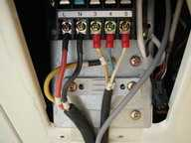
11. Failure cases for installation
Electrical Safety
Wire clip is not used. Wire is disjoined easily when it is dragged.
Installation Tips:
It is highly suggested to use wire clip to fix the wire.

Slide 50
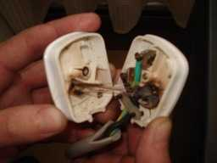
11. Failure cases for installation
Electrical Safety
For big capacity unit, if power plug is used, it is very dangerous.
Installation Tips:
Usually, only single phase air conditioner with rated current which isn’t bigger than 16A is suggest to use power plug, while other A/C is usually connected to the wire connector. If use power plug on these units, it has big potential to cause heat or even fire.

Slide 51
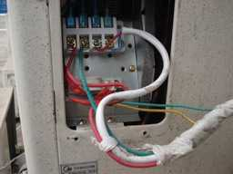
11. Failure cases for installation
Electrical Safety
Using nonstandard connection wire
Installation Tips:
The indoor-outdoor connection wire must be neoprene wire, PVC wire can’t be used.

Slide 52
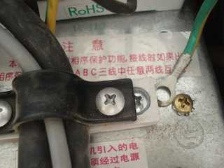
11. Failure cases for installation
Electrical Safety
Grounding is not well fixed.
Installation Tips:
Grounding wire or grounding end must be well connected or fastened. If you want to loosen it, you have to use tools to do that. And the green-yellow wire can only be used for grounding.

Slide 53

Notes:
53

