Slide 1
Trouble shooting
Nov.2012
Notes:
1

Slide 2
Contents
Main parts understanding
2. Refrigerant system trouble
3. Error code display
4. Error code understanding

Slide 3
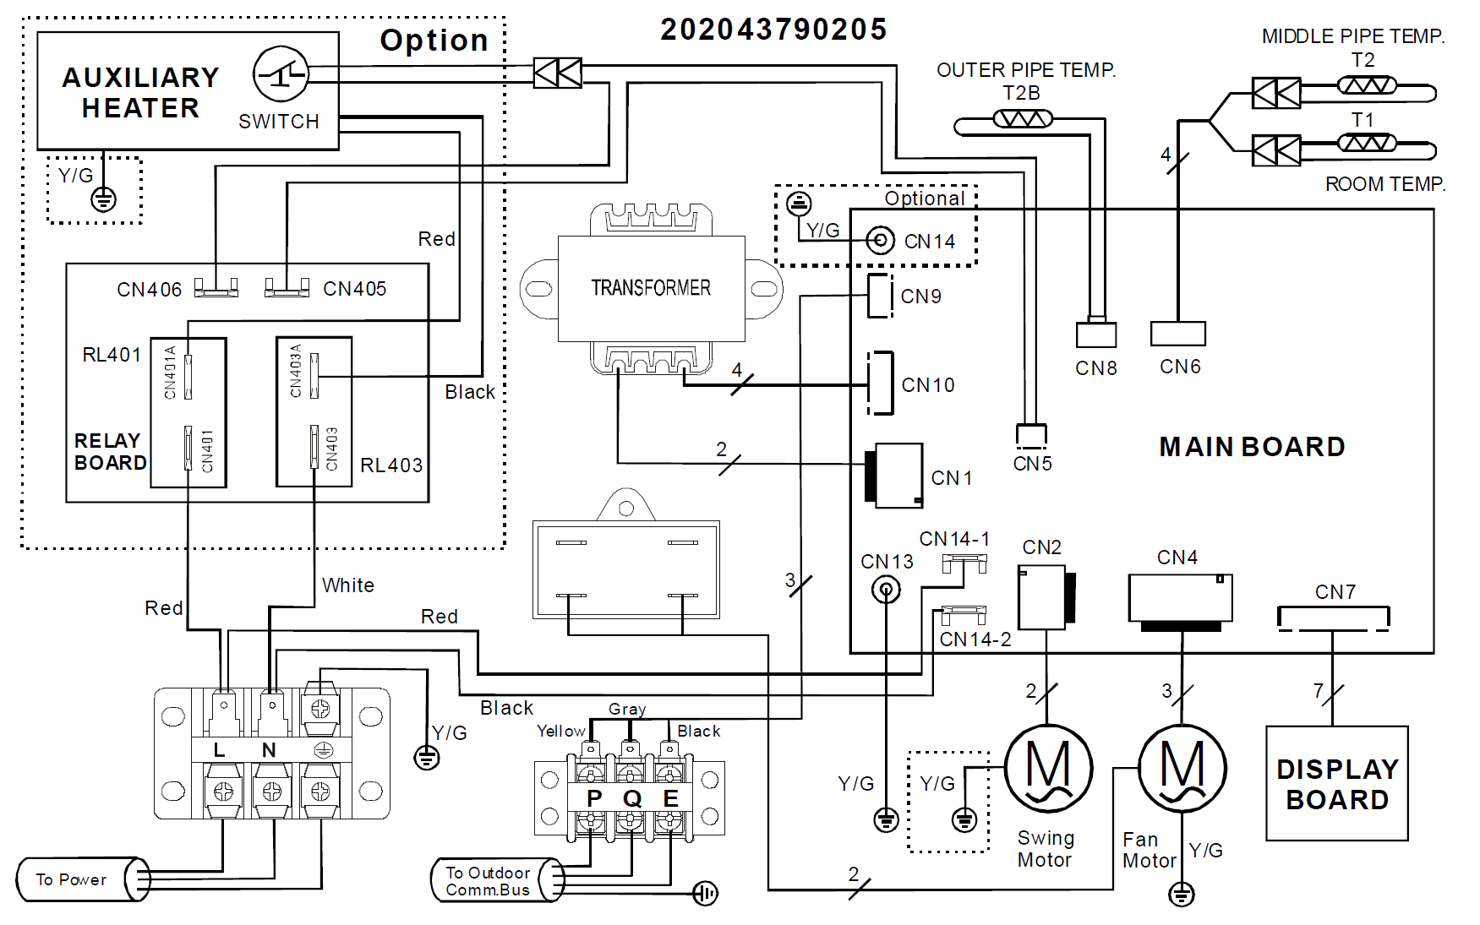
1. Main parts understanding
1. GA indoor PCB 36K

Slide 4
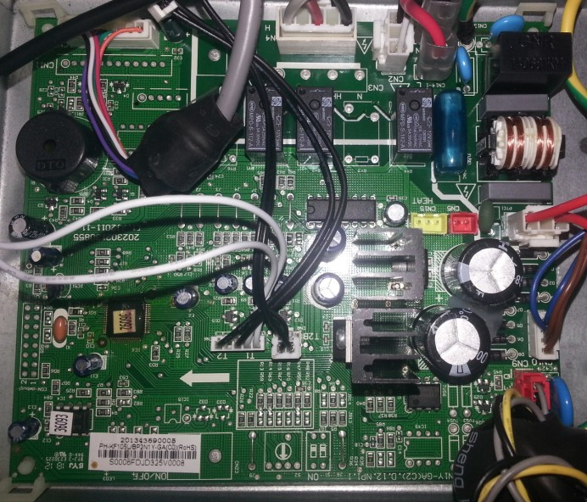
1. Main parts understanding
1. GA indoor PCB 36K
EEPROM
CN9
CN10
MCU
CN1
Port | Description | Parameter
CN9 | Communication wire to outdoor | 0~5V/DC
CN10 | Transformer output | 12V/DC
CN1 | Transformer input | 220V/DC
Power

Slide 5
1. Main parts understanding
1. GA indoor PCB 36K
CN8
CN6
Port | Description | Parameter
CN2 | Power of swing motor | 12V/DC
CN4 | Power of indoor fan | 220V/AC
CN7 | Display | 5V/DC
CN6 | T2B sensor | 5V/DC
CN6 | T1,T2 sensor | 5V/DC
CN2
CN4
CN7

Slide 6
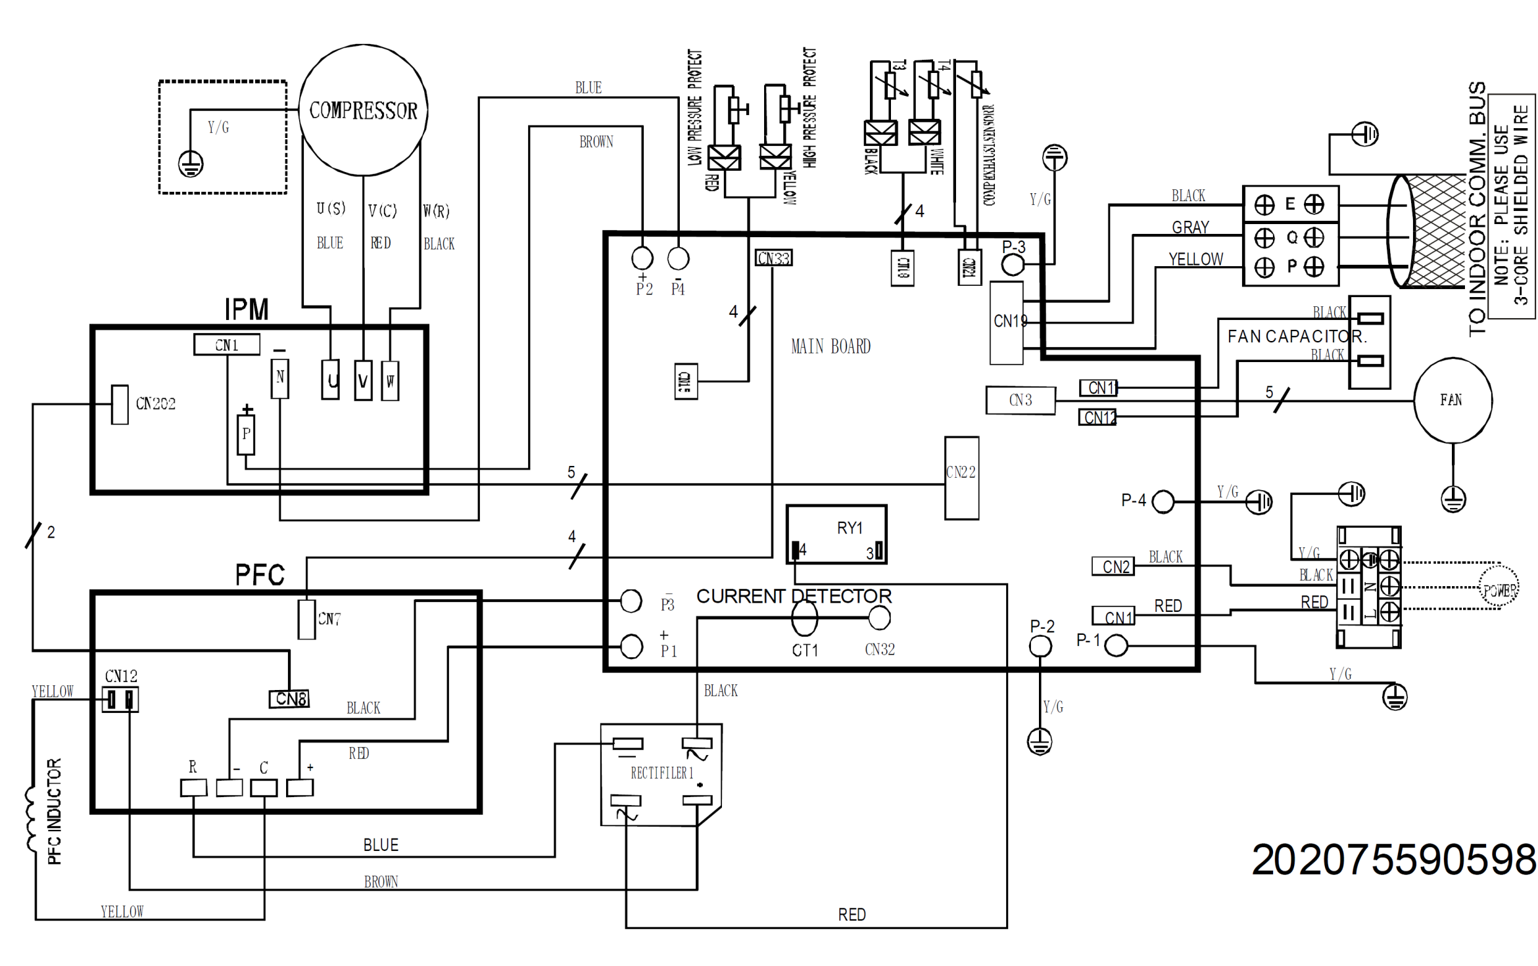
1. Main parts understanding
2. GA outdoor PCB 36K

Slide 7
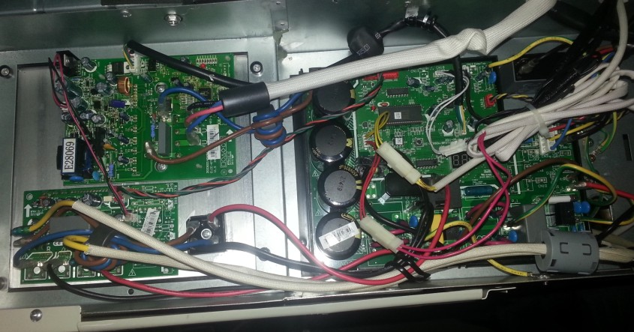
1. Main parts understanding
2. GA outdoor PCB 36K
IPM
PFC
Rectifier
Outdoor main PCB

Slide 8
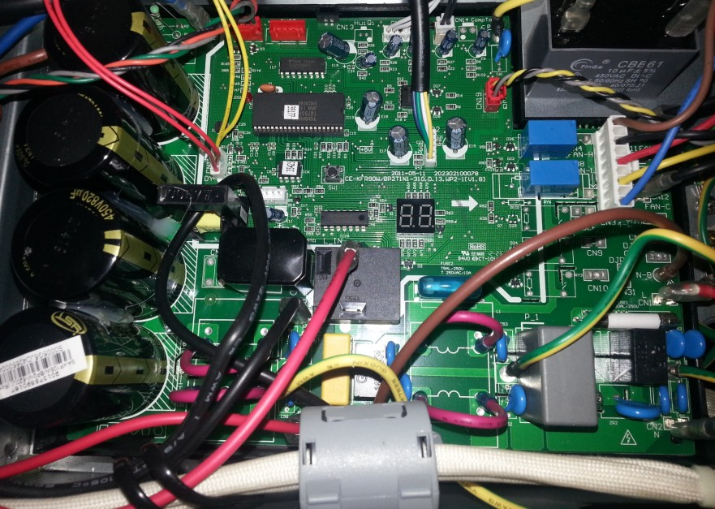
1. Main parts understanding
2. GA outdoor PCB 36K
PFC communication,
0~12VDC
T3,T4
0~5VDC
Com. discharge,
0~5VDC
CN1, PQE,0~5V DC
L-Pre, H_Pre, 0~5V DC
Fan power,220V
IPM communication 0~12VDC

Slide 9
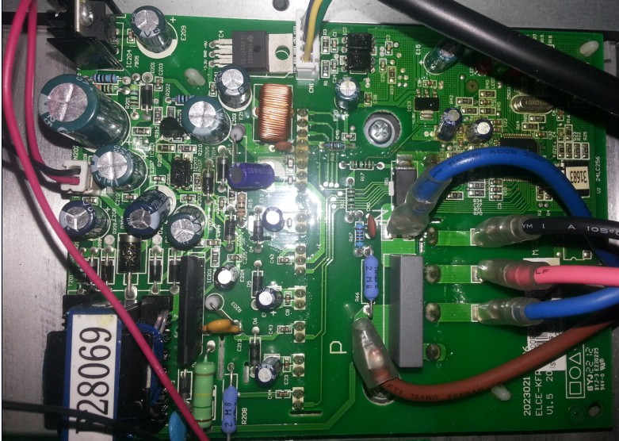
1. Main parts understanding
3. GA outdoor IPM 36K
PCB communication, 0~12VDC
About 277~410VDC
Power to PFC 0~12VDC
When the normal operation，the terminals between is 0 ~ 200VAC

Slide 10
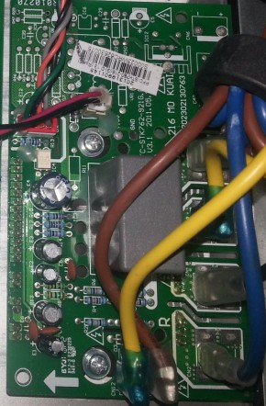
1. Main parts understanding
4. GA outdoor PFC 36K
PCB communication, 0~12VDC
Power from IPM, 0~12VDC
It’s 0V between “R” and “-”, the other ports is 380V

Slide 11
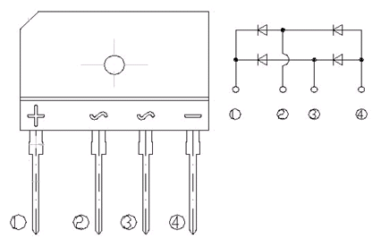
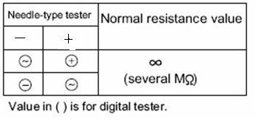
1. Main parts understanding
5. Rectifier Checking

Slide 12
1. Main parts understanding
6. Compressor checking
Measure the resistance value of each winding by using the multi-meter.
Position | Resistance Value
Blue - Red | TNB306FPGMC-L 0.53 Ω (20℃)
Blue - Black
Red - Blue

Slide 13
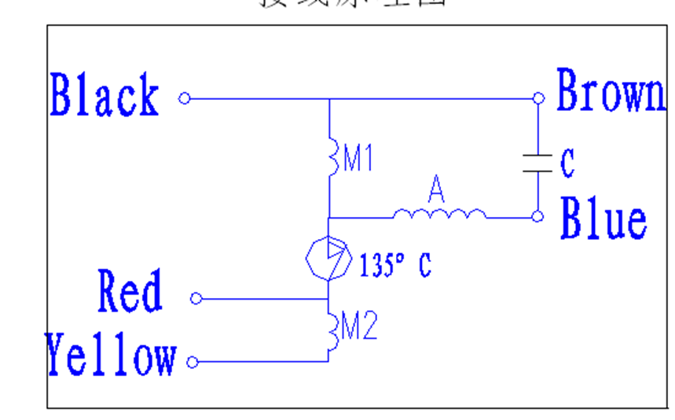
1. Main parts understanding
7. Outdoor fan motor checking
Measure the resistance value of each winding by using the multi-meter.
Model | Position | Resistance Value
YDK180-8GB | Black - Red | 24.5±8%Ω
 | Red-blue | 19±8%Ω

Slide 14
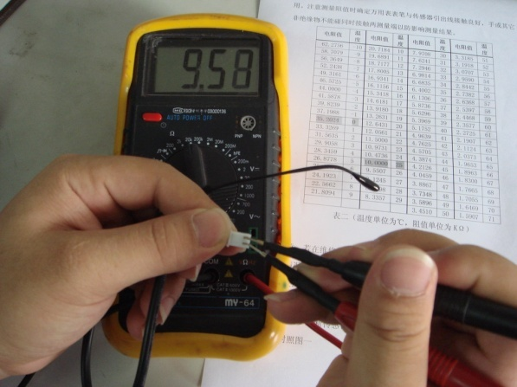
1. Main parts understanding
8. Sensor
Measure the resistance value of each winding by using the multi-meter.
Some frequently-used R-T data for T1,T2, T2B,T3 and T4 sensor:
Temperature (℃) | 5 | 10 | 15 | 20 | 25 | 30 | 40 | 50 | 60
Resistance Value (KΩ) | 26.9 | 20.7 | 16.1 | 12.6 | 10 | 8 | 5.2 | 3.5 | 2.4
Some frequently-used R-T data for Td sensor:
Temperature (℃) | 5 | 15 | 25 | 35 | 60 | 70 | 80 | 90 | 100
Resistance Value (KΩ) | 141.6 | 88 | 56.1 | 36.6 | 13.8 | 9.7 | 6.9 | 5 | 3.7

Slide 15
2. Refrigerant system trouble
1. When turn on the unit, the compressor can not start
Reason | Solution
1. Power cut off | Wait for the power on, then turn on the unit.
2. Wire plugs contact badly | Use multi-meter check the contact of the connector plugs, repair the bad part.
3. Low voltage. Lower than 198V. | If the voltage usual lower than the rating, stop the unit. It can avoid the compressor burn out.
4. Wrong wiring connection | Cut off the power, check the connection according to wiring diagram.
5.The compressor in open circuit. | Check the resistance of every terminal of compressor, if abnormal, replace the compressor
6. Compressor “hold- shaft” | Replace compressor, Big current.
7. Compressor burn out | Test the winding, replace compressor

Slide 16
2. Refrigerant system trouble
2. Cooling capacity is not enough.
Reason | Solution
1. Dirty exchanger | Clear or replace it; the dust on the coil fin should clean in time.
2. The fan motor burn out/can not run | If the motor is burn out, should replace the motor;
3. Dirty filter | Clean it.
4. Bad ventilation of outdoor or indoor unit | Ensure the installation space.
5. Straight sunshine of outdoor | Sunshade is necessary.
6. The refrigerant is not enough. | Low pressure and running current are lower than normal value. Check where is the leak point, repair it, then charge refrigerant again.
7. Jammed filter of capillary | Temperature difference between the blocked point, ice may appear.
8. Air in system | High current, high consumption. Discharge-vacuum dry - recharge.
9. Inner water | Capillary is freezing .Replace the dry filter

Slide 17
2. Refrigerant system trouble
2. Cooling capacity is not enough.
Reason | Solution
10. Too long pipe system | Long pipe or high elevation will decrease cooling capacity.
11. Small capacity indoor unit | Replaced by a big capacity unit
12. Expansion valve broken or bad control | Replace it
13. High pressure and low pressure side conducted of four way valve | Replace it
14. High pressure and low pressure side conducted of compressor | Replace it

Slide 18
2. Refrigerant system trouble
3. After start up, the unit stopped
Reason | Solution
1. Power cut off | Check the power supply
2. Protection or error occur | According to the error solution chart
4. The indoor temp is low enough, but the unit still running
Reason | Solution
1. The position of the room sensor is not well | Ensure the sensor in the right position.
2. The room sensor is not accurate | Replace it

Slide 19
2. Refrigerant system trouble
5. The unit startup and stop frequently.
Reason | Solution
1. Many appliances have same power supply | Air-condition should have it own power supply.
2. Outdoor ambient temp is over high. | Check the ventilation and sunshine of the outdoor unit, if bad ventilation, should remove barriers; if outdoor unit is exposed sunshine straight, sunshade is necessary
3. Refrigerant system jammed. | Repair
4.Compressor is short of oil. | The pipe length and elevation should not exceed max length and oil traps are necessary for long pipe and high elevation.

Slide 20
2. Refrigerant system trouble
6. The unit has big noise when running.
Reason | Solution
1. Screw loosen. Compressor, fan motor, outdoor base | Fixed them.
2. Outdoor pipe distorted | Correct or replace it
3. The indoor and outdoor fan is broken. | Replace them.
4. Fan motor hold distorted | Correct or replace it
5. Connection pipe not fixed | Fixed it
6. Plastic expand with heat and contract with cold | Normal

Slide 21
2. Refrigerant system trouble
7. High pressure
Reason | Solution
1. Condenser dirty or partially blocked | Clear it
2. air or other un condensable gases in refrigerant cycle | Recharge, or replace the filter
3. Overcharged refrigerant | Discharge according to the pressure
4. Insufficient condensing medium | Check the installation space
5. High temperature condensing medium | Sunshade
6. Short cycling of condensing air | Check the installation space

Slide 22
2. Refrigerant system trouble
8. Low suction pressure
Reason | Solution
1. Shortage of refrigerant | Charge it
2. Blocked of capillary or EXV | Repair it
3. Resistance against refrigerant flow | Pipe over bent, block of system
9. High suction pressure
Reason | Solution
1. Overcharged of refrigerant | Release it according to pressure
2. Unit undersized for application | Replace by a bigger one
3. Air or other un condensable gases in refrigerant cycle | Recharge, or replace the filter
4. Blocked of capillary or EXV | Repair it

Slide 23
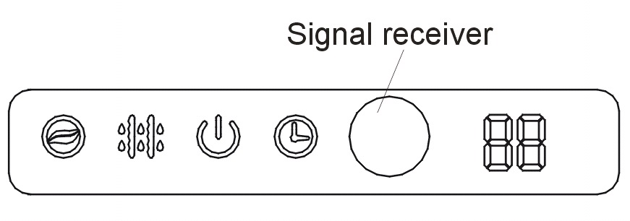





3. Error code display
1. Oasis
 | ION indication lamp(optional function)：This lamp illuminates when Clean Air feature is activated.
 | DEFROST indication lamp(For cooling & heating models only): Lights up when the air conditioner starts defrosting automatically or when the warm air control feature is activated in heating operation.
 | OPERATION indication lamp：This lamp illuminates when the air conditioner is in operation.
 | TIMER indication lamp：Lights up during Timer operation.
 | Temperature indicator：Displays the temperature settings when the air conditioner is operational. Displays the malfunction code.

Slide 24
3. Error code display
1. Oasis
Operation lamp | Timer lamp | Display | LED STATUS
☆ 1 time | X | E0 | Indoor unit EEPROM parameter error
☆ 2 times | X | E1 | Indoor / outdoor units communication error
☆ 3 times | X | E2 | Zero-crossing signal error
☆ 4 times | X | E3 | Indoor fan speed has been out of control
☆ 5 times | X | E4 | Open circuit or short circuit of indoor room temperature T1 sensor
☆ 6 times | X | E5 | Open circuit or short circuit of evaporator coil temperature T2 sensor
☆ 7 times | X | EC | Refrigerant Leakage Detection
☆ 1 times | O | F0 | Over current protection
☆ 2 times | O | F1 | Open circuit or short circuit of outdoor ambient T4 temperature sensor
☆ 3 times | O | F2 | Open circuit or short circuit of condenser coil temperature T3 sensor
☆ 4 times | O | F3 | Open circuit or short circuit of compressor discharge T5 temperature sensor
☆ 5 times | O | F4 | Outdoor unit EEPROM parameter error
☆ 1 times | ☆ | P0 | IPM malfunction or IGBT over-strong current protection
☆ 2 times | ☆ | P1 | Over voltage or over low voltage protection
☆ 3 times | ☆ | P2 | High temperature protection of compressor top
☆ 5 times | ☆ | P4 | Inverter compressor drive error
O（light） X（off） ☆（flash 2.5Hz, stop 4s）

Slide 25
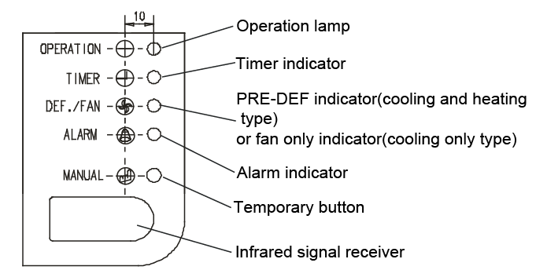
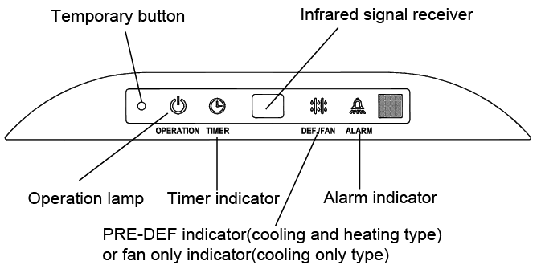
3. Error code display
2. Cassette and Ceiling&floor

Slide 26
3. Error code display
2. Cassette and Ceiling&floor
NO. | Malfunction | Running lamp | Timer lamp | Defrosting lamp | Alarm lamp | Display(nixie tube)
1 | Communication malfunction between indoor and outdoor units. | X | ☆ | X | X | E1
2 | Open or short circuit of T1 temperature sensor | ☆ | X | X | X | E2
3 | Open or short circuit of T2 temperature sensor | ☆ | X | X | X | E3
4 | Open or short circuit of T2B temperature sensor | ☆ | X | X | X | E4
5 | Full-water malfunction | X | X | X | ☆ | EE
6 | EEPROM malfunction | X | X | ☆ | X | E7
7 | Outdoor unit malfunction | X | X | X | ◎ | Ed
X(off) ☆(flash at 5Hz) ◎(flash at 0.5Hz)

Slide 27
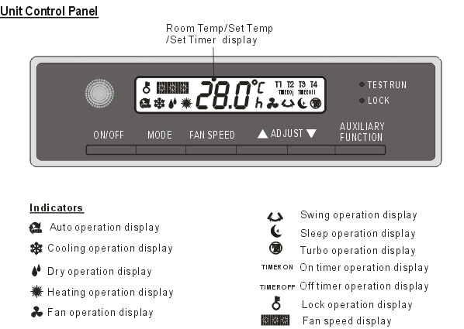
3. Error code display
3. GA Floor Standing

Slide 28
3. Error code display
3. GA Floor Standing
Codes | Contents
P0 | Evaporator low temp. protection, only showed when test running
P1 | Defrosting or anti-cold air, only showed when test running
Ed | Outdoor unit protection / Open or short circuit of outdoor temp. sensor
E1 | Indoor / outdoor units communication error
E2 | Open or short circuit of T1 temperature sensor
E3 | Open or short circuit of T2 temperature sensor
E4 | Open or short circuit of T2B temperature sensor
E7 | EEPROM chip malfunction

Slide 29

3. Error code display
4. LCAC Outdoor error code display
Display | Malfunction or Protection
E0 | Outdoor EEPROM malfunction
E2 | Indoor / outdoor units communication error
E3 | Communication malfunction between IPM board and outdoor main board
E4 | Open or short circuit of T3 or T4 temperature sensor
E5 | Voltage protection of compressor
E6 | PFC module protection
P0 | Top temperature protection of compressor
P1 | High pressure protection
P2 | Low pressure protection
P3 | Current protection of compressor
P4 | Discharge temperature protection of compressor
P5 | High temperature protection of condenser
P6 | IPM module protection
Digit display on outdoor PCB

Slide 30
4. Error code understanding
1. EEPROM parameter error
EEPROM: a read-only memory whose contents can be erased and reprogrammed using a pulsed voltage.
If this problem happened, need to replace the EEPROM or PCB.
Replace the PCB

Slide 31
4. Error code understanding
2. Indoor / outdoor units communication error
Check if there any electromagnetic interface source.
Check the wiring connected to indoor and outdoor are good?
Check the polarity of signal wire is correct of LCAC. P-P, Q-Q, E-E.
The signal wire of LCAC should be 3-Core shield wire.
The signal wire is good. For LCAC, the voltage is 0~5V. For wall mounted, the voltage between S and N is about 50V of indoor, about 90V of outdoor.
If not the above problem, replace the main PCB

Slide 32
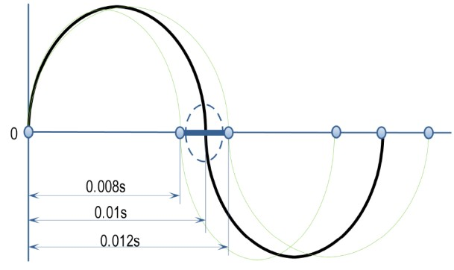
4. Error code understanding
3. Zero-crossing signal error
If it’s not the problem of power supply, it the problem of PCB.
DC inverter fan motor and wiper motor do not have this problem.
0.006
0.008
0.010

Slide 33
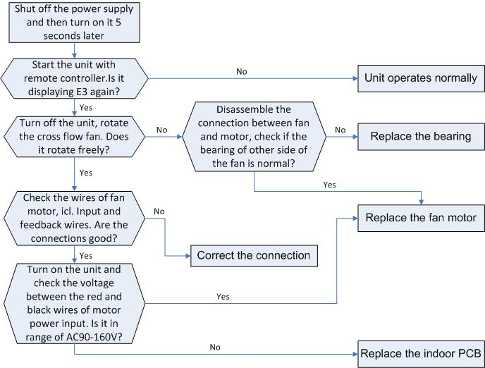
4. Error code understanding
4. Fan speed has been out of control
This problem is for DC motor and plastic motor.
Check the connection wire connection good.
Check the bearing by rotate the fan manually.
Restart by remoter controller, if the motor running for about 50s, it’s the problem of PCB. If not, motor has problem.
Double check to test the voltage between Red and black, the correct voltage should be 90~160VAC, and test the resistance is correct or not.
Fan capacitor also may cause the problem, test its capacitance.

Slide 34
4. Error code understanding
5. Sensor problem (T1, T2,T3,T4)
Test the resistance according to the table in the link document.

Slide 35
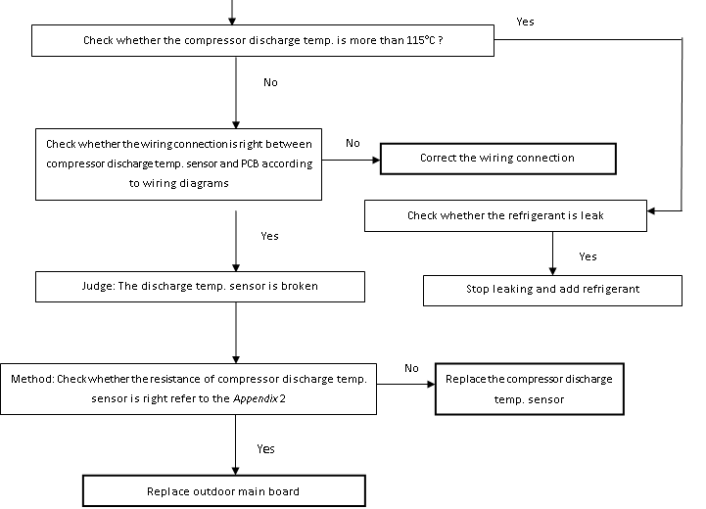
4. Error code understanding
6. Discharge temperature sensor problem
When compressor discharge temperature is higher than 115°C, the unit will stop, and unit runs again when compressor discharge temperature is lower than 90°C.
Maybe the wiring or sensor or outdoor PCB has problem.
Or the refrigerant is leaked or ambient temperature is very high.

Slide 36
4. Error code understanding
7.1. IPM Problem of Oasis; Inverter compressor drive error
Check the wire connection
Check the IPM fix fasten or not
Check the Radiating paste is exhaust or not
If the resistance between “U V W” and “P N” is infinity, the IPM is broken.
Check the fan motor is good? If the fan motor not work, will cause high current.
Check the compressor is good?

Slide 37

4. Error code understanding
7.2 IPM Problem of LCAC

Slide 38
4. Error code understanding
8. Voltage problem
Check the voltage of outdoor unit power supply, whether the voltage between L(1) and N is about 220VAC
No
Check the power supply
Yes
Check whether the voltage of IPM board P and N is 277-410VDC
No
Replace IPM board, then check whether the system can run normally
Yes
Yes
Replace bridge rectifiers, then check whether the system can run normally
Yes
No
Trouble is solved
If the PCB and IPM is integrated, and the voltage is not correct, replace the PCB
No
Replace outdoor main board
If not integrated, check the voltage between P and N, if at the range of 277~410VDC, replace the rectifier, if not solve the problem, replace the PCB. If at this range, replace the IPM, them restart, if still have problem, replace PCB.

Slide 39
4. Error code understanding
9. High temperature protection of compressor top
If compressor can restart, it’s the problem of refrigerant system, need to check any leakage? Block? dirty condenser?
If compressor can not restart, check the wire connection of OLP, check the resistance, if zero, replace outdoor PCB, if not replace OLP.
OLP: Over load protector

Slide 40
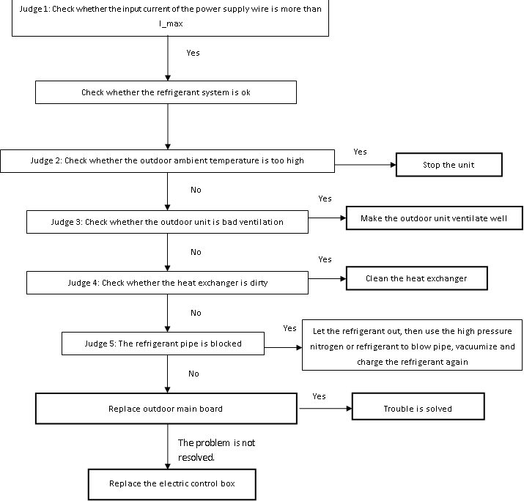
4. Error code understanding
10. Current protection of compressor
If the compressor can restart, it’s the problem of refrigerant system, check the ambient temperature is high? Exchange is dirty, any block?
If compressor can not restart(F0 display all the time), replace the outdoor PCB..

Slide 41
4. Error code understanding
11. Refrigerant Leakage Detection protection
Only for oasis, LCAC do not has this function.
If the outlet air is cold, need check the T2 sensor, if not the problem of T2, need to replace the PCB
If the outlet air not cold, need to check if the refrigerant leaked or system has blocked.

Slide 42
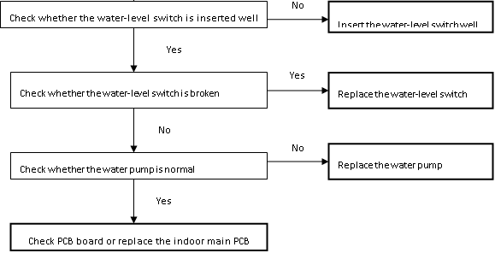
4. Error code understanding
12. Full-water malfunction
Only for the LCAC unit with pump
Check wire connection
Check water level switch insert well, Block？
Check water level switch broken? If the resistance is not zero, it broken.
Check the pump is normal? Power it.
If not the above problem, it’s the problem of PCB.

Slide 43
4. Error code understanding
13. Communication malfunction between IPM board and outdoor main board
Only for LCAC and IMP separate from PCB
Yes
Check whether the IPM board has error display
Replace IPM board
Check the connection wire?
Most of the condition is if the led has display, replace the IPM, if not, replace the outdoor PCB.
No
Yes
Trouble is solved
Insert the connecting wiring between the IPM module and the main board well over again
No
Yes
Trouble is solved
Replace the IPM board
No
Replace outdoor main PCB
Yes
Trouble is solved
The problem is not
resolved.
Replace the electric control box

Slide 44
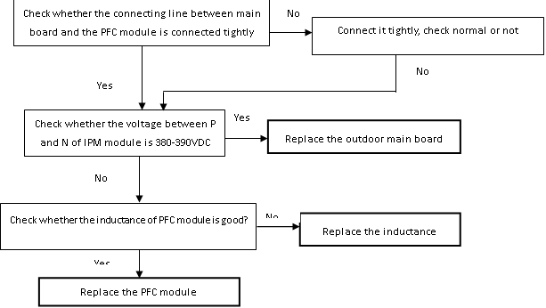
4. Error code understanding
14. PFC module protection
Only for LCAC and PFC separate from PCB
Check the connection wire Check the voltage of PN is 380~390VDC, if yes, it’s the problem of outdoor PCB. If not, check the resistance of inductance, if not, replace PFC..

Slide 45
4. Error code understanding
15. High pressure protection
Only for LCAC with high pressure switch
Judge 1: Whether the wiring between the high pressure switch and main control board is connected well or correctly
No
Connect it well
Yes
Judge 2: Whether the high pressure switch is broken
Check the connection wire Check the resistance, if not zero, it’s broken, otherwise it’s the problem of refrigerant system. Need to check outdoor temperature very high? Bad ventilation? Dirty condenser? Refrigerant system blocked? If not the above problem, replace the outdoor PCB.
Method: Short connect the high pressure switch socket, check whether the system can run normally
Yes
Replace high pressure switch
No
Check whether the refrigerant system is ok
Yes
Judge 3: Check whether the outdoor ambient temperature is too high
Stop the unit
No
Yes
Judge 4: Check whether the outdoor unit is bad ventilation
Make the outdoor unit ventilate well
No
Yes
Judge 5: Check whether the heat exchanger is dirty
Clean the heat exchanger
No
Yes
Judge 6: Check whether the refrigerant pipe is blocked
Let the refrigerant out, then use the high pressure nitrogen or refrigerant to blow pipe, vacuumize and charge the refrigerant again
No
Replace outdoor main board

Slide 46
4. Error code understanding
16. Low pressure protection
Check the connection wire Check the resistance, if not zero, it’s broken, otherwise it’s the problem of refrigerant system. Need to check if ambient temperature very low, stop the unit. Check the low pressure, if low than 0.14Mpa, need to find the leakage point and recharge. Check any block? If not the above problem, replace the outdoor PCB.
Judge 1: The wiring between the low pressure switch and main control board is connected well or correctly
No
Connect it well
Yes
Judge 2: Whether the low pressure switch is broken
Method: Short connect the low pressure switch socket, check whether the system can run normally
Yes
Replace low pressure switch
No
Check whether the refrigerant system is ok
Judge 3: Check whether the outdoor ambient temperature is too low
Yes
Stop the unit
No
Judge 4: The refrigerant of the system is leakage
Leak hunting: Charge nitrogen or refrigerant to the system, if the leakage is serious, there will be distinct gas leakage “cici” sound; if the leakage is slight, use the suds (mixture of water and abluent is also ok if it can make bubble) or electronic leak detector.
Method: Connect the pressure gauge to the gauge joint of the system, check whether the pressure is lower than 0.14MPa
Yes
No
Yes
Let the refrigerant out, then use the high pressure nitrogen or refrigerant to blow pipe, vacuumize and charge the refrigerant again
Judge 5: The refrigerant pipe is blocked
No
Replace outdoor main board

Slide 47
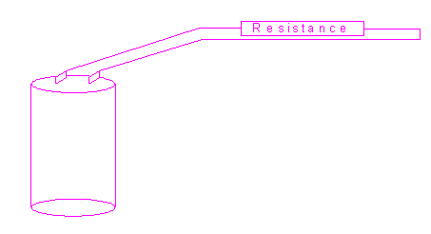
4. Error code understanding
17. Notes
Safety
Because of there are capacitors in PCB and relative circuit in outdoor unit, even shut down the power supply, electricity power still are kept in capacitors, do not forget to discharge the electricity power in capacitor.
Use a resistor with 1500 ohm to 2000 ohm resistance to discharge the electricity.
The voltage in P2 and P4 in outdoor PCB is high voltage about 310V

Slide 48

Notes:
48

