Slide 1
Technical Feature of
Midea LAC Product

Slide 2
Content
1.
Super Slim Cassette
5.
Floor-standing：GA
2.
4.
3.
New Ceiling-floor
Mid-Static Pressure A5 Duct
Optional wire controller

Slide 3
Products Line up
Series
Power supply
24K
36K
48K
60K
Cassette | 230V~ 60Hz, 1Ph
 | 230V~ 60Hz, 3Ph
Ceiling Floor | 230V~ 60Hz, 1Ph
 | 230V~ 60Hz, 3Ph
Duct | 230V~ 60Hz, 1Ph
 | 230V~ 60Hz, 3Ph
Floor Standing | 230V~ 60Hz, 1Ph
 | 230V~ 60Hz, 3Ph
: Non-Inverter Model
: Inverter Model

Slide 4
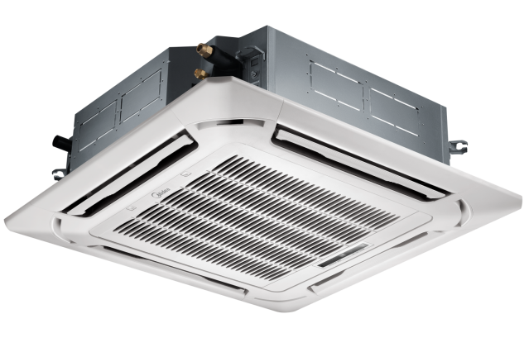
1. Super Slim Cassette
Overview

Slide 5

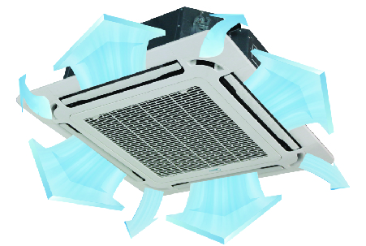
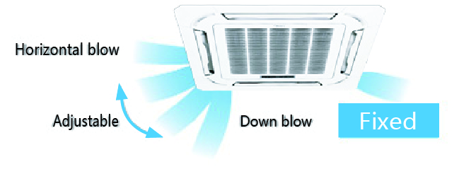
1. Super Slim Cassette
Outstanding Features
Comfort
Convenience
Health
For some panels
360°Round Flow
Ensure a uniform temperature distribution across the room without dead corners.
Independent Vane Control (optional)
If the air flow direction needs to be changed as a result of an altered room layout, the air direction of each 4 vanes can be set independently as preferred by using the wired controller.

Slide 6

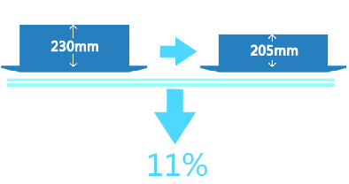
1. Super Slim Cassette
Outstanding Features
Comfort
Convenience
Health
 | Old Cassette | New Slim Cassette | Reduction
18K-24K | 840*230*840 | 840*205*840 | 11%↓
30K | 840*300*840 | 840*205*840 | 32%↓
36K-48K | 840*300*840 | 840*245*840 | 18%↓
48K-60K | 840*300*840 | 840*287*840 | 4%↓
Super slim design
Re-designed heat exchanger and structure enable to reduce the height of the indoor unit, less space requiring in installation.

Slide 7
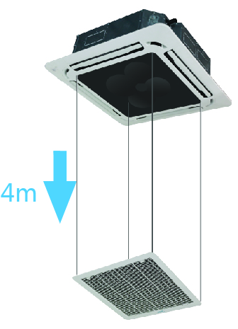
1. Super Slim Cassette
Outstanding Features
Comfort
Convenience
Health
Auto Elevation Grille (optional)
The grille can be lowered automatically to
maximum 4m, easy to clean the air filter.
Regular cleaning of the filter is an important factor in saving energy.

Slide 8
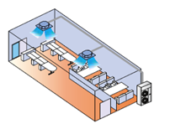
1. Super Slim Cassette
Outstanding Features
Comfort
Convenience
Health
 | Indoor Units | Outdoor Unit
Twin System | 18K + 18K | 36K
 | 24K + 24K | 48K
 | 30K + 30K | 60K
Available for Inverter Multi model
Twin System
The twin system connects two indoor units of the same type and capacity to one outdoor unit in order to ensure more air distribution in a large zone. The controller can only control the master unit. The slave unit will work in the same state as the master unit.

Slide 9
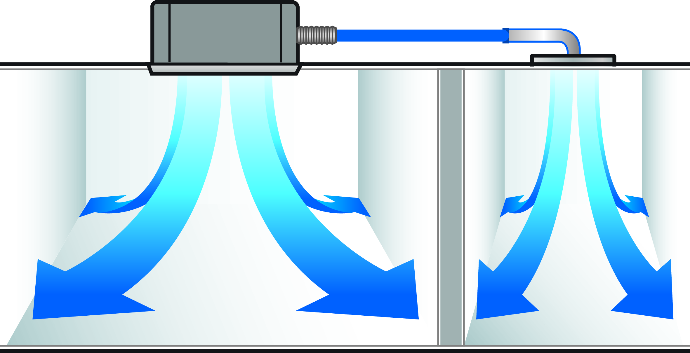
1. Super Slim Cassette
Outstanding Features
Comfort
Convenience
Health
Standard
Reserved Air Outlet For Duct
Reserves the space for air outlet from the side of indoor unit;
It’s available to connect air duct from side to small rooms nearby.

Slide 10
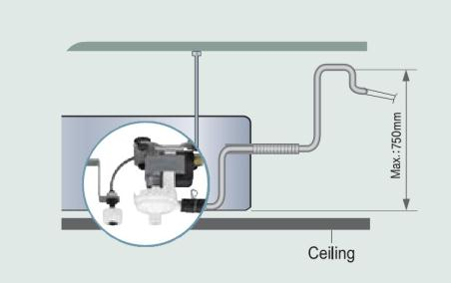
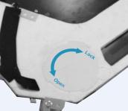
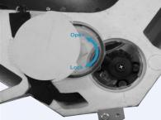
1. Super Slim Cassette
Outstanding Features
Comfort
Convenience
Health
Standard
  Build-in Drain Pump
The drain pump can lift the condensing water up to 750mm upmost.
It’s convenient to install drainage piping under most space condition.
  Easy maintained Drain Pump
Improved structure makes it more convenient to repair the drain pump.
Draining Pump

Slide 11
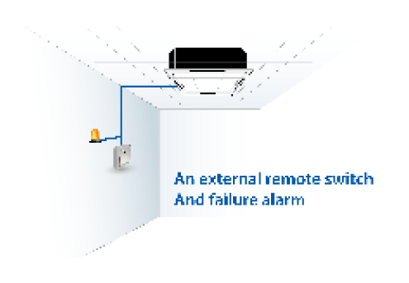
1. Super Slim Cassette
Outstanding Features
Comfort
Convenience
Health
Reserved remote on-off and alarm ports
Remote on-off: (Standard)
With the reserved ports. a remote switch can be easily connected to realize remote control.
Alarm: (Standard)
The built-in PCB can output alarm signal, which achieve setting up an external alarm light or vibration gauge possible.
Standard

Slide 12
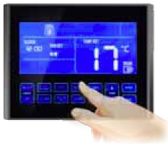
1. Super Slim Cassette
Outstanding Features
Comfort
Convenience
Health
Touch screen wired controller(optional)
User-friendly interface with error code indication function.
4 way wire layout design, more convenient for installation.

Slide 13

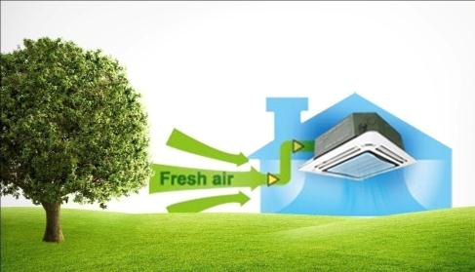
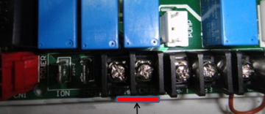
1. Super Slim Cassette
Outstanding Features
Comfort
Convenience
Health
Standard
ventilation motor connector
Fresh Air Intake (Only reserve connection port)
A ventilation motor (no more than 200W) can be installed in fresh air duct and works with indoor fan to increase the volume of fresh air.

Slide 14

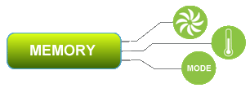
1. Super Slim Cassette
Auto-Restart
Standard
If the air conditioner shuts off unexpectedly due to the power off, it will restart to work under the previous setting mode automatically when the power resumes.

Slide 15
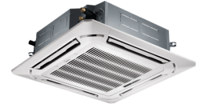
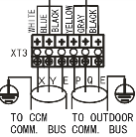
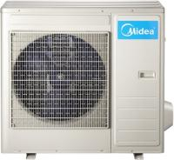
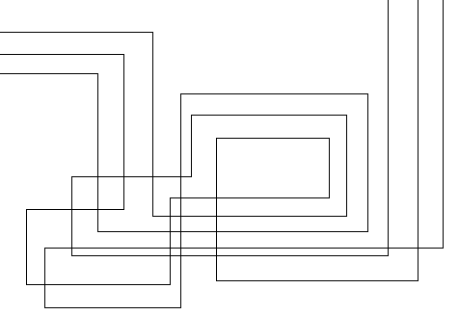


1. Super Slim Cassette
Improvement of communication wire connection
The Past…
P | Q | E
?
?
?
P
Q
E
P
Q
E
P
Q
E
P
Q
E
P
Q
E
P
Q
E
P
Q
E
3 wires must correspond to P, Q and E terminal one by one. You may be confused when the wires are too long .

Slide 16
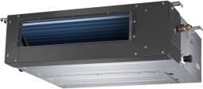

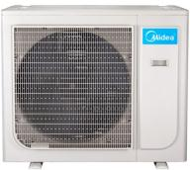

1. Super Slim Cassette
Improvement of communication wire connection
Now
S1 | S2
S1 | S2
S1
S2
S1
S2
Only two connection wires and without polarity, which can hardly make mistakes.

Slide 17
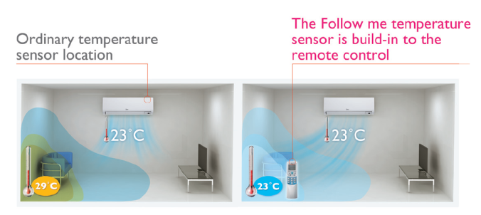
1. Super Slim Cassette
Follow me
Optional
With this function, the room temperature sensor built in remote controller is activated and replaces the one in indoor unit. Then the air conditioner will regulate the room temperature based on the temperature around the remote controller, just like the air conditioner is following the user.

Slide 18


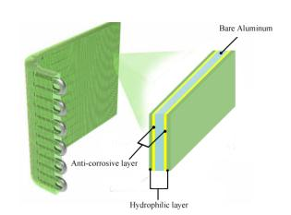
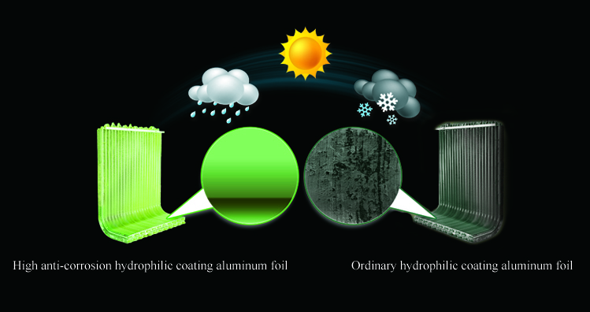
1. Super Slim Cassette
Golden fin
High anti-corrosion
Optional
Gorgeous
Prevent bacteria from breeding and spreading
Improve the heating efficiency
Withstand the salty air, rain and other corrosive elements

Slide 19





1. Super Slim Cassette
Other Features
Standard Features
Optional Features
_{Auto Restart}
_{Function}
_{Follow Me}
_{Sleep Mode}
Wire Controller
_{Anti-cold Air} _{Function}
_{Timer}
_{Auxiliary Electric Heater}
Auto Defrosting
Independent Dehumidification

Slide 20
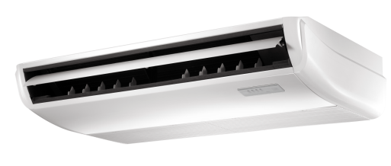
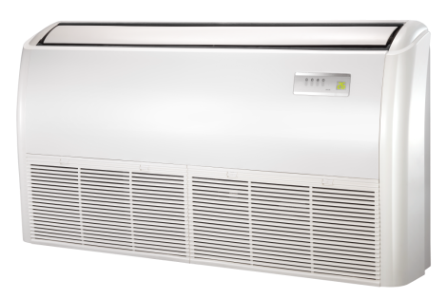
2.New Ceiling-floor
Overview

Slide 21
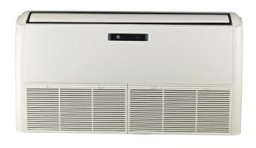
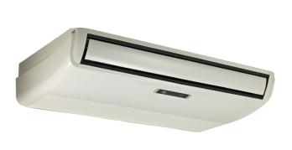
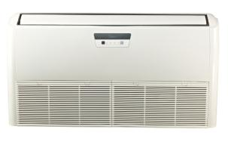
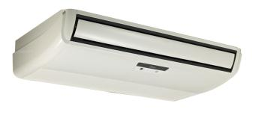
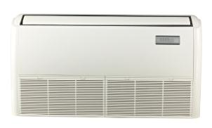
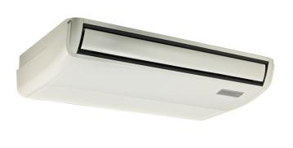
2.New Ceiling-floor
Different Designs For Your Choice
Design A
Design B
Design C

Slide 22
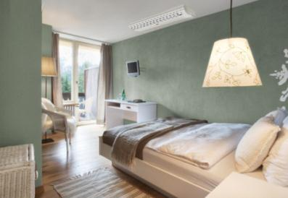
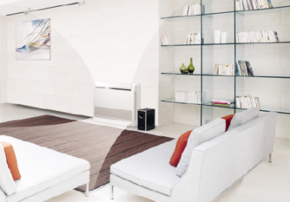


2.New Ceiling-floor
Outstanding Features
2 Style Installation
3D Air Flow
Convenience
Healthy Filter
Fashionable design and streamline appearance, suitable for different styles room;
Ceiling installation saves room space;
Floor installation helps prevent losing warm air.
Standard

Slide 23
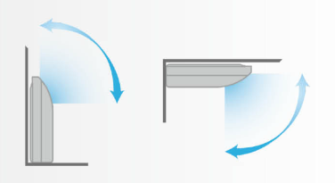
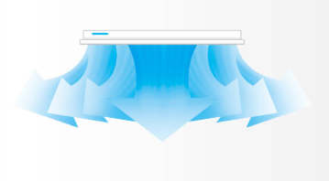
2.New Ceiling-floor
Outstanding Features
2 Style Installation
3D Air Flow
Convenience
Healthy Filter
standard
Vertical air flow and horizontal airflow can be adjusted by remote controller;
Fulfill the optimum air organization, more comfortable.

Slide 24
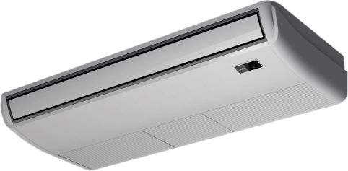
2.New Ceiling-floor
Outstanding Features
2 Style Installation
3D Air Flow
Convenience
Healthy Filter
Universal Spare Parts
More than 60% parts and assemblies (such as fan wheel, plastic cases, metal parts and etc.) are universal for 3 different bodies, which makes the production and maintenance much easier.

Slide 25
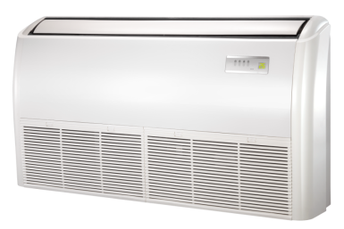
2.New Ceiling-floor
Outstanding Features
2 Style Installation
3D Air Flow
Convenience
Healthy Filter
3-way Pipe Direction
Standard
The connection pipe can be put into the unit from bottom, side or rear, which makes installation much easier.

Slide 26
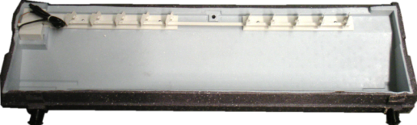
2.New Ceiling-floor
Outstanding Features
2 Style Installation
3D Air Flow
Convenience
Healthy Filter
2-way Drainage
Standard
Both right side and left side drainage holes are available to avoid the space limitation for drainage pipe installation.

Slide 27
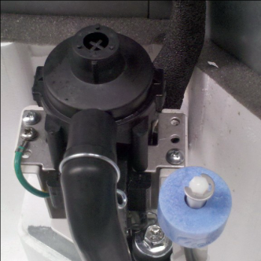
2.New Ceiling-floor
Outstanding Features
2 Style Installation
3D Air Flow
Convenience
Healthy Filter
Drain pump
Optional
Drain pump is optional, which can lift condensing water up to 750mm upmost.
** When drain pump is installed, the unit can only be installed under-ceiling.

Slide 28
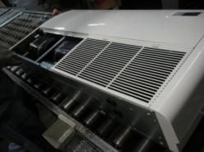
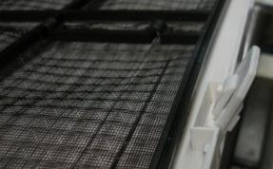
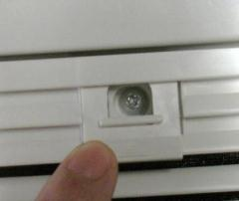
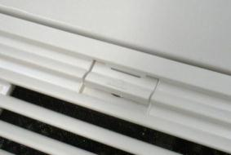
2.New Ceiling-floor
Outstanding Features
2 Style Installation
3D Air Flow
Convenience
Healthy Filter
Easy-to-remove air inlet grille and filter

Slide 29
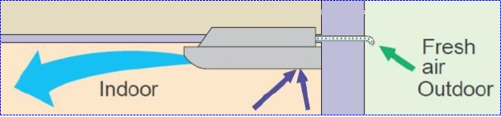
2.New Ceiling-floor
Outstanding Features
2 Style Installation
3D Air Flow
2-way Drainage
Healthy
Fresh air intake
Optional
Fresh air fulfills air quality healthier and more comfortable.
Only provide connection port

Slide 30

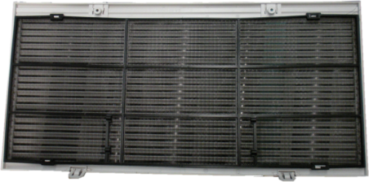




2.New Ceiling-floor
Outstanding Features
2 Style Installation
3D Air Flow
2-way Drainage
Healthy
Healthy filters
Optional
VC Filter
Nano Filter
Bio Filter
Silver Filter
Carbon Filter
Varies of healthy filters can be chosen to fix on the main air filter.

Slide 31

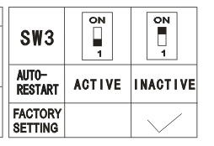
2.New Ceiling-floor
Auto-Restart
Standard
Optional for Inverter model
Dial switch to realize Auto-Restart or cancel
If the air conditioner shuts off unexpectedly due to the power off, it will restart to work under the previous setting mode automatically when the power resumes.

Slide 32
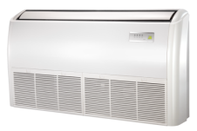
2.New Ceiling-floor
Improvement of communication wire connection
The Past…
P | Q | E
?
?
?
P
Q
E
P
Q
E
P
Q
E
P
Q
E
P
Q
E
P
Q
E
P
Q
E
3 wires must correspond to P, Q and E terminal one by one. You may be confused when the wires are too long .

Slide 33
1. Super Slim Cassette
Improvement of communication wire connection
Now
S1 | S2
S1 | S2
S1
S2
S1
S2
Only two connection wires and without polarity, which can hardly make mistakes.

Slide 34
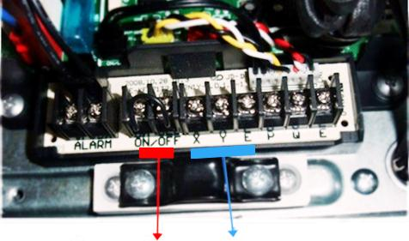
Mid-Static Pressure A5 Duct
Outstanding Features
Optional
Reserved remote on-off and alarm ports
Optional
Remote on-off or central control:
With the reserved ports. a remote switch or a central controller can be easily connected to realize remote control or group control.
Alarm:
The built in PCB can output alarm signal, which achieve setting up an external alarm light or vibration gauge possible.
Alarm ports
Remote on-off ports
Central control ports

Slide 35
2.New Ceiling-floor
Follow me
Optional
With this function, the room temperature sensor built in remote controller is activated and replaces the one in indoor unit. Then the air conditioner will regulate the room temperature based on the temperature around the remote controller, just like the air conditioner is following the user.

Slide 36
2.New Ceiling-floor
Golden fin
High anti-corrosion
Optional
Gorgeous
Prevent bacteria from breeding and spreading
Improve the heating efficiency
Withstand the salty air, rain and other corrosive elements

Slide 37
2.New Ceiling-floor
Other Features
Standard Features
Optional Features
_{Auto Restart}
_{Function}
_{Follow Me}
_{Sleep Mode}
Wire Controller
_{Anti-cold Air} _{Function}
_{Timer}
_{Auxiliary Electric Heater}
Auto Defrosting
Independent Dehumidification

Slide 38
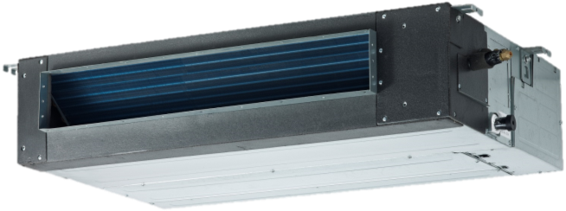
3.Mid-Static Pressure A5 Duct
Overview

Slide 39

3.Mid-Static Pressure A5 Duct
Outstanding Features
Comfort
Convenience
Health
Concealed Installation
Concealed installation, harmonize with indoor decoration.

Slide 40




3.Mid-Static Pressure A5 Duct
Outstanding Features
Comfort
Convenience
Health
Easy Installation
Air intake from rear (Standard)
Air intake from bottom (Optional)
The size of air inlet frame from rear and bottom is same, it’s very easy to move the cover from bottom to rear side, or from rear to the bottom, in order to match the installation condition.

Slide 41


3.Mid-Static Pressure A5 Duct
Outstanding Features
Comfort
Convenience
Health
Easy Maintenance
It is easy to draw out the filter from the indoor unit for cleaning, even the filter is installed in rear side or bottom side.
(Optional for filter)

Slide 42

3.Mid-Static Pressure A5 Duct
Outstanding Features
Comfort
Convenience
Health
Easy Maintenance
Remove the ventilated panel firstly.
Remove a half of blower housing and take out the motor with centrifugal fan.
Directly remove two bolts, and then replace the motor or centrifugal fan easily.
Motor
Blower Housing
Ventilated Panel

Slide 43





3.Mid-Static Pressure A5 Duct
Outstanding Features
Comfort
Convenience
Health
Installation Accessories (optional)
Front Board
Canvas Air Passage
Filter
Midea have canceled this accessories producing, the client need to purchase locally
Panel
Optional accessories are available to meet different needs of the customers.

Slide 44




3.Mid-Static Pressure A5 Duct
Outstanding Features
Comfort
Convenience
Health
Built-in drain pump (optional)
Max. 750mm
Built-in drain pump can lift the water to 750mm upmost.
It’s convenient to install drainage piping under most space condition.

Slide 45
3.Mid-Static Pressure A5 Duct
Outstanding Features
Comfort
Convenience
Health
Reserved remote on-off and alarm ports
Standard
Remote on-off or central control:
With the reserved ports. a remote switch or a central controller can be easily connected to realize remote control or group control.
Alarm:
The built in PCB can output alarm signal, which achieve setting up an external alarm light or vibration gauge possible.
Alarm ports
Remote on-off ports
Central control ports

Slide 46



3.Mid-Static Pressure A5 Duct
Outstanding Features
Comfort
Convenience
Health
Wired Controller (Standard)
Remote Controller (Optional)
There is a display board with a receiver in the E-box. Move out the display, and fix it in other place, even in the distance of 10m. The unit will realized remoter control.
The wired controller and the display board can display the error code or production code when the chips detect some failure.

Slide 47



3.Mid-Static Pressure A5 Duct
Outstanding Features
Comfort
Convenience
Health
Twins Function (Available for Inverter Multi models)
 | Outdoor Unit | Indoor Units
Twin System | 36K | 18K + 18K
 | 48K | 24K + 24K
 | 60K | 30K + 30K
The twin system connects two indoor units of the same type and capacity to one outdoor unit in order to ensure more air distribution in a large zone. The controller can only control the master unit. The slave unit will work in the same state as the master unit.

Slide 48



3.Mid-Static Pressure A5 Duct
Outstanding Features
Comfort
Convenience
Health
Fresh Air (optional)
ventilation motor connector
Install one duct from the reserved fresh-air intake to outdoor.
Continually inhale the fresh air to improve the quality of the indoor air, fulfills air quality more healthy and comfortable.
A ventilation motor (provided by the installer) can be installed inside the fresh air duct to improve the fresh air volume. There are reserved ports for this motor on main PCB (Standard for 3D inverter units, and only optional for DC inverter 53~160 units).

Slide 49
3.Mid-Static Pressure A5 Duct
Auto-Restart
Standard
Optional for Inverter model
Dial switch to realize Auto-Restart or cancel
If the air conditioner shuts off unexpectedly due to the power off, it will restart to work under the previous setting mode automatically when the power resumes.

Slide 50
3.Mid-Static Pressure A5 Duct
Follow me
Optional
With this function, the room temperature sensor built in remote controller is activated and replaces the one in indoor unit. Then the air conditioner will regulate the room temperature based on the temperature around the remote controller, just like the air conditioner is following the user.

Slide 51
3.Mid-Static Pressure A5 Duct
Golden fin
High anti-corrosion
Optional
Gorgeous
Prevent bacteria from breeding and spreading
Improve the heating efficiency
Withstand the salty air, rain and other corrosive elements

Slide 52

Improvement of communication wire connection
The Past…
P | Q | E
?
?
?
P
Q
E
P
Q
E
P
Q
E
P
Q
E
P
Q
E
P
Q
E
P
Q
E
3 wires must correspond to P, Q and E terminal one by one. You may be confused when the wires are too long .

Slide 53

Improvement of communication wire connection
Now
S1 | S2
S1 | S2
S1
S2
S1
S2
Only two connection wires and without polarity, which can hardly make mistakes.

Slide 54

3.Mid-Static Pressure A5 Duct
Other Features
Standard Features
Optional Features
_{Auto Restart}
_{Function}
_{Follow Me}
_{Auxiliary Electric Heater}
_{Sleep Mode}
_{Anti-cold Air} _{Function}
_{Timer}
Auto Defrosting
Independent Dehumidification
Wired Controller

Slide 55

4. Optional wire controller
Wire controller is optional for Cassette / Ceiling& Floor / Duct unit
KJR-90A：
KJR-90C：
90C model has infrared receiver, it’s OK to use remote controller to adjust the unit toward the wire controller, no need to turn towards the indoor unit display

Slide 56

4. Optional wire controller
KJR-12B：
Have “Follow me” function, can show the indoor room temperature

Slide 57


4. Optional wire controller
KJR-120：
Timer Weekly Function:
Set what data you want from Mon. to Sun.

Slide 58

5. Floor-standing—GA Series
Simple and bright panel
Adopts simple and bright style panel, GA series are suitable for most different space, and show in good taste.

Slide 59




5. Floor-standing—GA Series
Different optional panels
GA : standard
GA1:
Black LED display (optional)
GA2:
Green LED display (optional)

Slide 60

5. Floor-standing—GA Series
Sleep Mode
Standard
The function enables the air conditioner to automatically increase cooling or decrease heating 1℃ per hour for the first two hours, then holds steady for the next 5 hours, after that it will switch off. This function maintains both energy saving and comfort in night.

Slide 61

5. Floor-standing—GA Series
Self-diagnosis and Auto-protection
Standard
Once abnormal operation or parts failure happen, the unit will shut off automatically to protect the system. Meanwhile it will indicate protection or error code for fast servicing.

Slide 62

5. Floor-standing—GA Series
  Auto-Restart (Standard)
Standard
If the air conditioner breaks off unexpectedly due to the power cut, it will restart with the previous function setting automatically when the power resumes.

Slide 63
5. Floor-standing—GA Series
Golden fin
High anti-corrosion
Optional
Gorgeous
Prevent bacteria from breeding and spreading
Improve the heating efficiency
Withstand the salty air, rain and other corrosive elements

Slide 64

5. Floor-standing—GA Series
Silver Ion Filter (optional)
Sterilize bacteria effectively by decomposing cell wall of bacteria

Slide 65

5. Floor-standing—GA Series
Improvement of communication wire connection
The Past…
For Inverter model
P | Q | E
?
?
?
P
Q
E
P
Q
E
P
Q
E
P
Q
E
P
Q
E
P
Q
E
P
Q
E
3 wires must correspond to P, Q and E terminal one by one. You may be confused when the wires are too long .

Slide 66
5. Floor-standing—GA Series
Improvement of communication wire connection
Now
For Inverter model
S1 | S2
S1 | S2
S1
S2
S1
S2
Only two connection wires and without polarity, which can hardly make mistakes.

Slide 67


