Slide 1
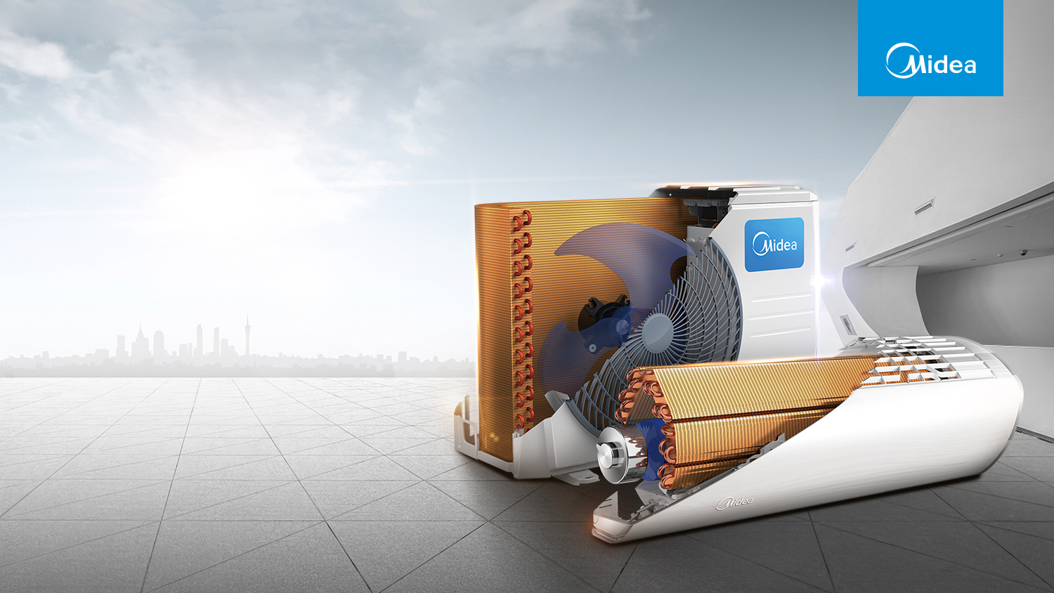
Golden Fin
Nov 8, 2017

Slide 2
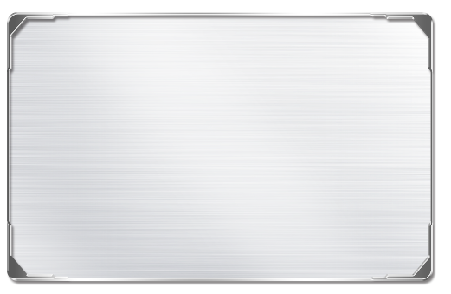
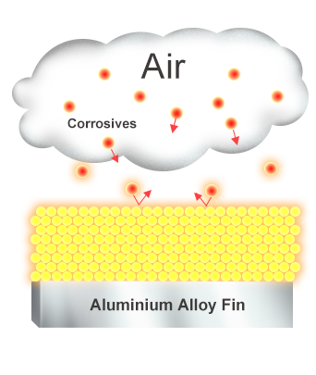
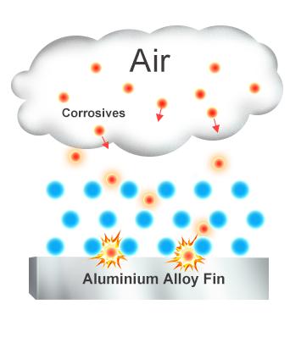
Better anti-corrosion ability
Golden
Blue
The unique anti-corrosive golden coating on the condenser can withstand the salty air, rain and other corrosive elements.
Notes:
表层更加致密，所以耐腐蚀性会更好。

Slide 3
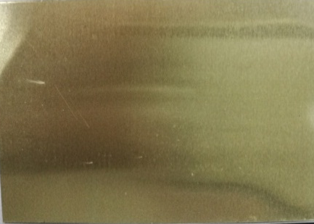
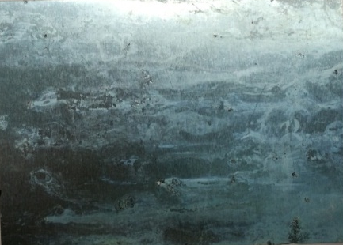
Salt spray test
Golden
Blue
Salt spray test 500h, the same as the product has been used for 5 years, golden fin has no obvious corrosion marks.
Notes:
500个小时的盐雾测试后，金色铝箔几乎看不到腐蚀痕迹。中性盐雾试验按GB/T 1771的规定进行

Slide 4
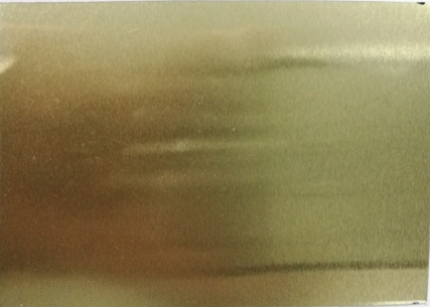
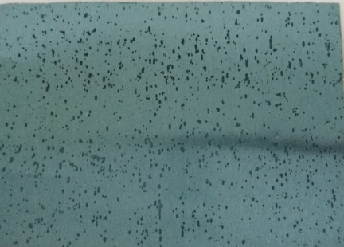
Golden Fin
Golden
Blue
The acid test for 30 minutes, simulated the product is been used in acid rain, golden fin had no obvious corrosion marks.
Notes:
30分钟的酸性物质腐蚀，金色铝箔的被腐蚀情况远好于蓝色。耐酸性试验按YS/T 95.2进行

Slide 5
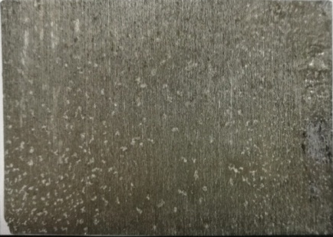
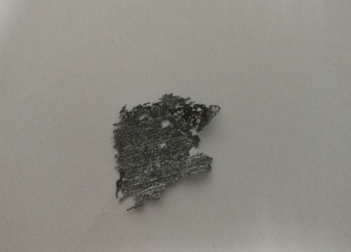
Salt spray test
1、1000h salty environment test(about 10years of normal environment),safety grade≥9.5，no holes caused
2、30 min acid resistance test of 30min(about 10000 times of acid rain condition)：corrosion area≤0.5%
 | Grey fin(cooling only condenser) | Blue fin | New golden fin
Neutral salty environment 1000h
Acid resistance30min
Note：
1.Neutral salty environment test according to GB/T 1771
2. Acid resistance test according to YS/T 95.2

Slide 6

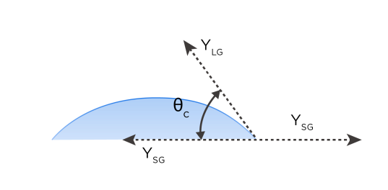
Better hydrophilic ability
The golden fin has a smaller contact angle than blue, so the water is easier to flow, we can get the higher heat exchange efficiency.
Φc
50
Blue
40
30
Golden
20
10
0
Time
1000
2000
3000
Notes:
金色的亲水角更小，所以水更容易滑落，对风的阻力更小。图为干湿循环测试后的角度对比图。

Slide 7
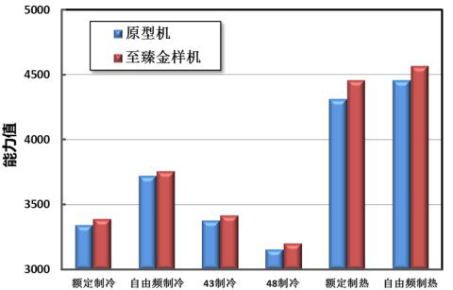
Performance test comparison
Unit with blue fin
Unit with new golden fin
capacity
Rated cooling
Random frequency cooling
43 C cooling
48 C cooling
Rated heating
Random frequency heating

