Slide 1

light commercial
KLG-IF100-4F3M410

Slide 2

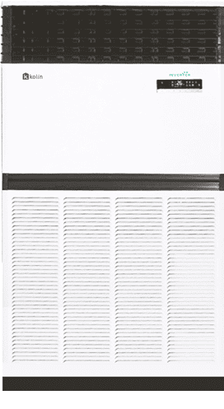
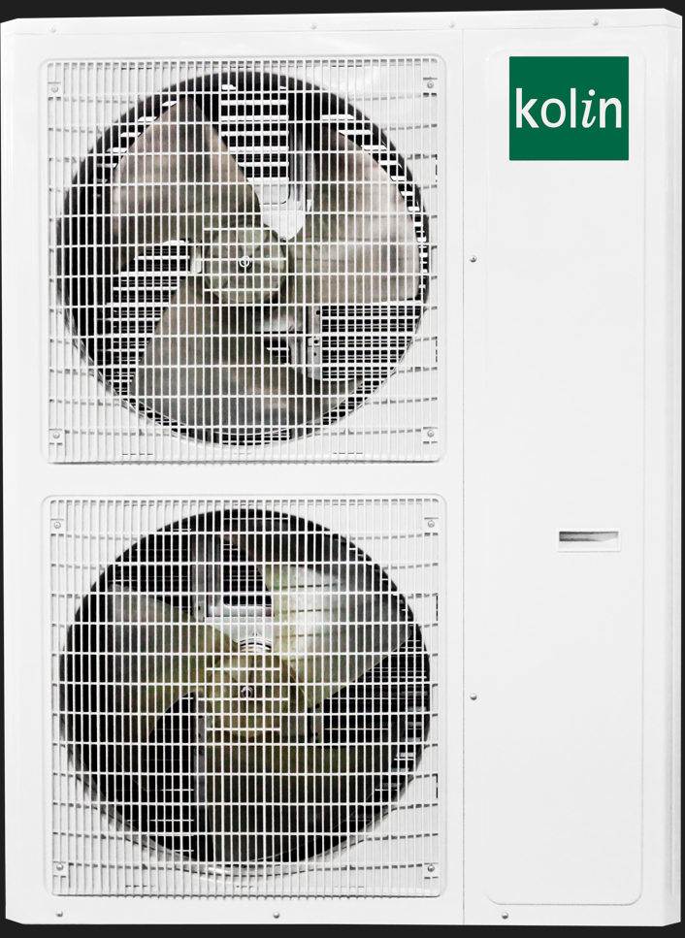
K
Kolin
LG
Light Commerical
I
Inverter
F
Floor Mounted
100
Nominal Capacity (10HP)
4F
Generational Model
3
3 Phase
M
Side Discharge
410
Refrigerant

Slide 3
Model | KLG-IF100-4F3M410
Nominal Capacity | 10 hp / 7.5 TR
Cooling Capacity | 100,800 kJ/hr
Power Supply | 3 Ph / 230 V / 60 Hz
Rated Current | 44.6 A
Rated Power | 15,400 W
CSPF Rating
Star Rating
Refrigerant (Type/Charge) | R410a / 8,000 g
INDOOR UNIT
Area (Unloaded Space) | 173 m2
Airflow | 4,000 m3/h (High)
Sound Level (SH/Hi/Mi/Lo) | 63 dB(A) High
Unit Dimension (WxDxH) | 1200x400x1850 mm
Packaging Dimension (WxDxH) | 1363x513x2013 mm
Unit Weight (Net/Gross) | 133/145 kg
OUTDOOR UNIT
Unit Dimension | 940x460x1615 mm
Packaging Dimension | 1033x573x1765 mm
Unit Weight(Net/Gross) | 152/166 kg
Copper Tube Size
High Side/ Low Side | 3/8'' / 7/8''
Maximum Pipe Distance Indoor and Outdoor
Height/Length/Circuit Breaker | 30m / 70m / 3Ph / 100A

Slide 4

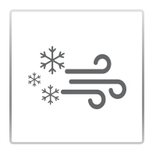


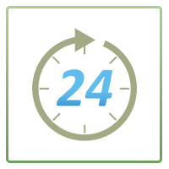


Inverter Technology - Inverter technology ensures efficient cooling and comfort while saving on energy consumption!
Quick Cooling - As long as the air conditioner’s size is correct, the room is well-insulated, and the setting temperature is set at a comfort cooling setting of 23 – 25 ˚C, quick cooling is achievable.
LED Display - LED Display feature shows you the mode of the setting of your air conditioner through safe and pleasant LED light.
Sleep Mode - Upon activating the Sleep Mode feature, the room temperature will rise to 1 degree Celsius every 1 hour after setting the temperature. After 2 hours of the cooling process, the room temperature will now stabilize for 8 hours preventing you from over-cooled temperature, making your sleep at night be peaceful and uninterrupted.
Timer On/ Timer OFF
Self Diagnostic Error feature - will scan your air conditioner to detect any minor or major errors that your air conditioner currently experiencing.
X-Fan Function - after closing down the unit under cooling the air conditioner will automatically dry the water of evaporator of indoor unit to prevent breeding of bacteria and mildew.
Features

Slide 5
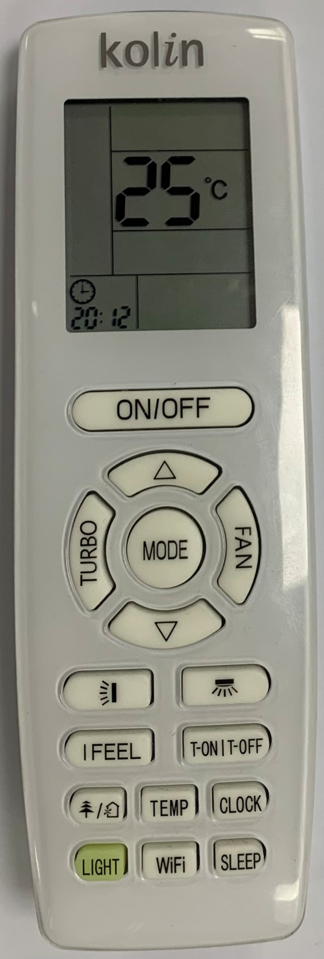
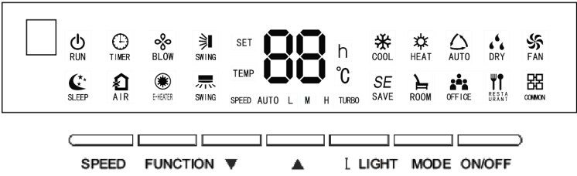
Remote and Display Panel

Slide 6
warranty
One (1) Year Parts and Labor
(3) Years Compressor (Inverter)

Slide 7
THANK YOU!

