Slide 1
All Home
OFFICE DAY
August 13, 2024, Tuesday

Slide 2
HOUSE RULES
•Maintain Safety Protocols.
•Switch phones to silent mode.
•Avoid side conversations; listen when someone is talking.
•Share your ideas; raise your hand when you want to talk.
•Remember and apply all learnings.
•Clean as you go.

Slide 3
AGENDA
Time Keeping
Sales Performance
- Daily Sales Report
- Last Month Sales Report
- Sales Target for the month
Promotions
Sellout Support
New Items

Slide 4
01
Time Keeping

Slide 5
DTR Submission
Unauthorized Absences
Filing of Leaves (deadlines)

Slide 6
02
Sales Performance

Slide 7
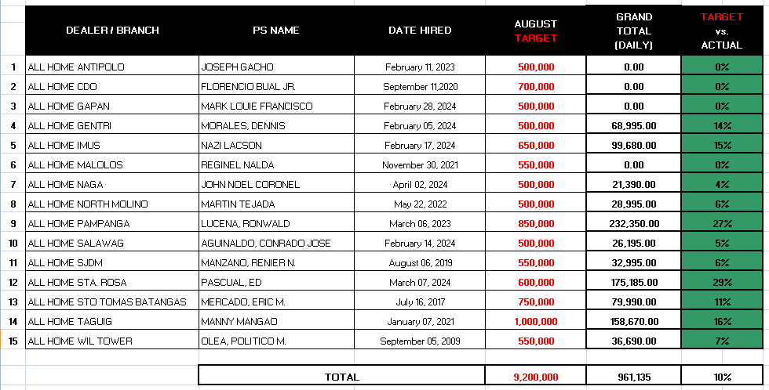
Daily Sales Report As Of (August 5, 2024)

Slide 8
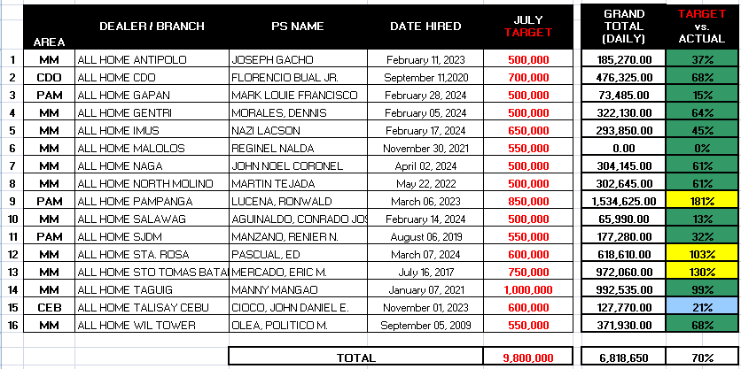
JULY 2024 Sell-out

Slide 9
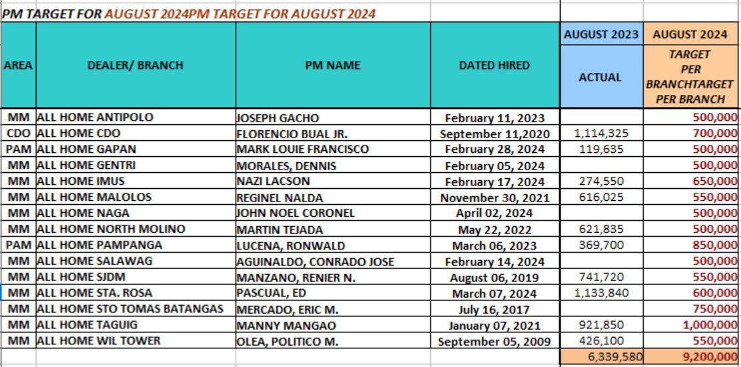
Sales Target For The Month

Slide 10
SALES STRATEGIES TO REACH TARGET
Stock Availability
Highlight Promotion
Product Knowledge
Improve Selling Techniques

Slide 11
05
Questions & Concerns

