Slide 1
All Home
OFFICE DAY
January 23, 2025, Thursday

Slide 2
HOUSE RULES
•Maintain Safety Protocols.
•Switch phones to silent mode.
•Avoid side conversations; listen when someone is talking.
•Share your ideas; raise your hand when you want to talk.
•Remember and apply all learnings.
•Clean as you go.

Slide 3
AGENDA
Time Keeping
Sales Performance
- Daily Sales Report
- Last Month Sales Report
- Sales Target for the month
Promotions
Sellout Support
Comprehensive Pricelist

Slide 4
01
Time Keeping

Slide 5
DTR Submission
Unauthorized Absences
Filing of Leaves (deadlines)

Slide 6
02
Sales Performance

Slide 7
Daily Sales Report As Of (January 22, 2025)
AS of JANUARY 22, 2025
BRANCH | SALES | TARGET | % TO TARGET
ALL HOME ANTIPOLO | 241,550.00 | 600,000.00 | 40%
ALL HOME CDO | 397,530.00 | 900,000.00 | 44%
ALL HOME MALOLOS | 144,280.00 | 550,000.00 | 26%
ALL HOME NORTH MOLINO | 167,670.00 | 600,000.00 | 28%
ALL HOME PAMPANGA | 458,125.00 | 900,000.00 | 51%
ALL HOME SJDM | 106,185.00 | 600,000.00 | 18%
ALL HOME STO TOMAS BATANGAS | 351,540.00 | 750,000.00 | 47%
ALL HOME TAGUIG | 701,285.00 | 900,000.00 | 78%
ALL HOME WIL TOWER | 107,180.00 | 650,000.00 | 16%
ALL HOME NAGA | 305,555.00 | 600,000.00 | 51%
ALL HOME STA. ROSA | 245,355.00 | 800,000.00 | 31%
 | 3,226,255.00 | 7,850,000.00 | 41%

Slide 8
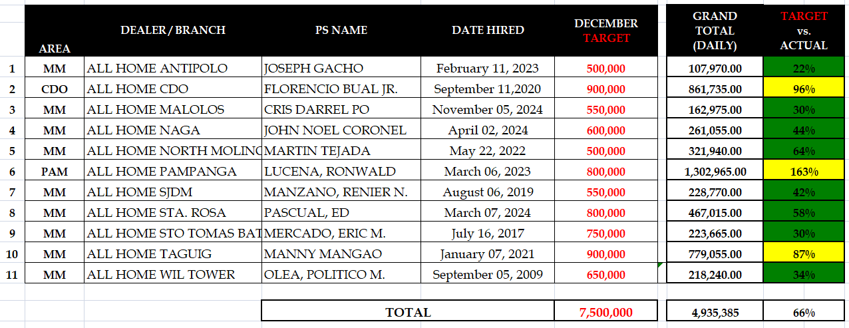
December 2024 Sell-out

Slide 9
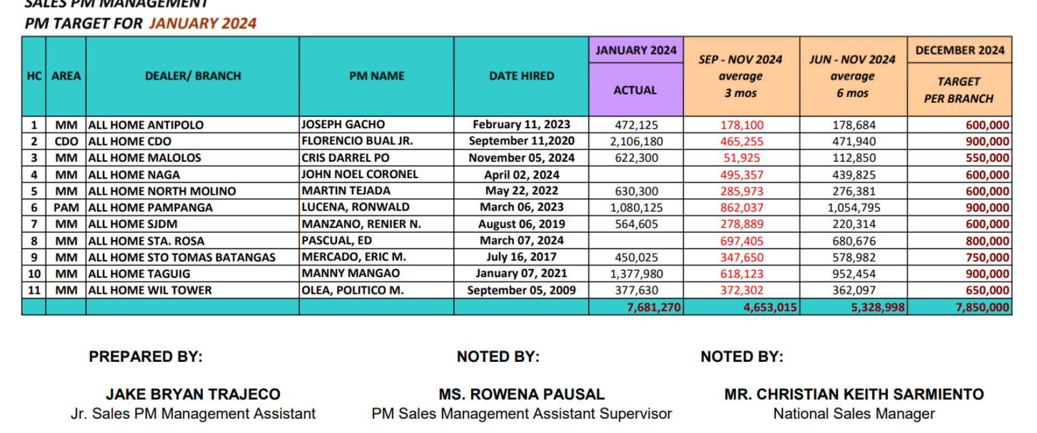
Sales Target For The Month

Slide 10
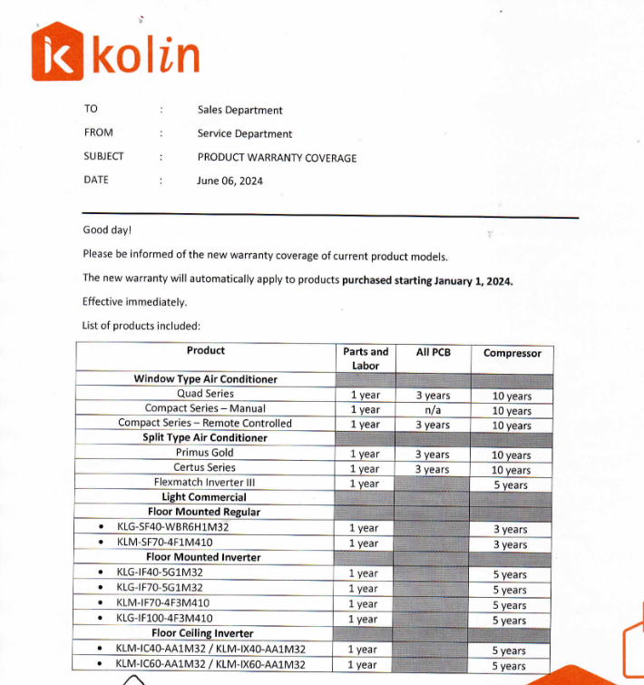
NEW WARRANTY

Slide 11
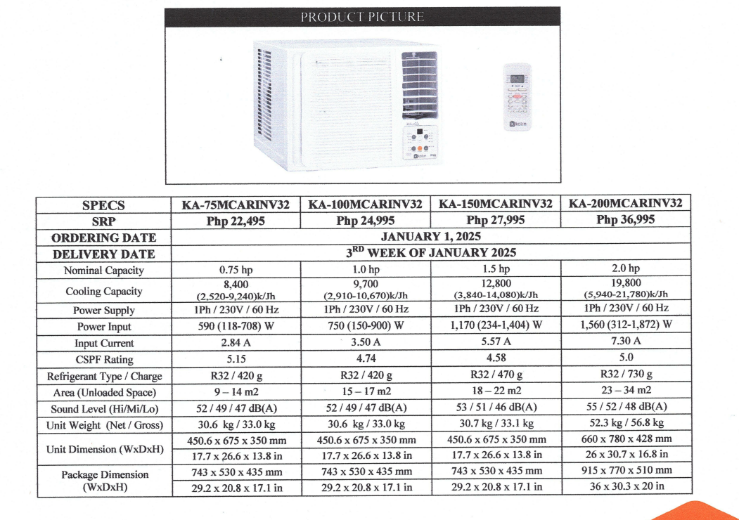
NEW MODEL

Slide 12
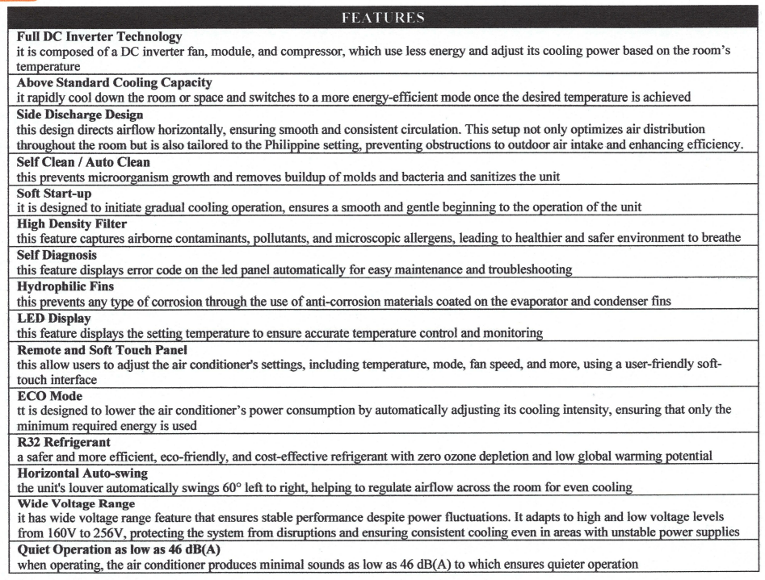
NEW ITEMS

Slide 13
05
Questions & Concerns

