Slide 1
ABENSON
OFFICE DAY
March 13,2023

Slide 2
HOUSE RULES
•Maintain Safety Protocols
•Switch phones to silent mode
•Avoid side conversations; listen when someone is talking
•Share your ideas; raise your hand when you want to talk
•Remember and apply all learnings
•Clean as you go

Slide 3
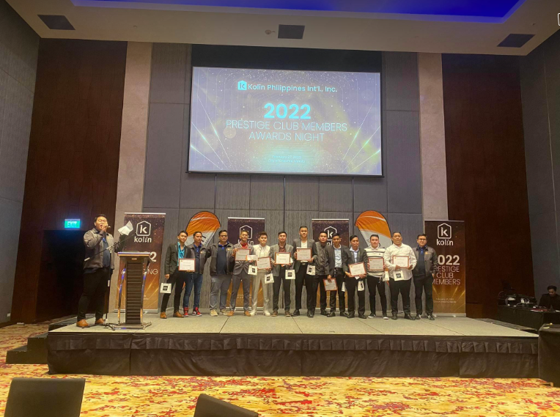

Slide 4
AGENDA
01
02
03
04
05
06
Sales Upate
Sales Target
March
Running Sales
Group Planning & Feedback
Other Concern/ Questions
Sales Strategies

Slide 5
01
Sales Update

Slide 6
FEBRUARY FINAL

Slide 7
TARGET
39,785,737
VS
ACTUAL
38,007,165

Slide 8
02
Sales Target
March

Slide 9
MARCH TARGET
60,448,387
MARCH 1-8
11,453,595

Slide 10
03
Running Sales

Slide 11
MARCH RUNNING SALES

Slide 12
04
STRATEGIES

Slide 13
SALES STRATEGIES TO REACH TARGET
Stock Availability
Highlight Promotion
Product Knowledge
Improve Selling Techniques

Slide 14
https://youtu.be/h5cZybM2iP4

Slide 15
SALES APPROACH
Ask
Listen
Create Sense of Urgency
Match product to customer’s need

Slide 16
05
Group Planning & Feedback

Slide 17
06
Other Concern/ Questions

Slide 18


