Slide 1
Binondo Group
OFFICE DAY
March 12, 2025, Wednesday

Slide 2
HOUSE RULES
•Maintain Safety Protocols.
•Switch phones to silent mode.
•Avoid side conversations; listen when someone is talking.
•Share your ideas; raise your hand when you want to talk.
•Remember and apply all learnings.
•Clean as you go.

Slide 3
AGENDA
Time Keeping
Sales Performance
- Daily Sales Report
- Last Month Sales Report
- Sales Target for the month
Promotions
Sellout Support
Comprehensive Pricelist

Slide 4
01
Time Keeping

Slide 5
DTR Submission
Unauthorized Absences
Filing of Leaves (deadlines)

Slide 6
02
Sales Performance

Slide 7
Daily Sales Report As Of (MAR 10, 2025)
MARCH 2025
BRANCH | ACTUAL | TARGET | %
AMBASSADOR GLORIETTA | 48,695.00 | 600,000.00 | 8%
FAIR N SQUARE BINONDO | 2,527,390.00 | 6,000,000.00 | 42%
FAIR N SQUARE CALOOCAN | 699,795.00 | 4,000,000.00 | 17%
FAIR N SQUARE BALIWAG | 0.00 | 0.00 | 0%
J&R CALOOCAN | 14,595.00 | 600,000.00 | 2%
J&R BINONDO | 0.00 | 2,300,000.00 | 0%
J&R IMUS | 288,760.00 | 600,000.00 | 48%
POWERAIRE ALABANG | 220,165.00 | 1,300,000.00 | 17%
POWERAIRE BINONDO | 533,610.00 | 1,750,000.00 | 30%
POWERAIRE ORTIGAS | 0.00 | 2,000,000.00 | 0%
POWERAIRE GREENHILLS | 883,505.00 | 750,000.00 | 118%
WELCOME HOME BINONDO | 3,296,785.00 | 6,700,000.00 | 49%
WELCOME HOME GREENHILLS | 2,314,220.00 | 8,800,000.00 | 26%
TOTAL | 10,827,520.00 | 35,400,000.00 | 31%

Slide 8
February 2025 Sell-out
FEBRUARY 2025
BRANCH | ACTUAL | TARGET | %
AMBASSADOR GLORIETTA | 196,465 | 600,000 | 33%
FAIR N SQUARE BINONDO | 8,302,035 | 5,950,000 | 140%
FAIR N SQUARE CALOOCAN | 3,307,175 | 4,000,000 | 83%
FAIR N SQUARE BALIWAG | 0 | 0 | 0%
J&R BINONDO | 497,595 | 2,200,000 | 23%
J&R CALOOCAN | 55,385 | 550,000 | 10%
J&R IMUS | 57,490 | 550,000 | 10%
POWERAIRE ALABANG | 1,038,650 | 1,300,000 | 80%
POWERAIRE BINONDO | 2,942,270 | 1,650,000 | 178%
POWERAIRE ORTIGAS | 2,065,790 | 2,000,000 | 103%
POWERAIRE GREENHILLS | 757,720 | 750,000 | 101%
WELCOME HOME BINONDO | 10,047,135 | 6,500,000 | 155%
WELCOME HOME GREENHILLS | 9,530,990 | 8,600,000 | 111%
TOTAL | 38,798,700.00 | 34,650,000.00 | 112%

Slide 9
Sales Target For The Month
SALES TARGET FOR MARCH 2025
BRANCH | TARGET
AMBASSADOR GLORIETTA | 600,000.00
FAIR N SQUARE BINONDO | 6,000,000.00
FAIR N SQUARE CALOOCAN | 4,000,000.00
FAIR N SQUARE BALIWAG | 0.00
J&R CALOOCAN | 600,000.00
J&R BINONDO | 2,300,000.00
J&R IMUS | 600,000.00
POWERAIRE ALABANG | 1,300,000.00
POWERAIRE BINONDO | 1,750,000.00
POWERAIRE ORTIGAS | 2,000,000.00
POWERAIRE GREENHILLS | 750,000.00
WELCOME HOME BINONDO | 6,700,000.00
WELCOME HOME GREENHILLS | 8,800,000.00
TOTAL | 35,400,000.00

Slide 10
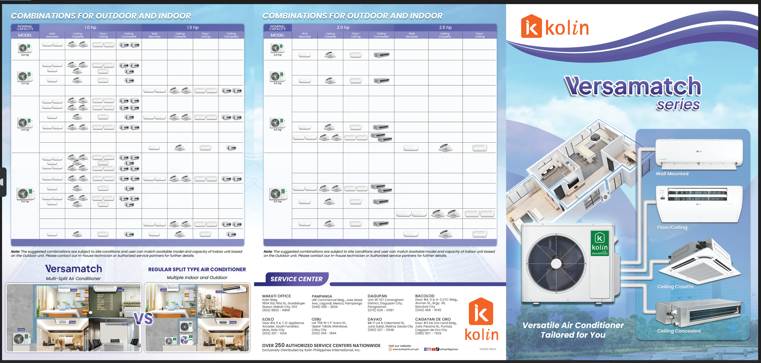
BROCHURES

Slide 11
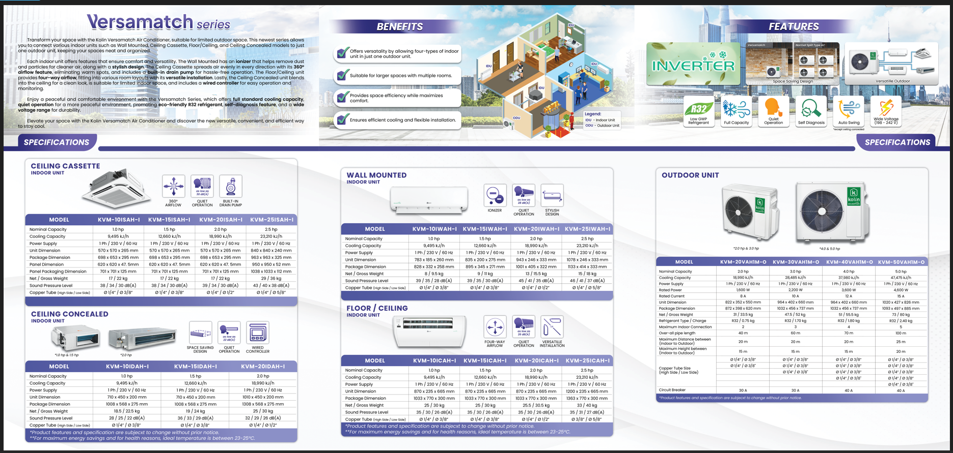
BROCHURES

Slide 12


BROCHURES

Slide 13
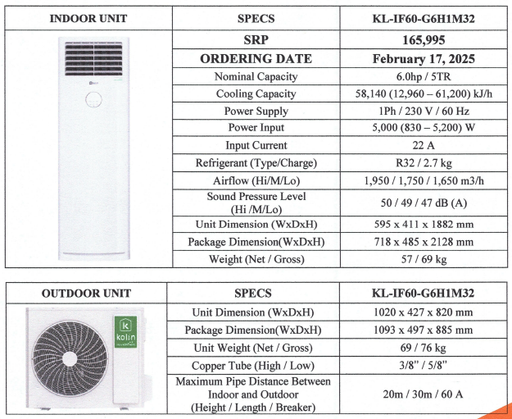
NEW MODEL

Slide 14
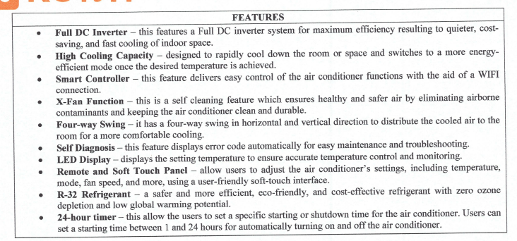
NEW ITEMS

Slide 15
05
Questions & Concerns

