Slide 1

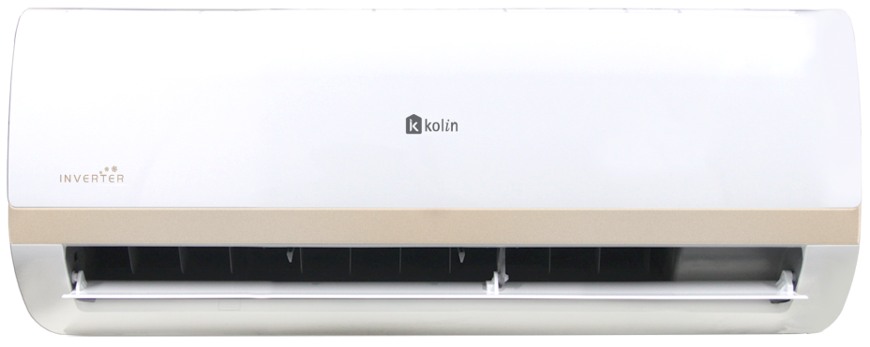
KSM-IW#-WCT10M1M32
Notes:
As the world advances, so does technology. Our lives are becoming smarter, more energy-efficient, and tailored to our needs. In this era of smart homes and green initiatives, it's imperative that our air conditioning systems keep up. By doing so, we ensure comfort, savings, and reduced environmental impact.

Slide 2

Agenda
Introduce the new split type inverter.
New split type, product highlight
1
3
New split type VS existing split type
2
INSERT LOGO HERE

Slide 3

Certus
KSM-IW#-WCT10M1M32
- Higher Cooling Capacity
- Higher CSPF Rating

Slide 4
What does Certus means?
- Certain or Sure
Certus" is a Latin word that means "certain" or "sure." It is often used to convey the idea of being confident or definite about something.
INSERT LOGO HERE

Slide 5
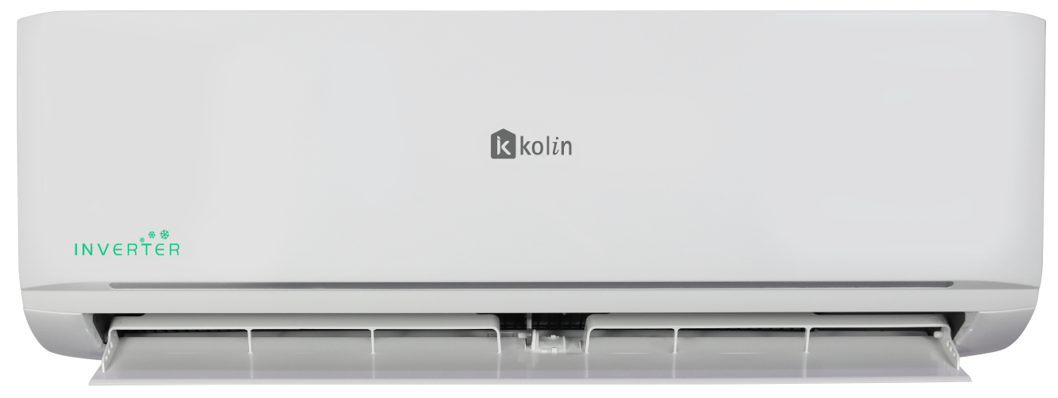
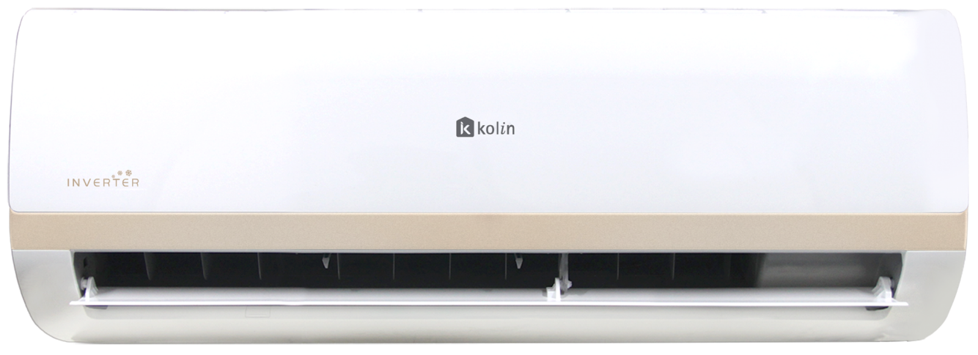
APTUS
CERTUS
INSERT LOGO HERE

Slide 6
 | CERTUS | APTUS
Nominal Capacity | 1 hp | 1 hp
Cooling Capacity | 9,800 kJ/hr | 9,495 kJ/hr
Power Input | 740 W | 699 W
Input Current (Cooling) | 5.20 A | 3.04 A
Rated Power | 1,900W/ 13A | 1,190W/ 7A
CSPF | 5.24 | 4.18
Sound Pressure Level Indoor | 39 dBA (High) | 36/34/32 dBA
Sound Pressure Level Outdoor | 53.5 dBA (High) | 53.5 dBA
Net Weight Indoor | 7.2 kg | 8.2 kg
Net Weight Outdoor | 18.8 kg | 21.5 kg
Unit Dimension Indoor (WxDxH) | 715 x 194 x 285 mm | 726 x 270 x 495 mm
Unit Dimension Outdoor (WxDxH) | 720 x 270 x 495 mm | 720 x 270 x 495 mm
Refrigerant/Charge | R32/ 0.35kg | R32/ 0.38kg
INSERT LOGO HERE

Slide 7
 | CERTUS | APTUS
Nominal Capacity | 1.5 hp | 1.5 hp
Cooling Capacity | 12,660 kJ/hr | 12,660 kJ/hr
Power Input | 1,150 W | 1,034 W
Input Current (Cooling) | 7.15 A | 4.6 A
Rated Power | 2,200W/ 11A | 1,750W/ 7.5 A
CSPF | 5.17 | 4.34
Sound Pressure Level Indoor | 40.5 dBA (High) | 43/37/32 dBA
Sound Pressure Level Outdoor | 54 dBA (High) | 53.5
Net Weight Indoor | 7.7 kg | 9 kg
Net Weight Outdoor | 19.9 kg | 24 kg
Unit Dimension Indoor (WxDxH) | 805 x 194 x 285 mm | 835x208x295 mm
Unit Dimension Outdoor (WxDxH) | 720 x 270 x 495 mm | 720 x 270 x 495 mm
Refrigerant/Charge | R32/0.40kg | R32/0.44kg
INSERT LOGO HERE

Slide 8
 | CERTUS | APTUS
Nominal Capacity | 2hp | 2hp
Cooling Capacity | 18,990 kJ/hr | 18,990 kJ/hr
Power Input | 1,789 W | 1,637 W
Input Current (Cooling) | 8.04 A | 7.64 A
Rated Power | 2,950 W/ 13.5A | 3,168 W/ 14.5A
CSPF | 5.09 | 4.39
Sound Pressure Level Indoor | 44.5 dBA (High) | 43/37/33
Sound Pressure Level Outdoor | 54 dBA (High) | 56 dBA
Net Weight Indoor | 10.4 kg | 11.7 kg
Net Weight Outdoor | 24.4 kg | 26.4 kg
Unit Dimension Indoor (WxDxH) | 957 x 213 x 302 mm | 969 x 241 x 320mm
Unit Dimension Outdoor (WxDxH) | 765 x 303 x 555 mm | 765 x 303 x 555mm
Refrigerant/Charge | R32/ 0.6kg | R32/ 0.65kg
INSERT LOGO HERE

Slide 9
 | CERTUS | APTUS
Nominal Capacity | 2.5 hp | 2.5 hp
Cooling Capacity | 23,210 kJ/hr | 23,210 kJ/hr
Power Input | 2,185 W | 2.015 W
Input Current (Cooling) | 9.50 A | 8.8 A
Rated Power | 3,000 W/ 14.5A | 2,840 W/ 13 A
CSPF | 4.59 | 5
Sound Pressure Level Indoor | 47 dBA (High) | 48/43/40 dB(A)
Sound Pressure Level Outdoor | 57 dBA (High) | 55.5 dB (A)
Net Weight Indoor | 13 kg | 14.1 kg
Net Weight Outdoor | 29 kg | 32.4 kg
Unit Dimension Indoor (WxDxH) | 1040 X 220 X 327 mm | 1083x244x336 mm
Unit Dimension Outdoor (WxDxH) | 805 x 330 x 554 mm | 805x330x554 mm
Refrigerant/Charge | R32/0.78 kg | R32/0.83 kg
INSERT LOGO HERE

Slide 10
PRODUCT HIGHLIGHT
Certus
- Higher CSPF than previous model.
- Aesthetic Design (Rose Gold Strip).
Quite Operation (Low Decibels).
Equipped with smart controller (Works with Alexa and Google Home).

Slide 11
Kolin
K
SM
Split Type
Inverter
I
W
Wall mounted
#
Nominal Capacity
CT
Certus
10M
Generational Model
1
Single Phase
M
Side Discharge
32
Refrigerant

Slide 12
Model | KSM-IW10-WCT10M1M32 | KSM-IW15-WCT10M1M32 | KSM-IW20-WCT10M1M32 | KSM-IW25-WCT10M1M32
Indoor
Nominal Capacity | 1.0 hp | 1.5 hp | 2.0 hp | 2.5 hp
Cooling Capacity | 9,800 (2,940-10,780) kJ/h | 12,660 (3,798 - 13,926) kJ/h | 18,990 (5,697 - 20,889) kJ/h | 23,210 (6,963 - 25,531) kJ/h
Power Supply | 1Ph/230V/60Hz | 1Ph/230V/60Hz | 1Ph/230V/60Hz | 1Ph/230V/60Hz
Input Current | 5.20 A | 7.15 A | 8.04 A | 9.50 A
Power Input | 740 (148 - 888) W | 1,050 (210 - 1260) W | 1,650 (330 - 1980) W | 2,045 (409 - 2454) W
CSPF Rating | 5.24 | 5.17 | 5.09 | 4.59
Star Rating | 5 Star | 5 Star | 5 Star | 5 Star
Area (Unloaded Space) | 17 m2 | 18 - 22 m2 | 23 - 32 m2 | 33 - 40 m2
Package Dimension (WxDxH) | 780x270x360 mm | 870x270x360 mm | 1035x295x380 mm | 1120x405x310 mm
Gross Weight | 9.3 kg | 9.8 kg | 13.2 kg | 16.5 kg
Unit Dimension (WxDxH) | 715x194x285 mm | 805x194x285 mm | 957x213x302 mm | 1040x220x327 mm
Net Weight | 7.2 kg | 7.7 kg | 10.4 kg | 13 kg
Indoor Airflow (Hi/Mi/Lo) | 486/390/280 m3/h | 580/450/310 m3/h | 800/660/500 m3/h | 960/750/600 m3/h
Indoor Sound Pressure (Hi/Mi/Lo) | 39/33/27 dB(A) | 40.5/34/26.5 dB(A) | 44.5/38.5/31 dB(A) | 47/41/37 dB(A)
Outdoor Unit
Package Dimension (WxDxH) | 835x300x540 mm | 835x300x540 mm | 887x337x610 mm | 915x370x615 mm
GrossWeight | 20.7 kg | 21.8 kg | 26.7 kg | 31.5 kg
Unit Dimension (WxDxH) | 720x270x495 mm | 720x270x495 mm | 765x303x555 mm | 805x330x554 mm
Unit Weight | 18.8 kg | 19.9 kg | 24.4 kg | 29 kg
Refrigerant Type | R32 | R32 | R32 | R32
Refrigerant Charge | 350 g | 400 g | 600 g | 780 g
Outdoor Sound Pressure Level | 53.5 dBA (High) | 54 dBA (High) | 54 dBA (High) | 57 dBA (High)

Slide 13
Model | KSM-IW10-WCT10M1M32 | KSM-IW15-WCT10M1M32 | KSM-IW20-WCT10M1M32 | KSM-IW25-WCT10M1M32
Nominal Capacity | 1.0 hp | 1.5 hp | 2.0 hp | 2.5 hp
Copper Tube Size
High Side / Low Side | ø 1/4'' / ø 3/8'' | ø 1/4'' / ø 1/2'' | ø 1/4'' / ø1/2'' | ø 1/4'' / ø1/2''
Maximum Pipe Distance Between Indoor and Outdoor
Height | 10 m | 10 m | 10 m | 10 m
Length | 20 m | 20 m | 25 m | 25 m
Circuit Breaker | 20 A | 20 A | 30 A | 30 A

Slide 14
Certus vs other brands
 | Kolin | Brand 1 | Brand 2 | Brand 3
Series | Certus | - | - | -
Model | KSM-IW10-WCT10M1M32 | TAC-09CSA/KEI | FTKF20AVL | AR09TYHYEWKNTC
Nominal Capacity | 1hp | 1hp | 1hp | 1hp
Motor Technology | Inverter | Inverter | Inverter | Inverter
Cooling Capacity | 9,800 kJ/ h (2,940 - 10, 780) | 8,604 kJ/ h (2,880-10,800) | 7,174 kJ/ h (3,587-8,651) | 9,917 kJ/ h (4,650 - 11,400)
Rated Power | 740 W (148 - 888) | 785(220~1,300) W | 650 W (200 - 920) | 915 W
CSPF | 5.24 | N/A | 4.6 | 4.24
Star Rating | 5 | N/A | 5 | 5

Slide 15
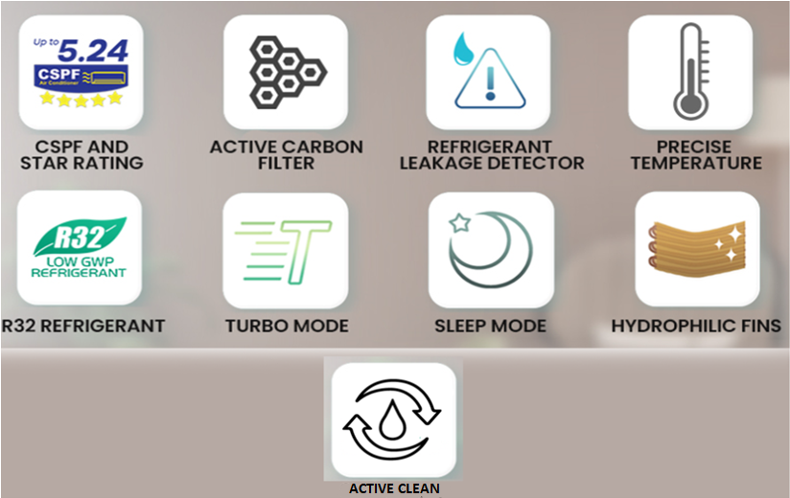
FEATURES
Notes:
Higher CSPF means greater Cooling Seasonal Performance Factor, indicating superior energy efficiency and cost savings in cooling operations.
Active carbon filter: A specialized air filter that employs activated carbon to effectively capture and remove odors, pollutants, and impurities from the air.
System diagnostic: An automated process that assesses the health and functionality of a system, identifying and reporting any potential issues or irregularities for efficient troubleshooting.
Precise temperature: Accurate and exact control of the desired temperature, ensuring optimal comfort and energy efficiency.
R32 and R410A serve as refrigerants for air conditioning systems. They are both eco-friendly with a zero ozone depletion potential. However, there are distinctions between these two refrigerants.
R410A is a compound comprising pentafluoroethane and difluoromethane. It is employed as a refrigerant in ACs and heat pump systems. As a part of the hydrofluorocarbon (HFC) refrigerant class, it's composed of equal parts R125 and R321. R410A was introduced as a replacement for R22, which was banned due to its contribution to greenhouse gases.
Conversely, R32 is an organic compound categorized as a halogenoalkane1. It finds predominant use in endothermic processes like air conditioning and refrigeration. Notably, R32 boasts a lower global warming potential (GWP) in comparison to R410A, rendering it more environmentally friendly.
Regarding performance, R32 exhibits higher cooling efficiency than R410A2. In AC gas refilling, a smaller quantity of R32 is required as opposed to R410A2. However, it's worth noting that R32 carries a moderate flammability risk compared to R410A.
Turbo Mode: A high-speed setting that rapidly cools the environment, providing quick comfort adjustment.
Sleep Mode: A feature that optimizes settings for a comfortable sleeping environment, by adjusting temperature and noise levels.
Gold Hydrophilic Fins: Air conditioner fins coated with a gold hydrophilic layer that repels moisture, improving efficiency and preventing corrosion.
Comparison: Blue Fins vs. Gold Hydrophilic Fins: While blue fins are common, gold hydrophilic fins offer enhanced moisture resistance, boosting efficiency and durability for longer-lasting performance.
Active Clean: A dynamic cleaning feature in air conditioners that uses advanced processes to maintain air quality by removing dust, allergens, and contaminants.

Slide 16
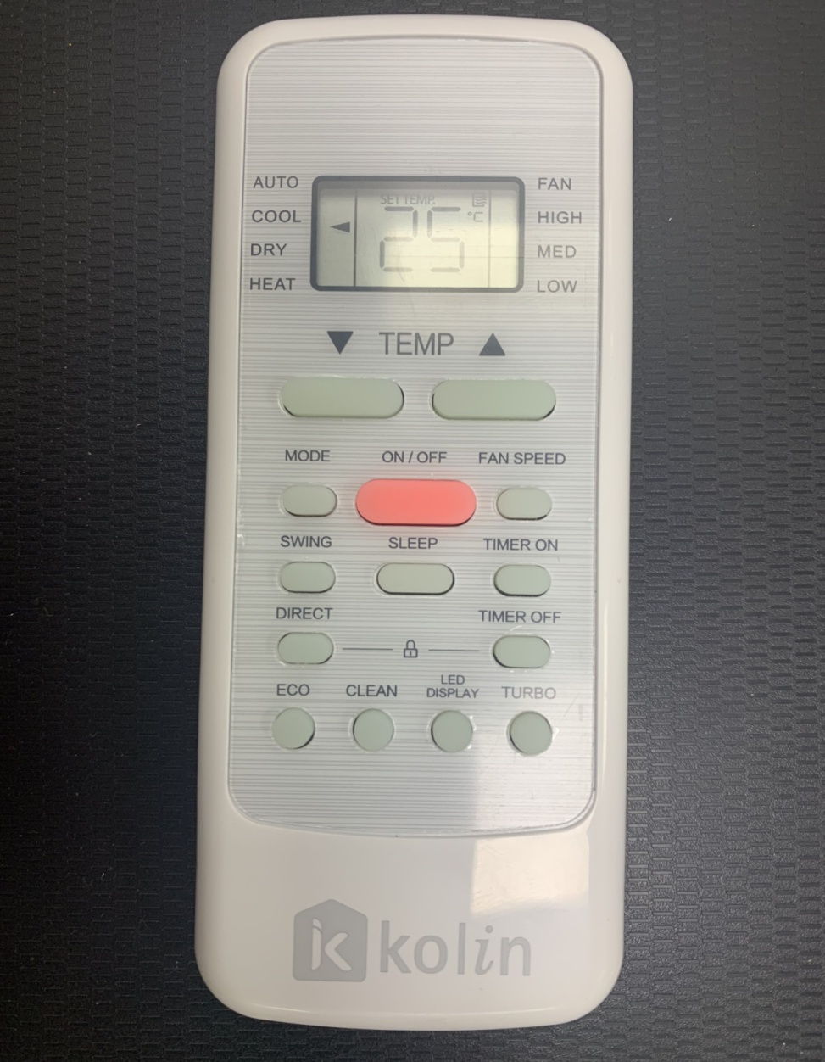
Remote Controller
Notes:
Higher CSPF means greater Cooling Seasonal Performance Factor, indicating superior energy efficiency and cost savings in cooling operations.
Active carbon filter: A specialized air filter that employs activated carbon to effectively capture and remove odors, pollutants, and impurities from the air.
System diagnostic: An automated process that assesses the health and functionality of a system, identifying and reporting any potential issues or irregularities for efficient troubleshooting.
Precise temperature: Accurate and exact control of the desired temperature, ensuring optimal comfort and energy efficiency.
R32 and R410A serve as refrigerants for air conditioning systems. They are both eco-friendly with a zero ozone depletion potential. However, there are distinctions between these two refrigerants.
R410A is a compound comprising pentafluoroethane and difluoromethane. It is employed as a refrigerant in ACs and heat pump systems. As a part of the hydrofluorocarbon (HFC) refrigerant class, it's composed of equal parts R125 and R321. R410A was introduced as a replacement for R22, which was banned due to its contribution to greenhouse gases.
Conversely, R32 is an organic compound categorized as a halogenoalkane1. It finds predominant use in endothermic processes like air conditioning and refrigeration. Notably, R32 boasts a lower global warming potential (GWP) in comparison to R410A, rendering it more environmentally friendly.
Regarding performance, R32 exhibits higher cooling efficiency than R410A2. In AC gas refilling, a smaller quantity of R32 is required as opposed to R410A2. However, it's worth noting that R32 carries a moderate flammability risk compared to R410A.
Turbo Mode: A high-speed setting that rapidly cools the environment, providing quick comfort adjustment.
Sleep Mode: A feature that optimizes settings for a comfortable sleeping environment, by adjusting temperature and noise levels.
Gold Hydrophilic Fins: Air conditioner fins coated with a gold hydrophilic layer that repels moisture, improving efficiency and preventing corrosion.
Comparison: Blue Fins vs. Gold Hydrophilic Fins: While blue fins are common, gold hydrophilic fins offer enhanced moisture resistance, boosting efficiency and durability for longer-lasting performance.
Active Clean: A dynamic cleaning feature in air conditioners that uses advanced processes to maintain air quality by removing dust, allergens, and contaminants.

Slide 17
Warranty
- One (1) year parts and labor
- Five (5) years compressor (residential use)
- Three (3) year compressor (commercial use)
Notes:
Higher CSPF means greater Cooling Seasonal Performance Factor, indicating superior energy efficiency and cost savings in cooling operations.
Active carbon filter: A specialized air filter that employs activated carbon to effectively capture and remove odors, pollutants, and impurities from the air.
System diagnostic: An automated process that assesses the health and functionality of a system, identifying and reporting any potential issues or irregularities for efficient troubleshooting.
Precise temperature: Accurate and exact control of the desired temperature, ensuring optimal comfort and energy efficiency.
R32 and R410A serve as refrigerants for air conditioning systems. They are both eco-friendly with a zero ozone depletion potential. However, there are distinctions between these two refrigerants.
R410A is a compound comprising pentafluoroethane and difluoromethane. It is employed as a refrigerant in ACs and heat pump systems. As a part of the hydrofluorocarbon (HFC) refrigerant class, it's composed of equal parts R125 and R321. R410A was introduced as a replacement for R22, which was banned due to its contribution to greenhouse gases.
Conversely, R32 is an organic compound categorized as a halogenoalkane1. It finds predominant use in endothermic processes like air conditioning and refrigeration. Notably, R32 boasts a lower global warming potential (GWP) in comparison to R410A, rendering it more environmentally friendly.
Regarding performance, R32 exhibits higher cooling efficiency than R410A2. In AC gas refilling, a smaller quantity of R32 is required as opposed to R410A2. However, it's worth noting that R32 carries a moderate flammability risk compared to R410A.
Turbo Mode: A high-speed setting that rapidly cools the environment, providing quick comfort adjustment.
Sleep Mode: A feature that optimizes settings for a comfortable sleeping environment, by adjusting temperature and noise levels.
Gold Hydrophilic Fins: Air conditioner fins coated with a gold hydrophilic layer that repels moisture, improving efficiency and preventing corrosion.
Comparison: Blue Fins vs. Gold Hydrophilic Fins: While blue fins are common, gold hydrophilic fins offer enhanced moisture resistance, boosting efficiency and durability for longer-lasting performance.
Active Clean: A dynamic cleaning feature in air conditioners that uses advanced processes to maintain air quality by removing dust, allergens, and contaminants.

Slide 18
Thank you!

