Slide 1

Window Type Airconditioner
KAM-#DRC32
Compact Series with Remote

Slide 2

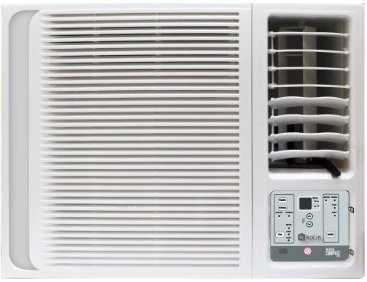
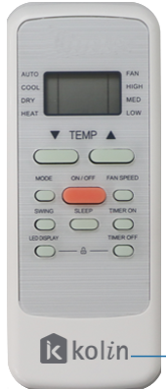
K
Kolin
AM
Window Type Airconditoner
#
Nominal Capacity
D
Generational Model
R
Remote
C
Compact
32
R32 Refrigerant

Slide 3

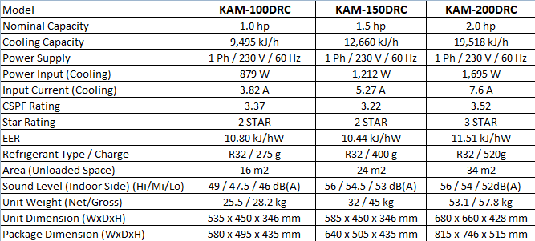
KAM-#DRC SERIES

Slide 4






FEATURES
SOFT TOUCH - The control panel is equipped with a SOFT TOUCH feature for an easy and comfortable manual control experience
REMOTE CONTROLLED - Easily set your desired settings using remote controller.
R32 Refrigerant - Safer, efficient, and eco-friendly refrigerant.
High Quality Motor - Equipped with a high-power compressor, that enables the air conditioner unit to operate at its high-level cooling performance to quickly reach the desired temperature in no time.
Horizontal Auto Swing - The auto-Swing feature enables the louvers to swing automatically to maximize the cool air of an area.
Washable Filter & Panel - Durable and easy to wash air filters that last for years.

Slide 5





FEATURES
Air Fresh Filter - An environmentally friendly filter that increases the efficiency of producing healthy and cool air.
Electrostatic Filter – Electrostatic filters use an electrostatic charge to attract and capture particles. The filter materials generate an electrostatic field that charges particles as they pass through, leading to electrostatic attraction and adhesion to the filter material.
Golden Hydrophilic Fins – Golden Hydrophilic Coated Fins increase the lifespan and enhance the cooling performance of the air conditioner by protecting its coils from damages caused by water, acids, and other salts coming from the atmosphere. Our indoor unit has gold protective fins making your Air conditioner resistant to corrosion and durable.
Compact Design – The Compact design feature was meant for areas with small spaces. It helps you to preserve more space and contains a great amount of cooling capacity that helps quickly reach the desired temperature in no time.
3-Minute Compressor Delay - The 3 Minute Delay Compressor feature serves as a protection for the compressor that helps its cooling performance become more efficient in the long run.

Slide 6
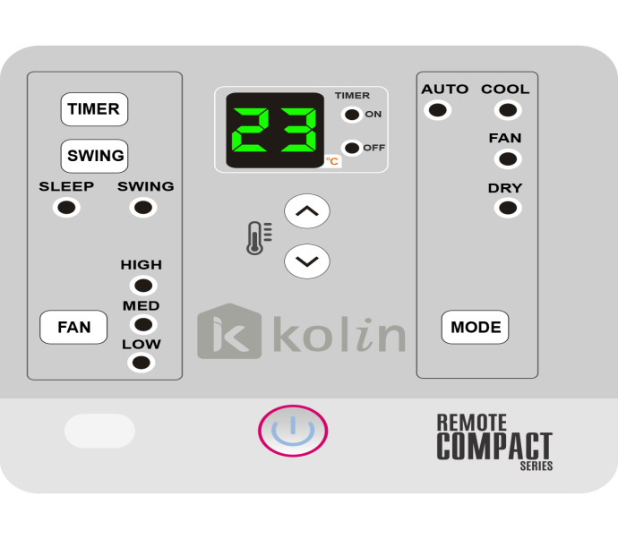
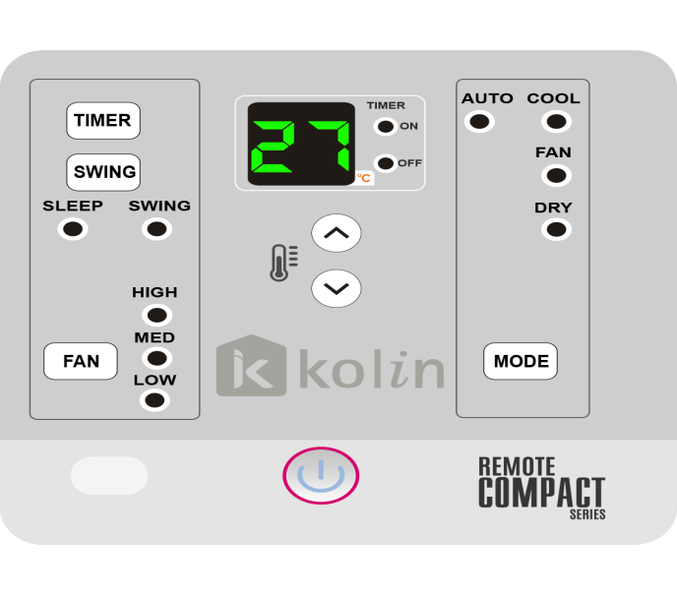
Ambient Room Temperature Display:
When adjusting the temperature, the Compact Series AC briefly shows your chosen setting on the display, after a few seconds, the display switches to show the current ambient room temperature, allowing quick assessment of your environment.
Capacity Consideration: Ensure your AC capacity matches your room size for optimal performance and energy efficiency.
Set temperature
Ambient Room Temperature

Slide 7


Slide 8
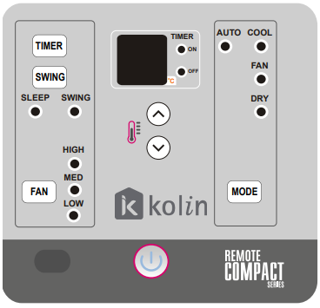
Display Panel and Remote

Slide 9
Warranty Coverage
1 year parts and labor
5 Years Compressor

