Slide 1




PRODUCT ORIENTATION
www.kolinphil.com.ph

Slide 2
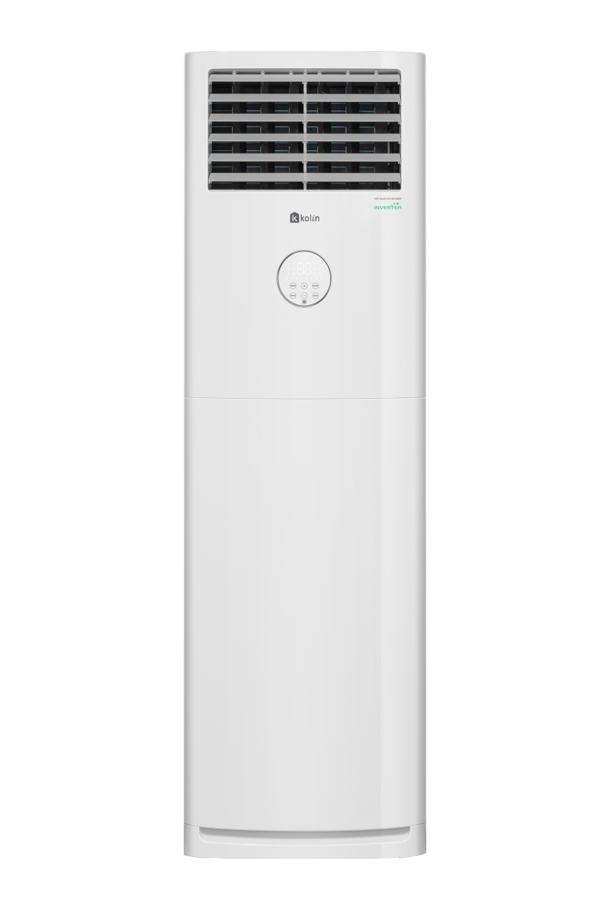
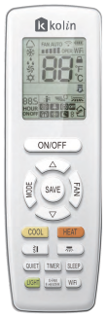
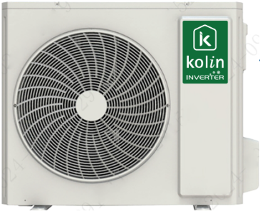

KL-IF60-G6H1M32
KL | Kolin Light Commercial
IF | Inverter Floor Mounted
60 | 6 hp (Nominal Capacity)
G6 | Generational Model
H | Series
1M | Single Phase / Side Discharge
32 | R32 Refrigerant
KL-IF60-G6H1M32
www.kolinphil.com.ph

Slide 3










LIGHT COMMERCIALS
WHERE TO USE?
CONFERENCE
OFFICES
HOTELS
RESTAURANTS
SHOWROOMS
MALLS
HOSPITALS
SCHOOLS
OTHER ESTABLISHMENTS
FACILITIES
www.kolinphil.com.ph

Slide 4

ADVANTAGES
Space Utilization: Optimizes room space by making it suitable for areas with limited wall or ceiling space.
Easy Installation: Floor-mounted units are generally easier to install, often requiring minimal modifications to the existing infrastructure.
Enhanced Air Circulation: Offers improved air circulation at a lower level, effectively distributing conditioned air across the room for consistent comfort.
adv/ben
www.kolinphil.com.ph

Slide 5







FEATURES
FULL DC INVERTER
HIGH COOLING CAPACITY
EWPE APP
LOW GWP REFRIGERANT
AUTO SWING
SELF-DIAGNOSIS
www.kolinphil.com.ph

Slide 6


FEATURES
KL-IF60-G6H1M32
LED DISPLAY
24 HOURS TIMER
www.kolinphil.com.ph

Slide 7
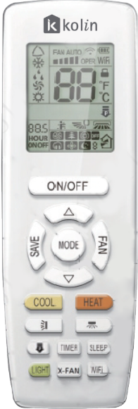
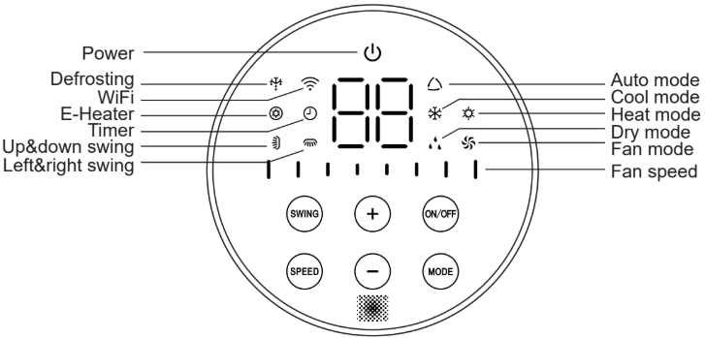
www.kolinphil.com.ph

Slide 8
Full Specification
Model | KL-IF60-G6H1M32
Nominal Capacity | 6.0 hp / 5 TR
Cooling Capacity | 58,140 (12,960 - 61,200) kJ/h
Power Supply | 1 Ph / 230 V / 60 Hz
Power Input | 5,000 (830 - 5,200) W
Input Current | 22 A
Refrigerant (Type / Charge) | R32 / 2.7 kg
INDOOR UNIT
Airflow (Hi / M / Lo) | 1,950 / 1,750 / 1,650 m³/h
Sound Pressure Level (Hi / M / Lo) | 50 / 49 / 47 dB(A)
Unit Dimension (WxDxH) | 595 x 411 x 1882 mm
Package Dimension (WxDxH) | 718 x 485 x 2128mm
Unit Weight (Net / Gross) | 57 / 69 kg
Outdoor Unit
Unit Dimension (WxDxH) | 1020 x 427 x 820 mm
Package Dimension (WxDxH) | 1093 x 497 x 885 mm
Unit Weight (Net / Gross) | 69 / 76 kg
Copper Tube Size
High Side / Low Side | 3/8'' / 5/8''
Maximum Pipe Distance Between Indoor and Outdoor
Height / Length / Breaker | 20m / 30m / 60 A
www.kolinphil.com.ph

Slide 9
WARRANTY
1 Year Parts & Labor
5 Years Compressor
www.kolinphil.com.ph

