Slide 1
All Home & Binondo Group
OFFICE DAY
July 17, 2024, Wednesday

Slide 2
HOUSE RULES
•Maintain Safety Protocols.
•Switch phones to silent mode.
•Avoid side conversations; listen when someone is talking.
•Share your ideas; raise your hand when you want to talk.
•Remember and apply all learnings.
•Clean as you go.

Slide 3
AGENDA
Time Keeping
Sales Performance
- Daily Sales Report
- Last Month Sales Report
- Sales Target for the month
Promotions
Sellout Support
Comprehensive Pricelist

Slide 4
01
Time Keeping

Slide 5
DTR Submission
Unauthorized Absences
Filing of Leaves (deadlines)

Slide 6
02
Sales Performance

Slide 7
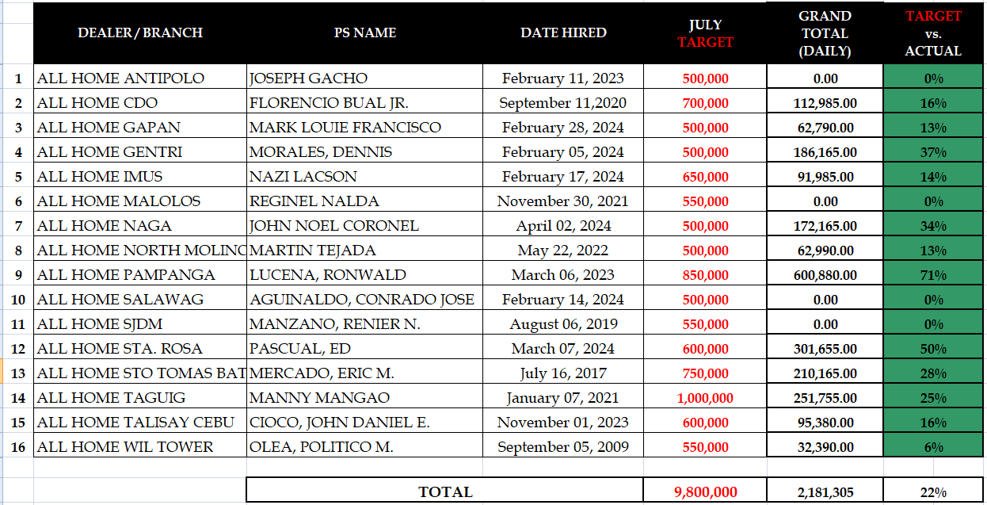
All Home Daily Sales Report As Of (July 10, 2024)

Slide 8
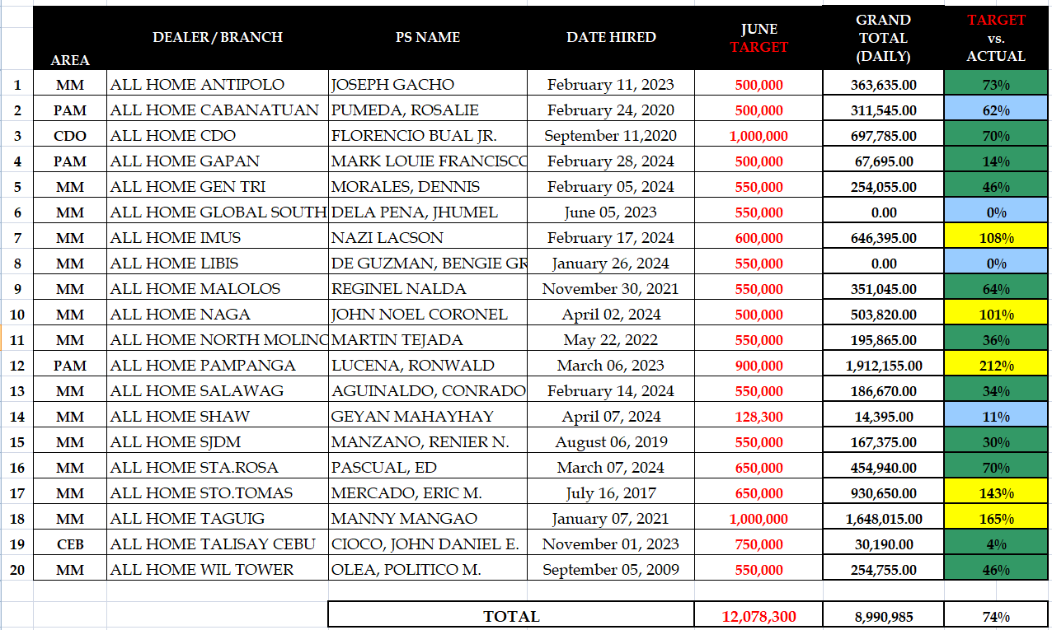
All Home June 2024 Sell-out

Slide 9
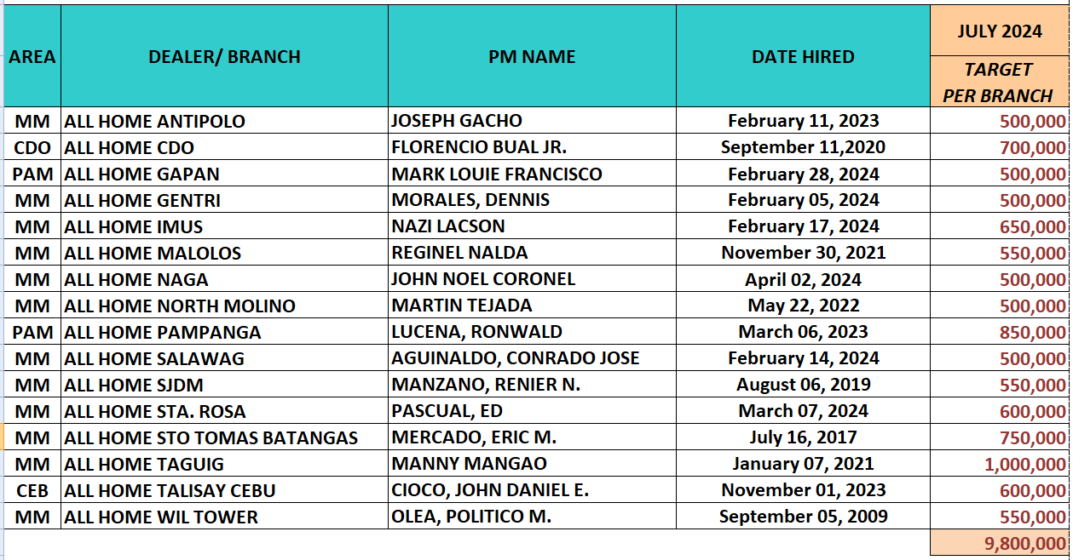
Sales Target For The Month

Slide 10
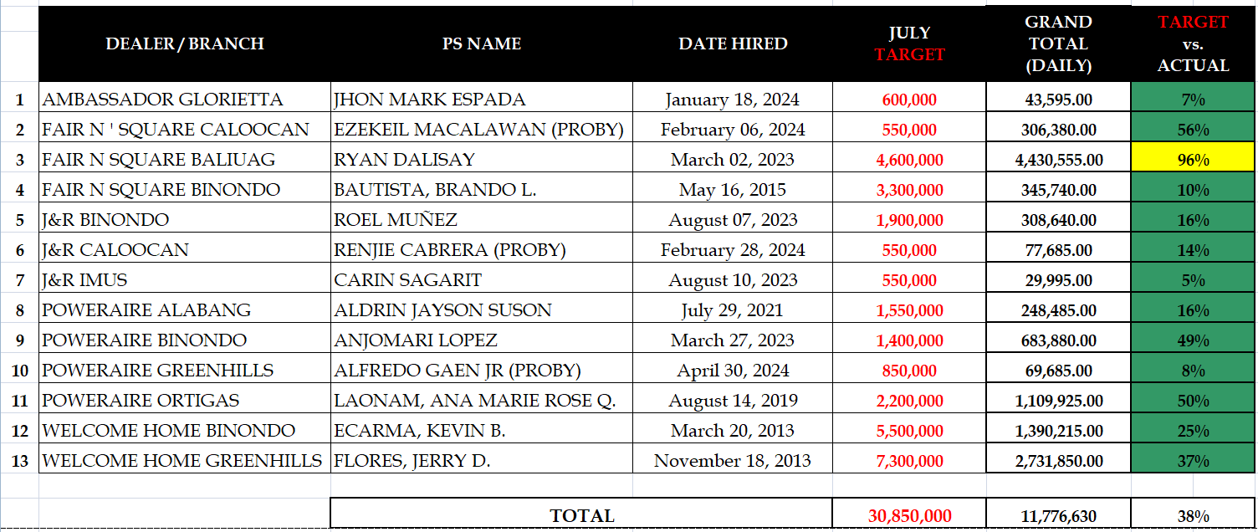
Binondo Group Daily Sales Report As Of (July 10, 2024)

Slide 11
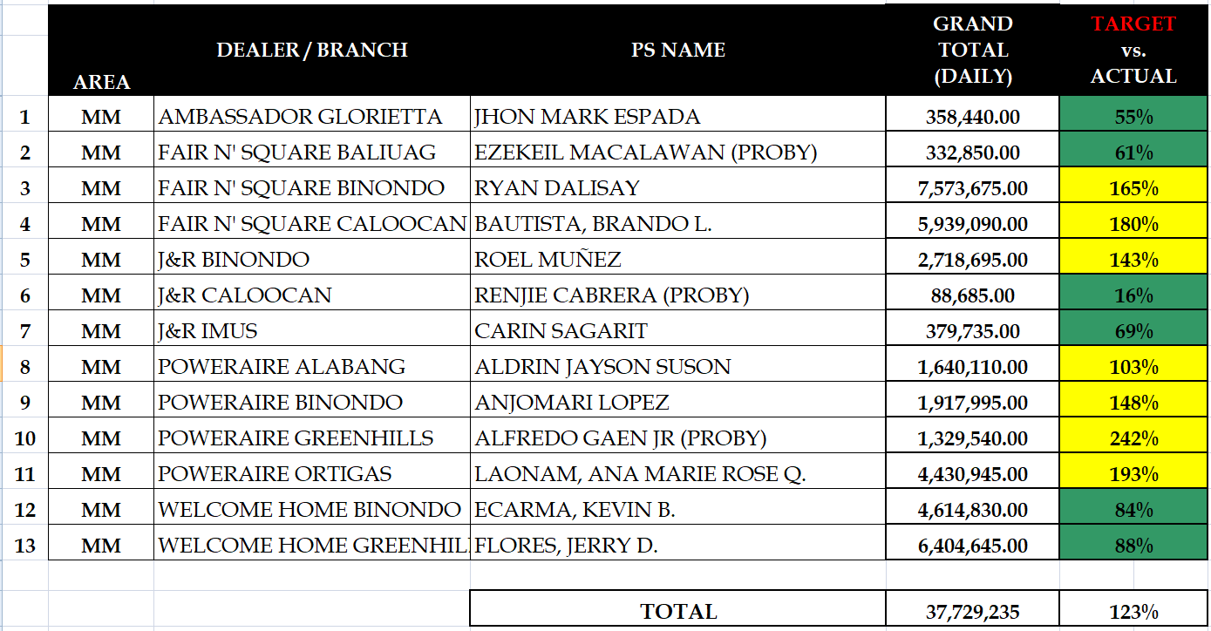
Binondo Group June 2024 Sell-out

Slide 12
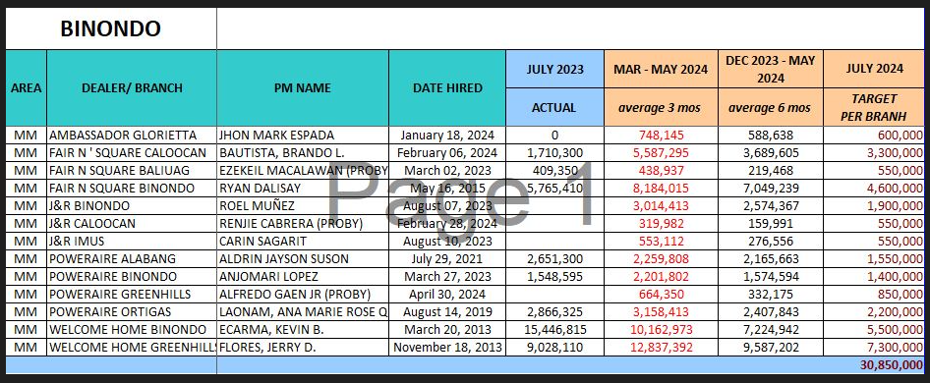
Sales Target For The Month

Slide 13
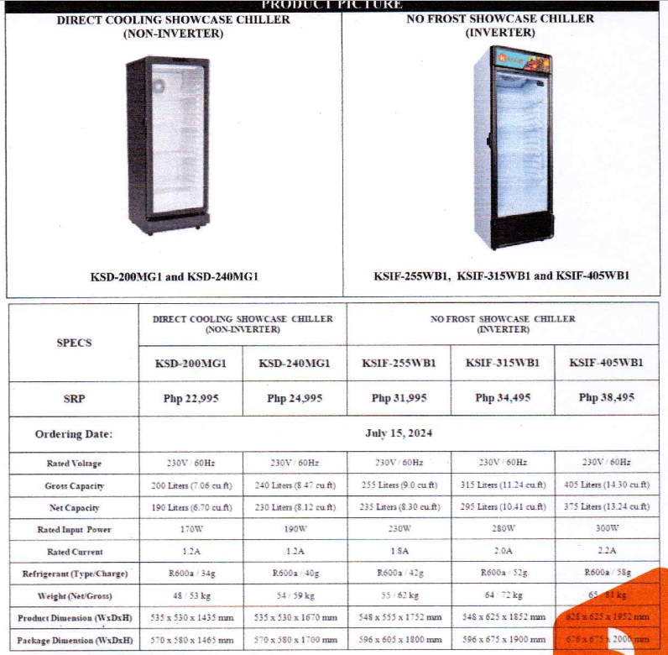
NEW ITEMS

Slide 14
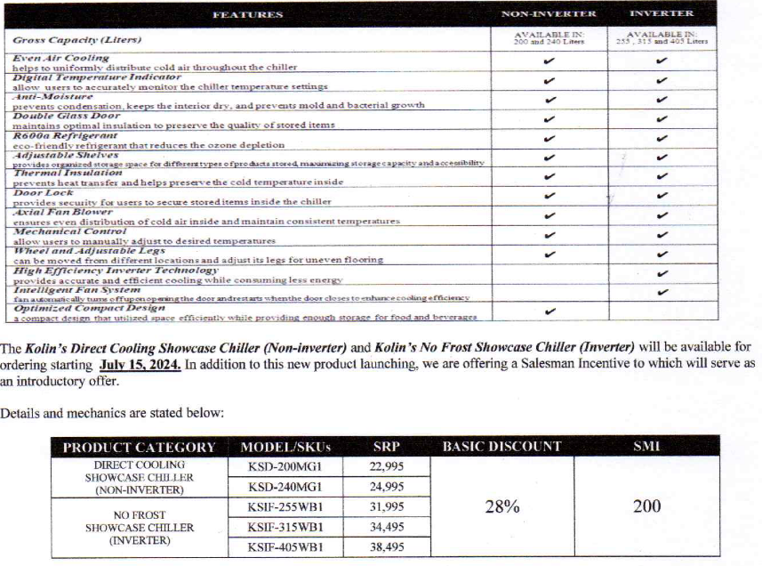
NEW ITEMS

Slide 15
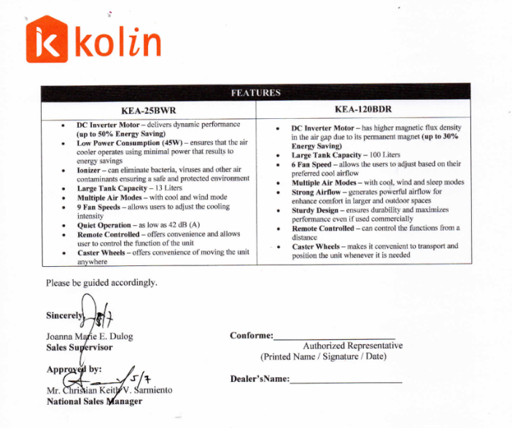
NEW ITEMS

Slide 16
05
Questions & Concerns

