Slide 1




PRODUCT ORIENTATION
2025
www.kolinphil.com.ph

Slide 2


Slide 3




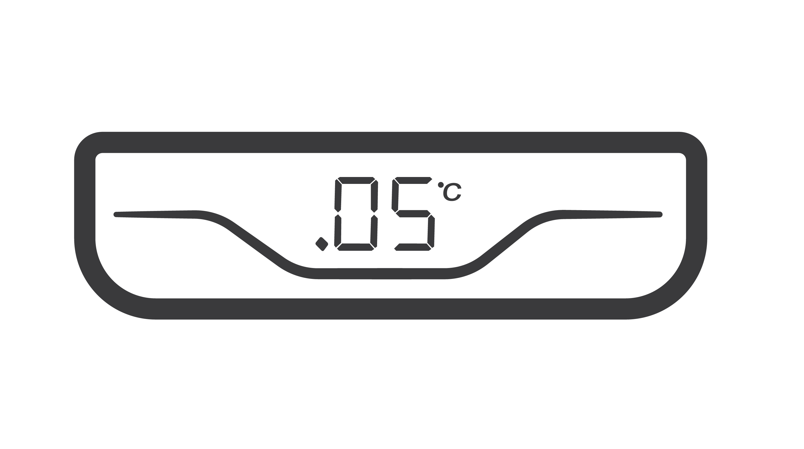




FEATURES
DIGITAL TEMPERATURE INDICATOR
EVEN AIR COOLING
AXIAL FAN BLOWER
DOUBLE GLASS DOOR
ANTI-MOISTURE
DOOR LOCK
10 ADJUSTABLE
SHELVES
(Double Door)
WHEELS AND ADJUSTABLE LEGS
www.kolinphil.com.ph

Slide 4

SPECIFICATION
FULL SPECIFICATION | KSIF-762WB2
Rated Voltage | 230 V / 60 Hz
Gross Capacity | 762 Liters (26.91 cu. ft)
Net Capacity | 711 Liters (25.11 cu.ft)
Rated Power | 650 W
Rated Current | 4.1 A
Weight (Net / Gross) | 133kg/154kg
Refrigerant / Charge | R290 / 115 g
Unit Dimension (WxDxH) | 1120 x 635 x 1980 mm
Package Dimension (WxDxH) | 1170 x 655 x 2030 mm
www.kolinphil.com.ph

Slide 5
WARRANTY COVERAGE
1 Year Parts
2 Years Labor
5 Years Compressor
www.kolinphil.com.ph

Slide 6

THANK YOU!
www.kolinphil.com.ph

